Slide 1
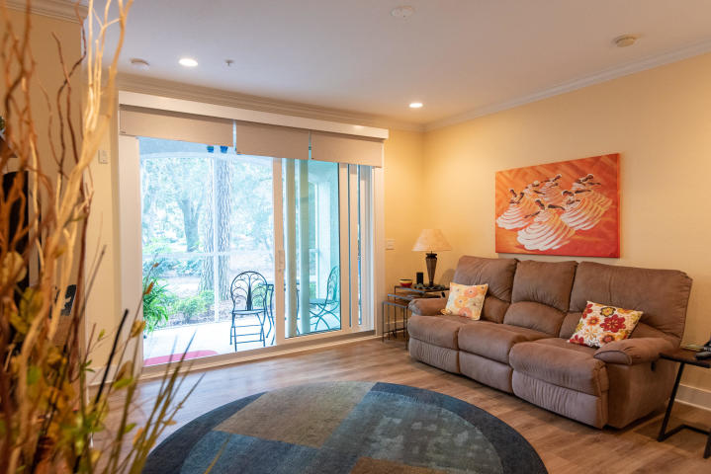
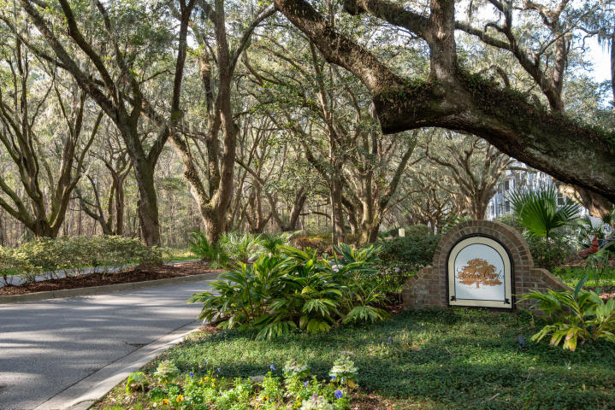
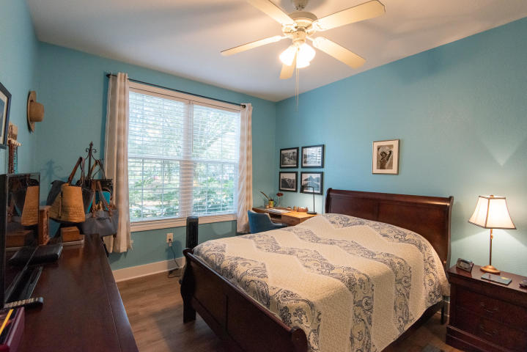
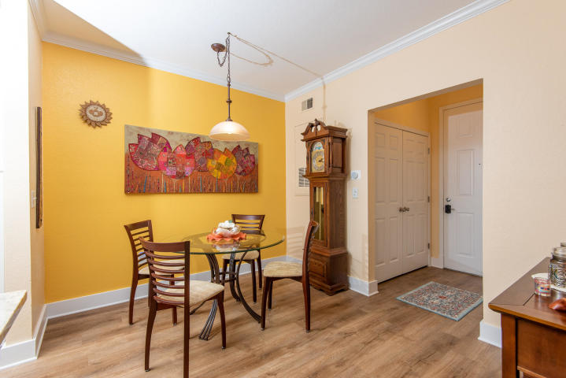
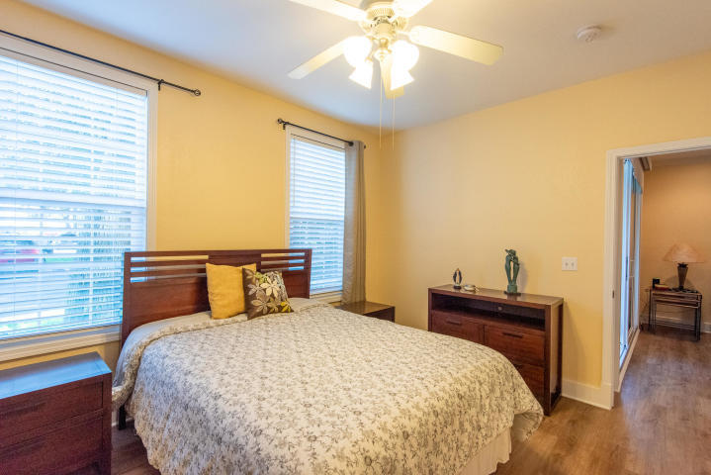
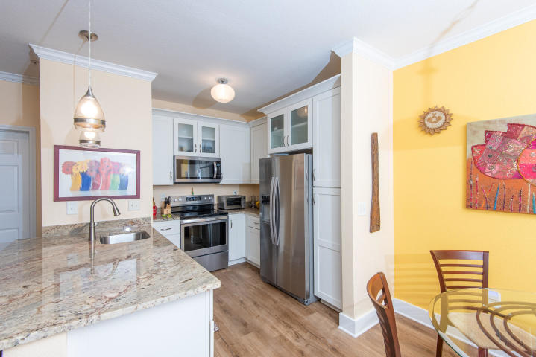
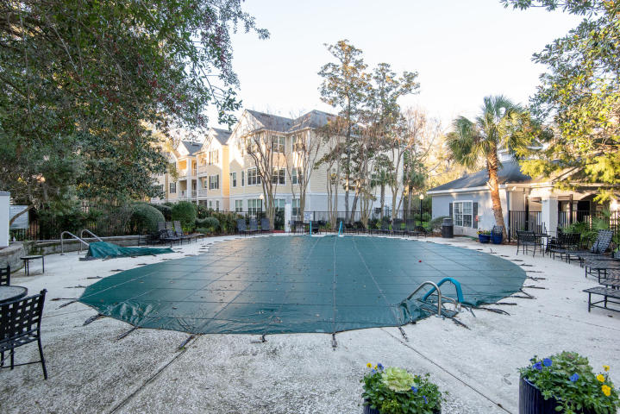


JUST LISTED!
Updated Condo on Johns Island
Priced under $200,000!
60 Fenwick Hall Alley 416
Twelve Oaks
Johns Island, SC 29455
MLS# 20001743 | $199,000
Fully renovated and unlike any other! This first floor unit feels like it's new because it iS virtually new in every way. New AC and hot water heater were installed. Every inch of flooring and baseboards have been replaced. Continuous luxury vinyl flooring is found in all living spaces including bedrooms and the kitchen. Both bathrooms have tile floors and the screened porch also has tile floors. The kitchen has had a complete overhaul with all new white cabinets, gorgeous granite countertops, new stainless steel appliances, and a new faucet as well. As you look across the family room you will see a beautiful stackable sliding glass door which allows for a more expansive opening. The porch is like another sitting room and looks out over lovely landscaping. New blinds cover this slider for privacy and new blinds were installed on all other windows too. Split plan allows privacy for each master with living area between. The current owner has done a complete overhaul to the finishes AND has found ways to improve the design too. For instance, a former desk station off the family room has been converted to a useful pantry. The entry to master bedroom one's closet was formerly in the bathroom (which is used by guests as it is also accessible from the entry hall) and now is accessed from the bedroom itself. Additionally, the doorway to the laundry and utility closet was widened to make it easier to access the laundry machines and brand new hot water heater. Built in shelves were added to the bathrooms, which also have new vanities with granite tops. Of course the entire interior has been repainted during the renovation. This unit will feel like new construction yet it is in the well established gorgeous community of Twelve Oaks. The natural beauty and stunning grand oaks will take your breath away. Twelve Oaks residents enjoy amenities including a neighborhood pool and exercise room. Conveniently located off Maybank Highway just over the Stono River, residents enjoy proximity to all the shops and restaurants of both James Island and Johns Island. Commuters are a mere 15 minutes to Downtown Charleston and the beaches at Folly and Kiawah are both just a short ride away. Come tour this one of a kind residence in Twelve Oaks while you have the opportunity!
Ellen O'Neil
Broker/Owner, ABR, e-PRO, CNE
Charleston Realtor of Distinction
(843) 300-8530
www.EllenONeilProperties.com

