Slide 1
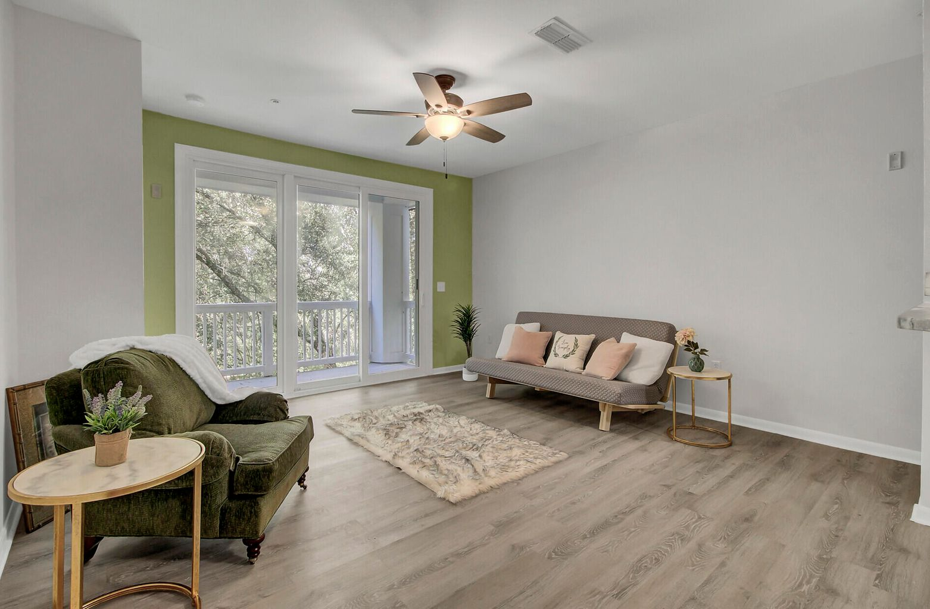
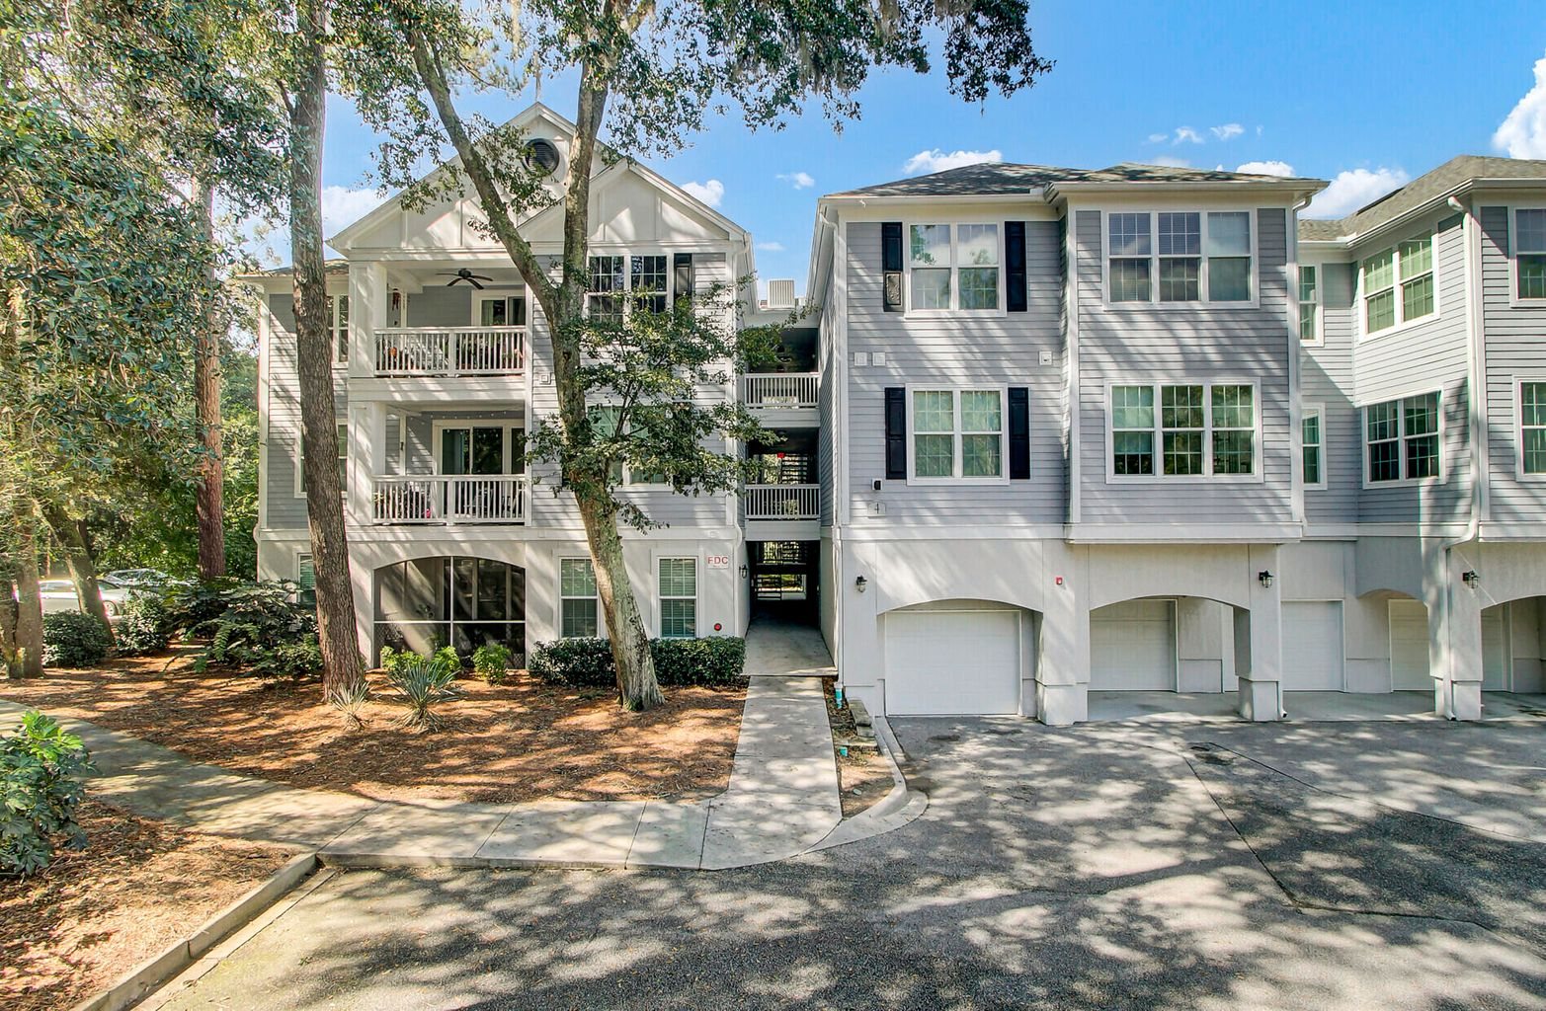
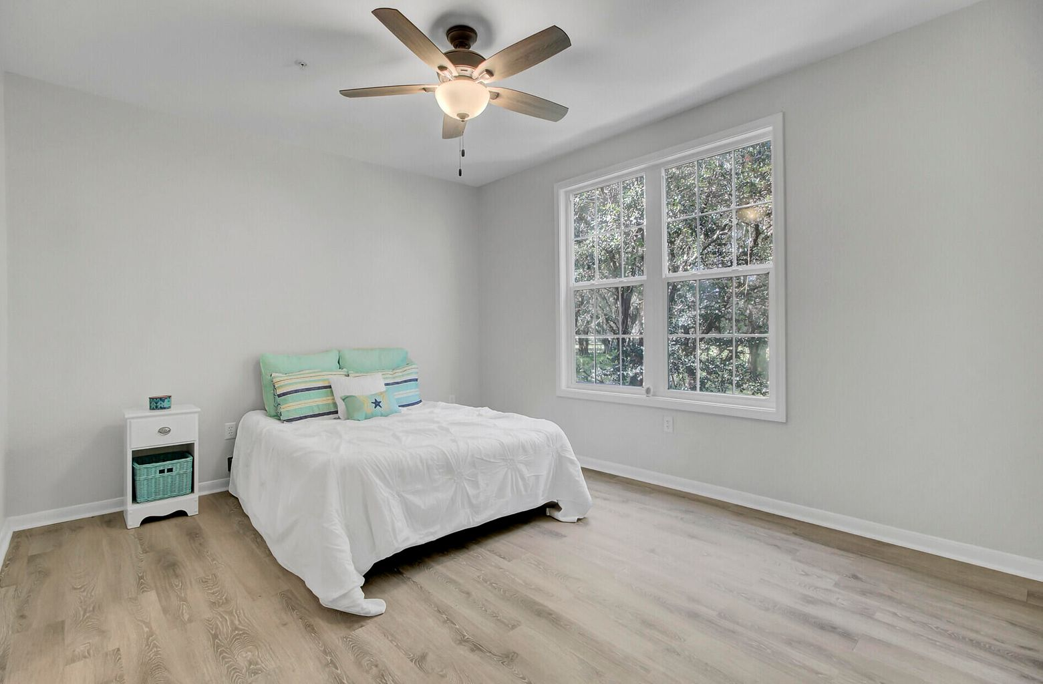
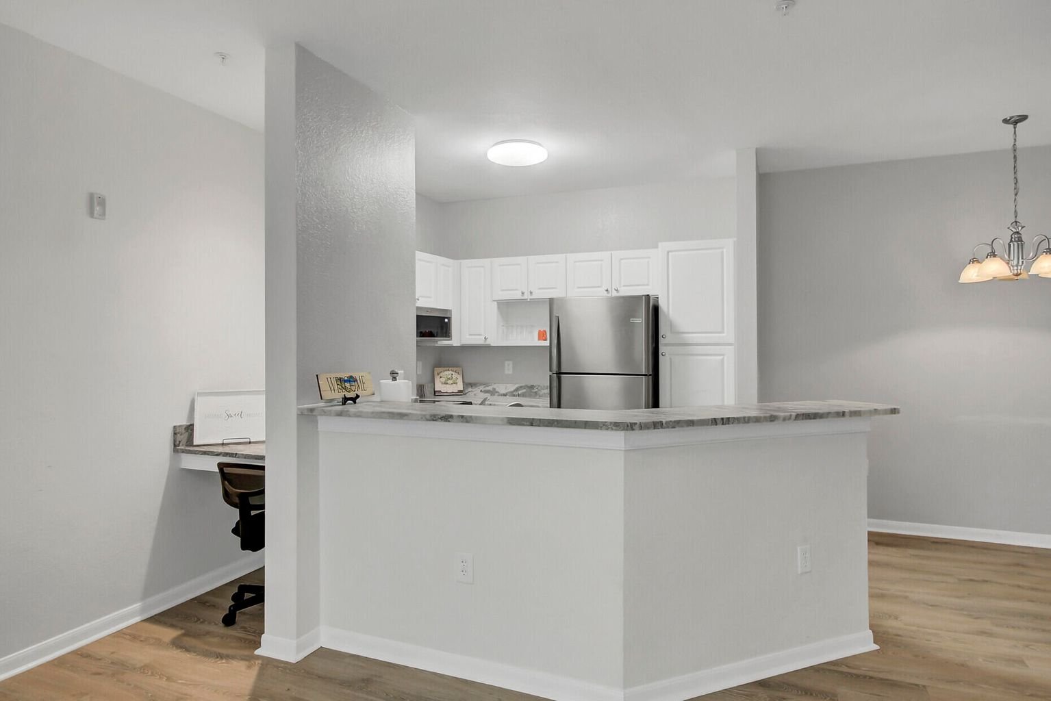
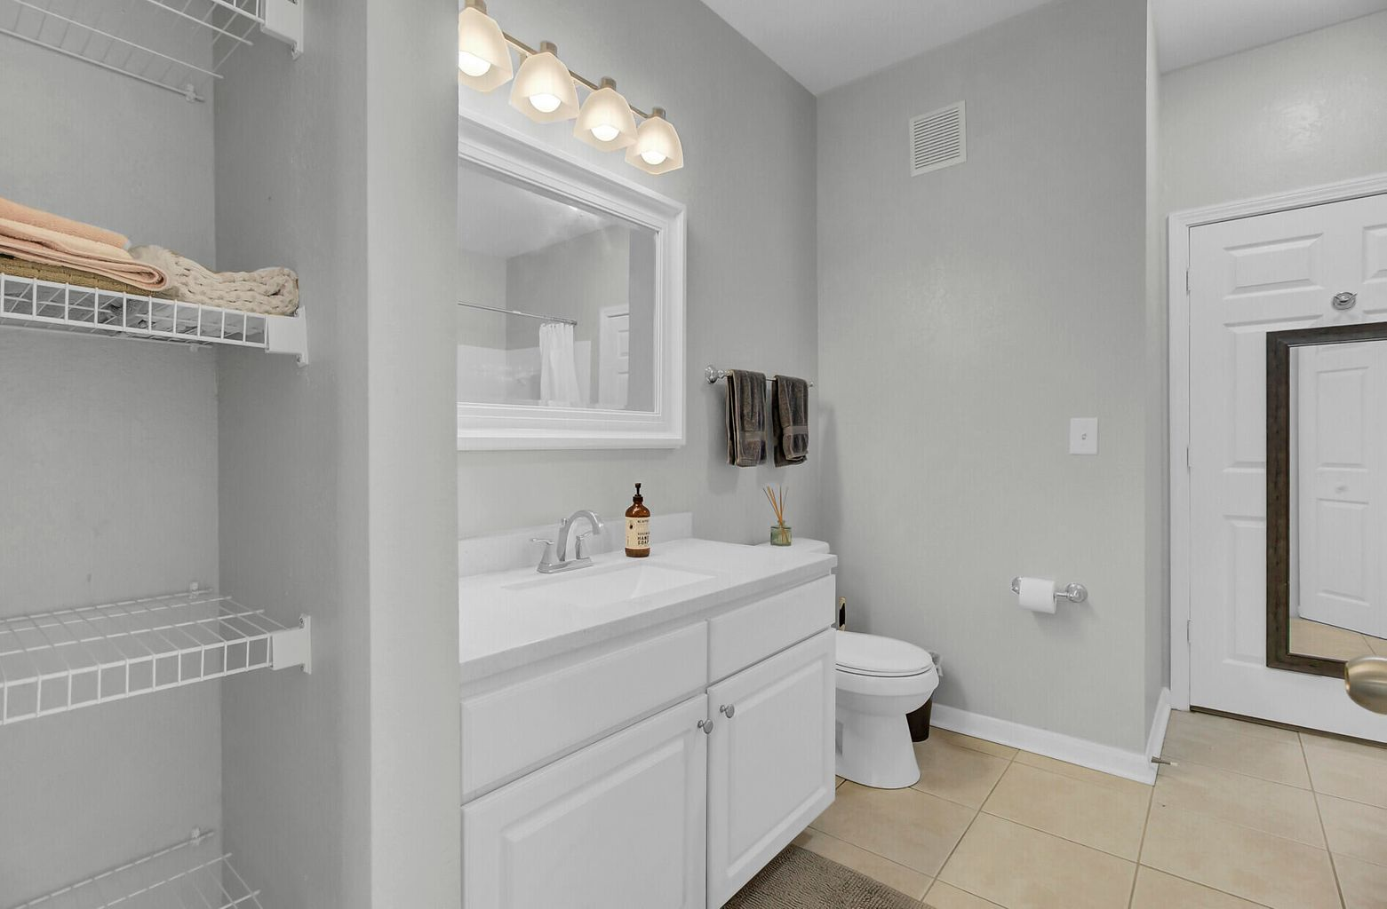
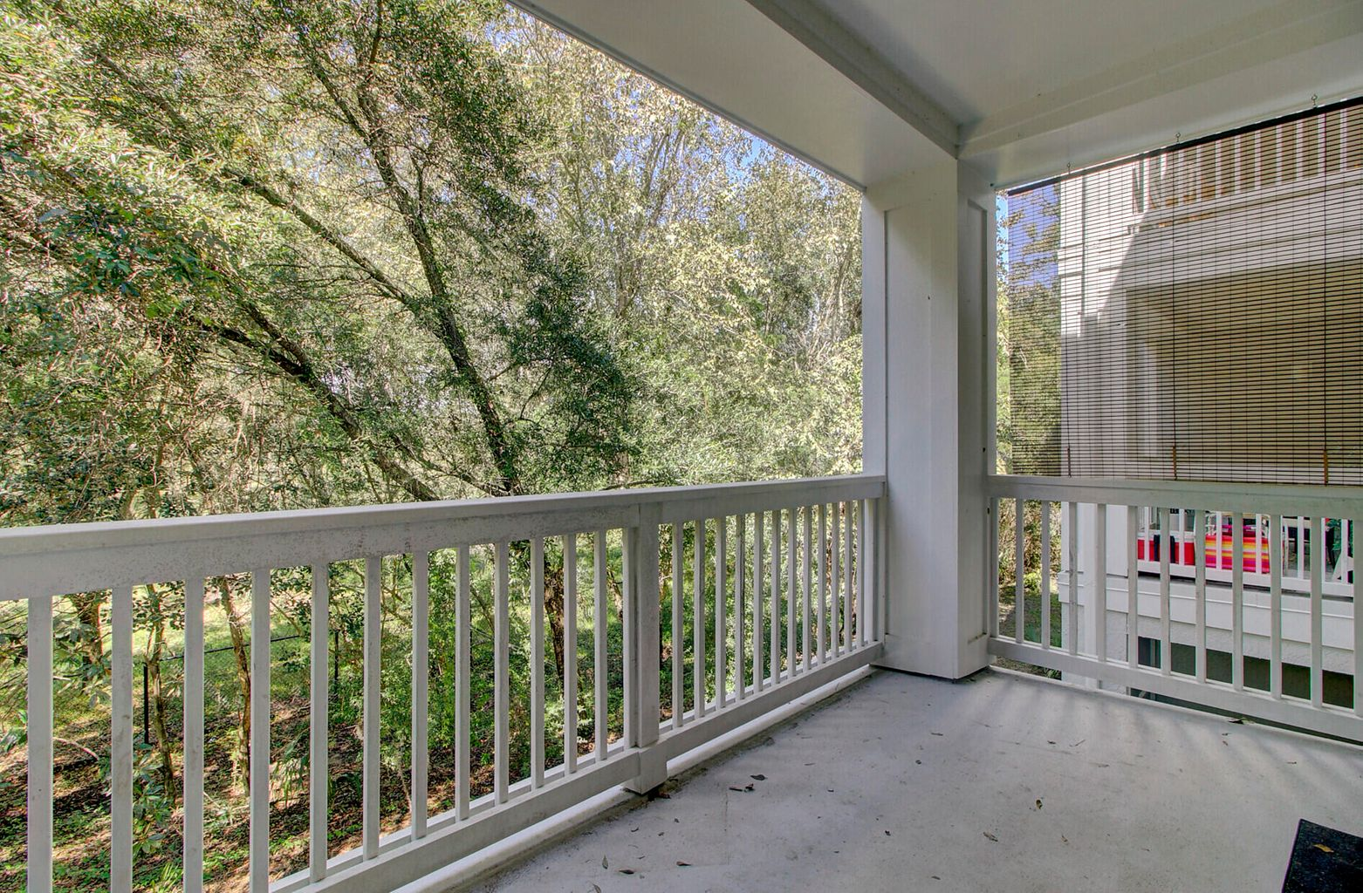
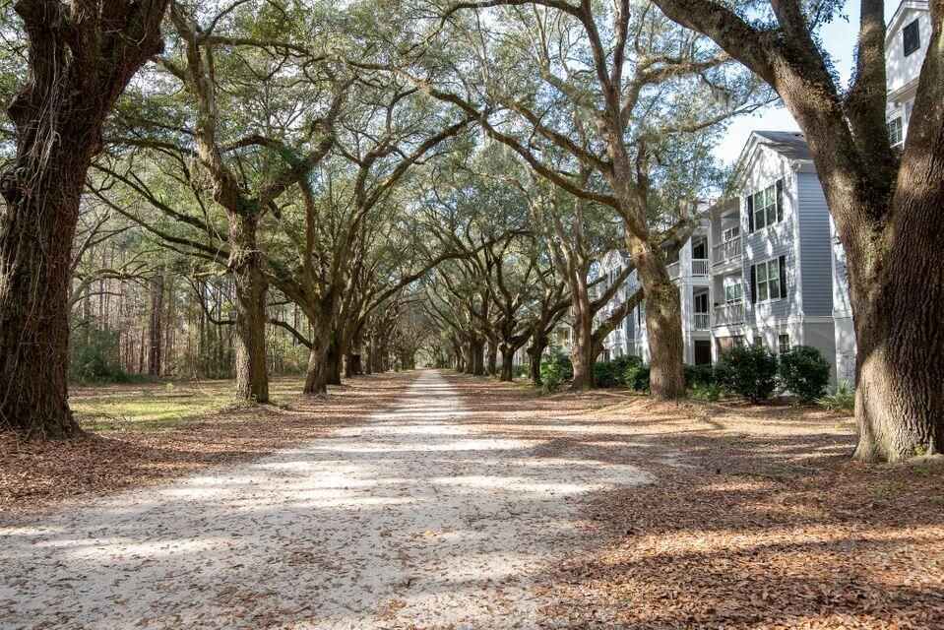


Turn-Key Condo at Twelve Oaks on Johns Island!
60 Fenwick Hall Alley #424
Twelve Oaks | Johns Island, SC 29455
MLS# 22026674 | $240,000
1 Bed | 1 Bath | 816 SF
Fantastic single bedroom condo with balcony overlooking the private woods behind the home. Move in ready, this open concept condo offers granite counters, stainless appliances, and newer flooring. Best of all, a BRAND NEW HVAC system has been installed (October 2022)! Live worry free in this GEM of a condo! Upon entering the community of Twelve Oaks, you will appreciate the BREATHTAKING natural beauty and know just how this community got its name! As a bonus, you will be close to ALL the hotspots along Maybank Highway in both James and Johns Island, as Twelve Oaks is accessed immediately upon crossing over the Stono River onto Johns Island. You have your pick of restaurants, breweries, coffee shops, grocery stores... Convenience is KEY! Just 10-15 minutes to Downtown and nearby Folly Beach or venture out to Kiawah and Seabrook if you prefer. Turn Key and Move In Ready, this second floor condo is sure to impress!
Video Tour | Virtual Tour
Ellen O'Neil
Broker/Owner, ABR, e-PRO, CNE
Charleston Realtor of Distinction
(843) 300-8530
www.EllenONeilProperties.com

