Slide 1
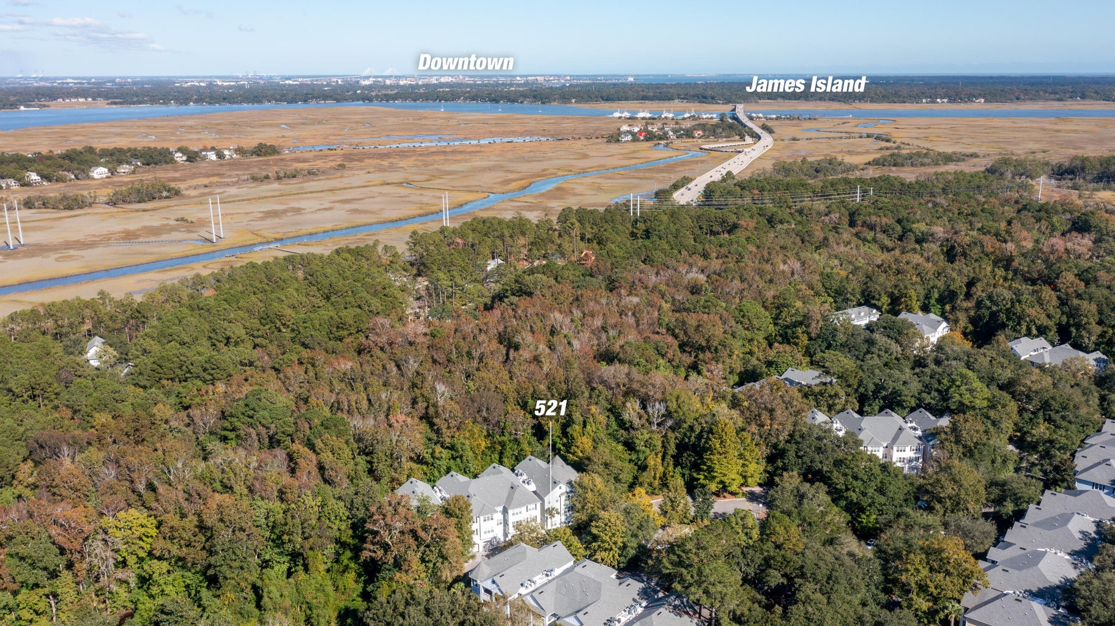
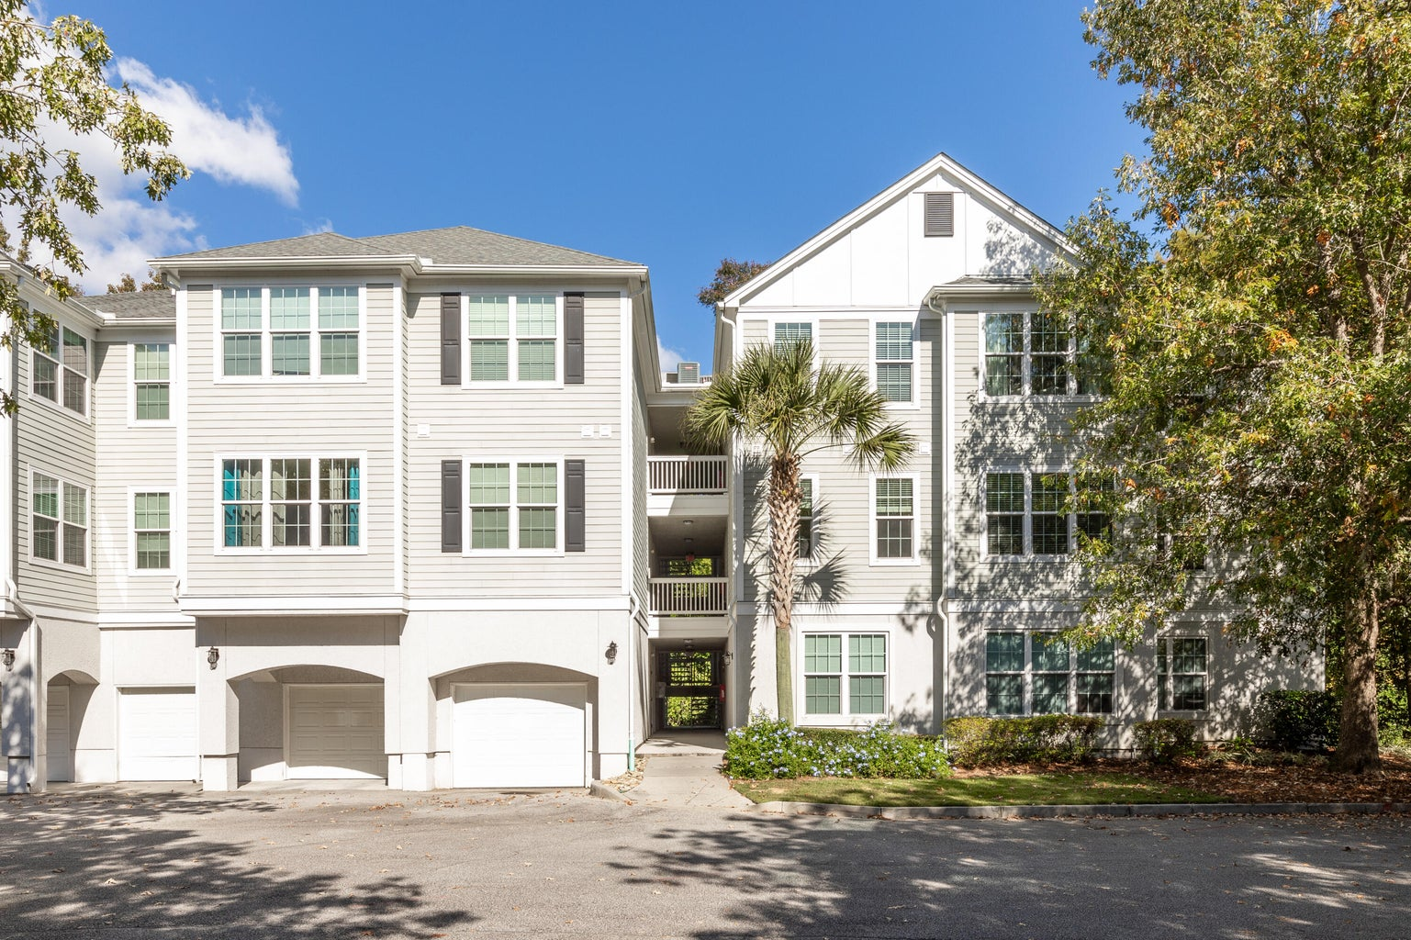
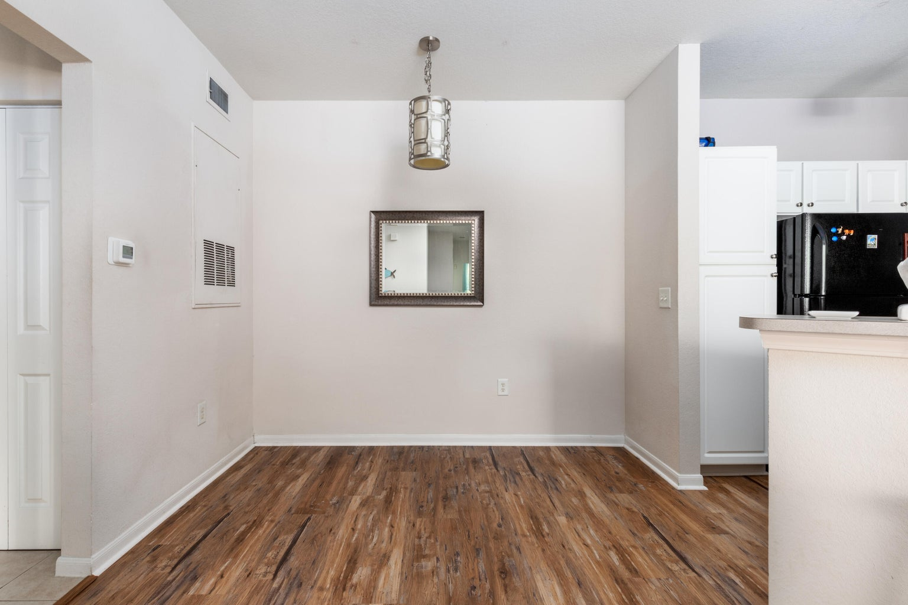
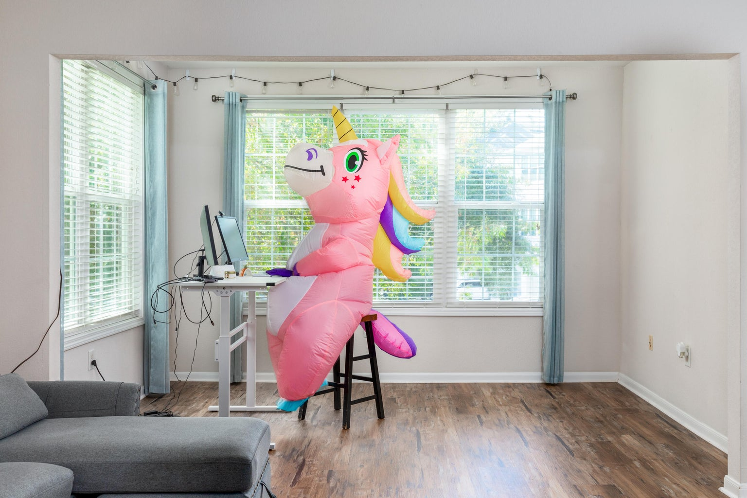
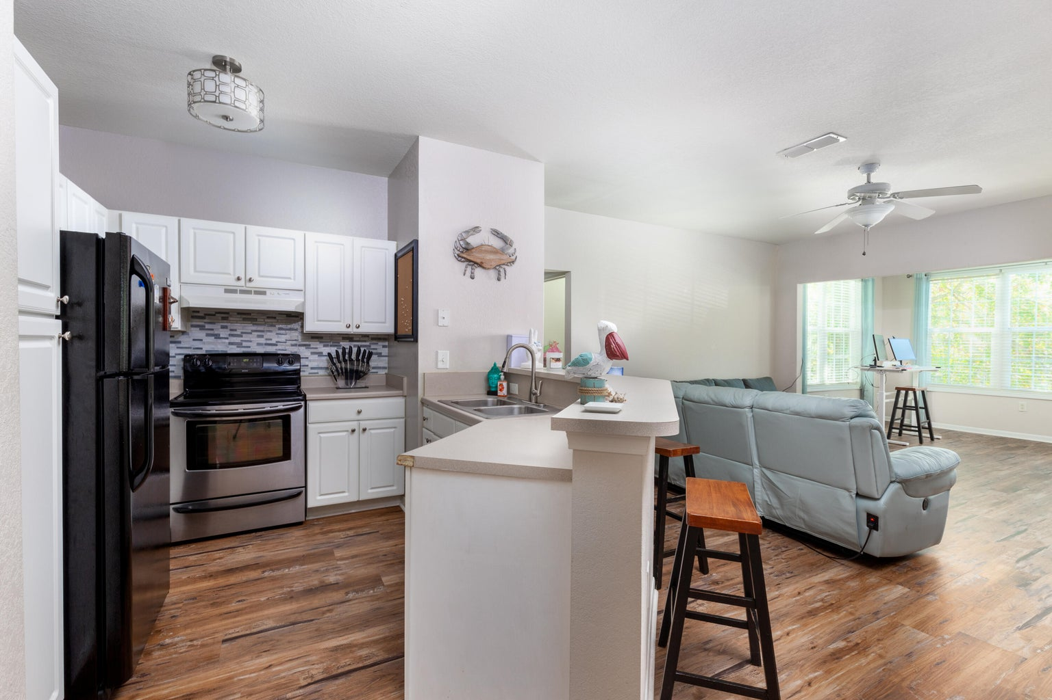
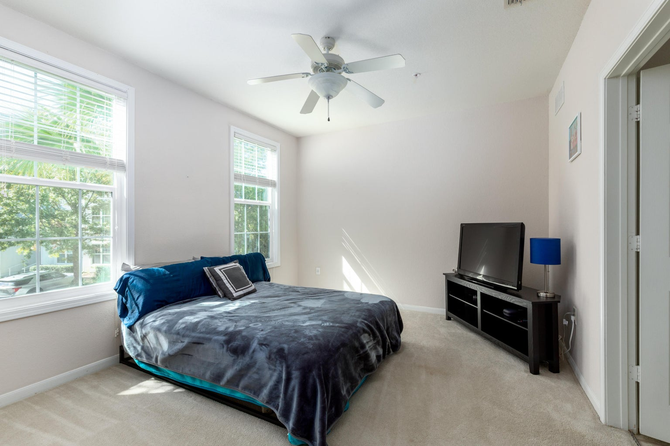
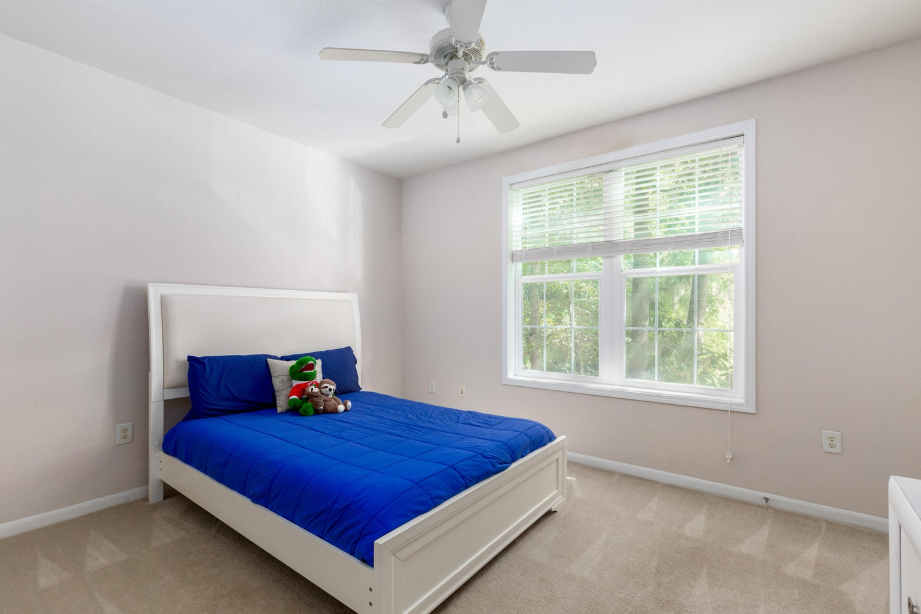
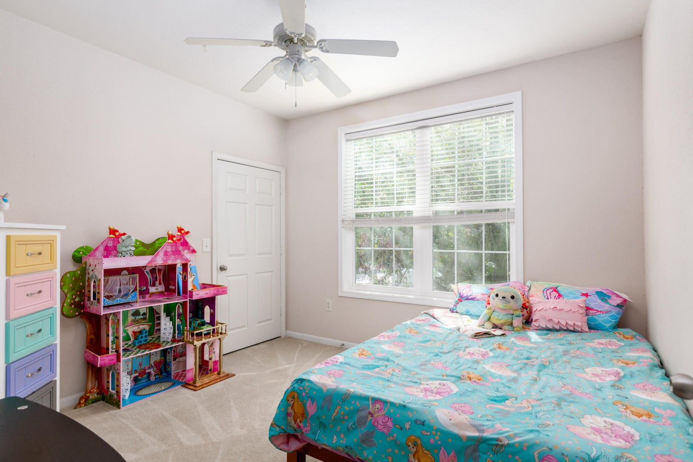
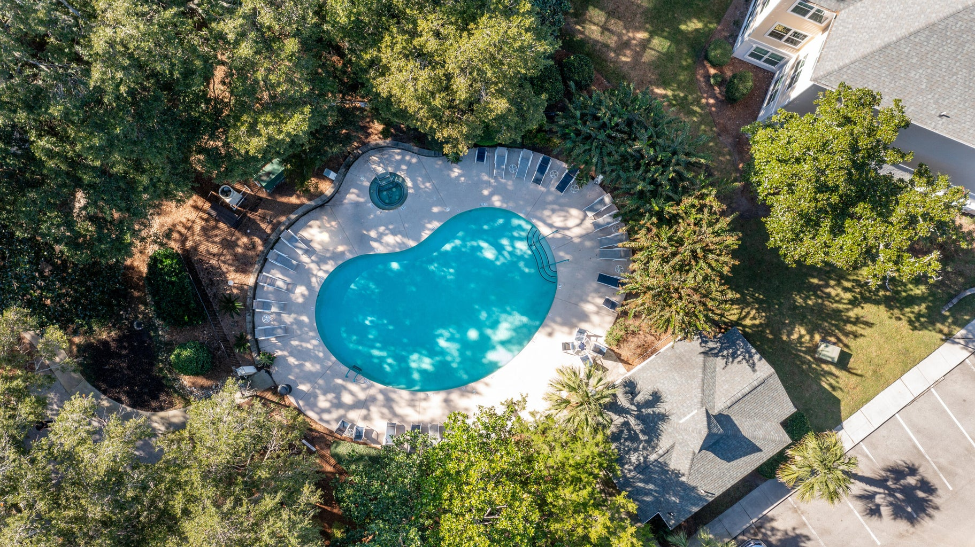



Open House Friday 4 - 6 PM & Sunday 2 - 4 PM
60 Fenwick Hall Allee 521
Twelve Oaks| Johns Island, SC 29455
MLS# 23024483 | $325,000
Welcome to Twelve Oaks Plantation, where coastal living meets convenience. This inviting three-bedroom, two-bathroom condo, nestled on highly sought-after Johns Island, offers the best of Lowcountry living. Situated minutes from pristine beaches, historic downtown Charleston, and local hotspots, this second-floor unit is a gem waiting to be discovered. Inside, you'll be greeted by hardwood floors that grace the living areas, accompanied by fresh fixtures and modern lighting, creating an ambiance of timeless charm and style. The living room's large windows open up to a serene wooded backdrop, ensuring both privacy and an abundance of natural light that bathes the space in warmth.
Don't miss your opportunity to experience the relaxed yet vibrant lifestyle Twelve Oaks Plantation has to offer. Schedule your showing today and unlock the door to your new home!
Christina Greene
904-660-8571
christinagreenehomes@gmail.com
Keller Williams Realty Charleston West Ashley
1180 Sam Rittenberg Ste 300
Charleston, SC 29407

