Slide 1
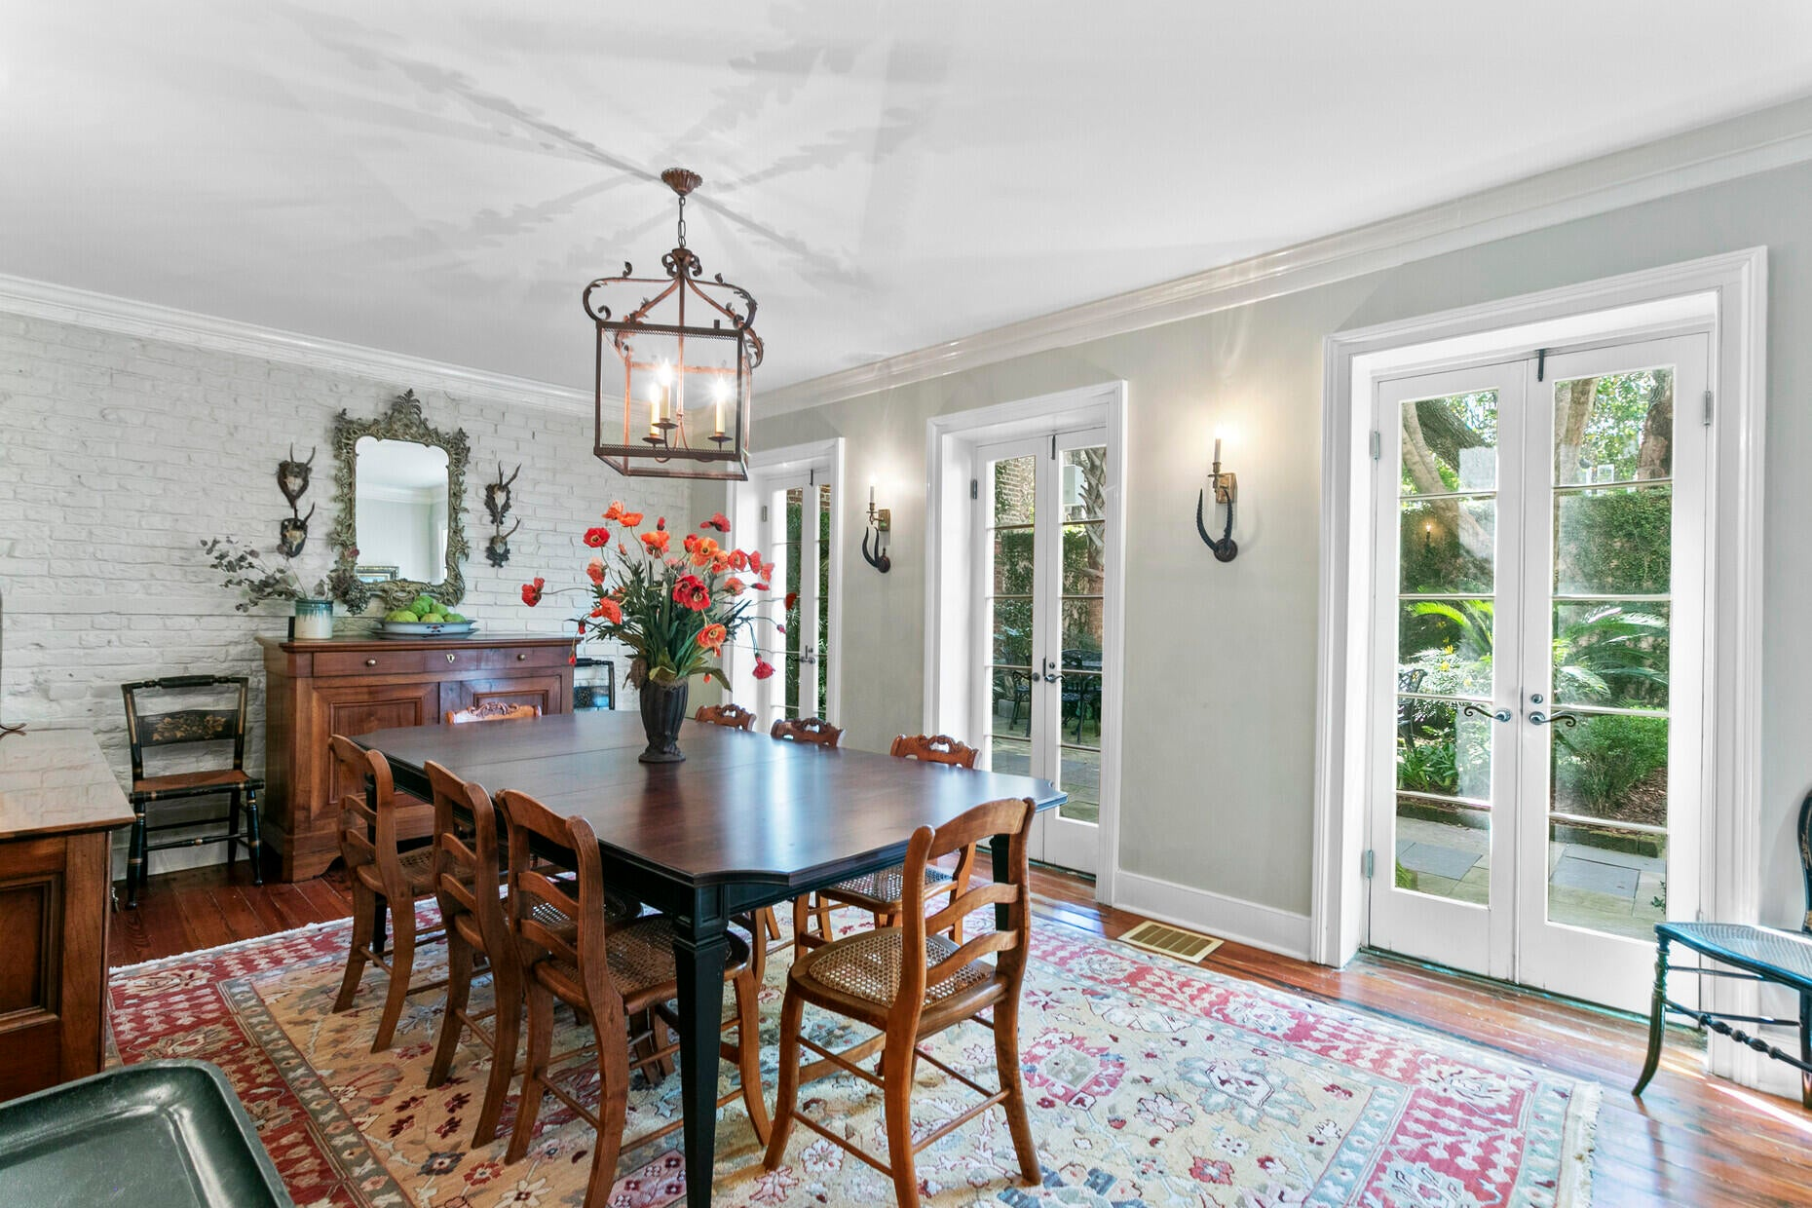
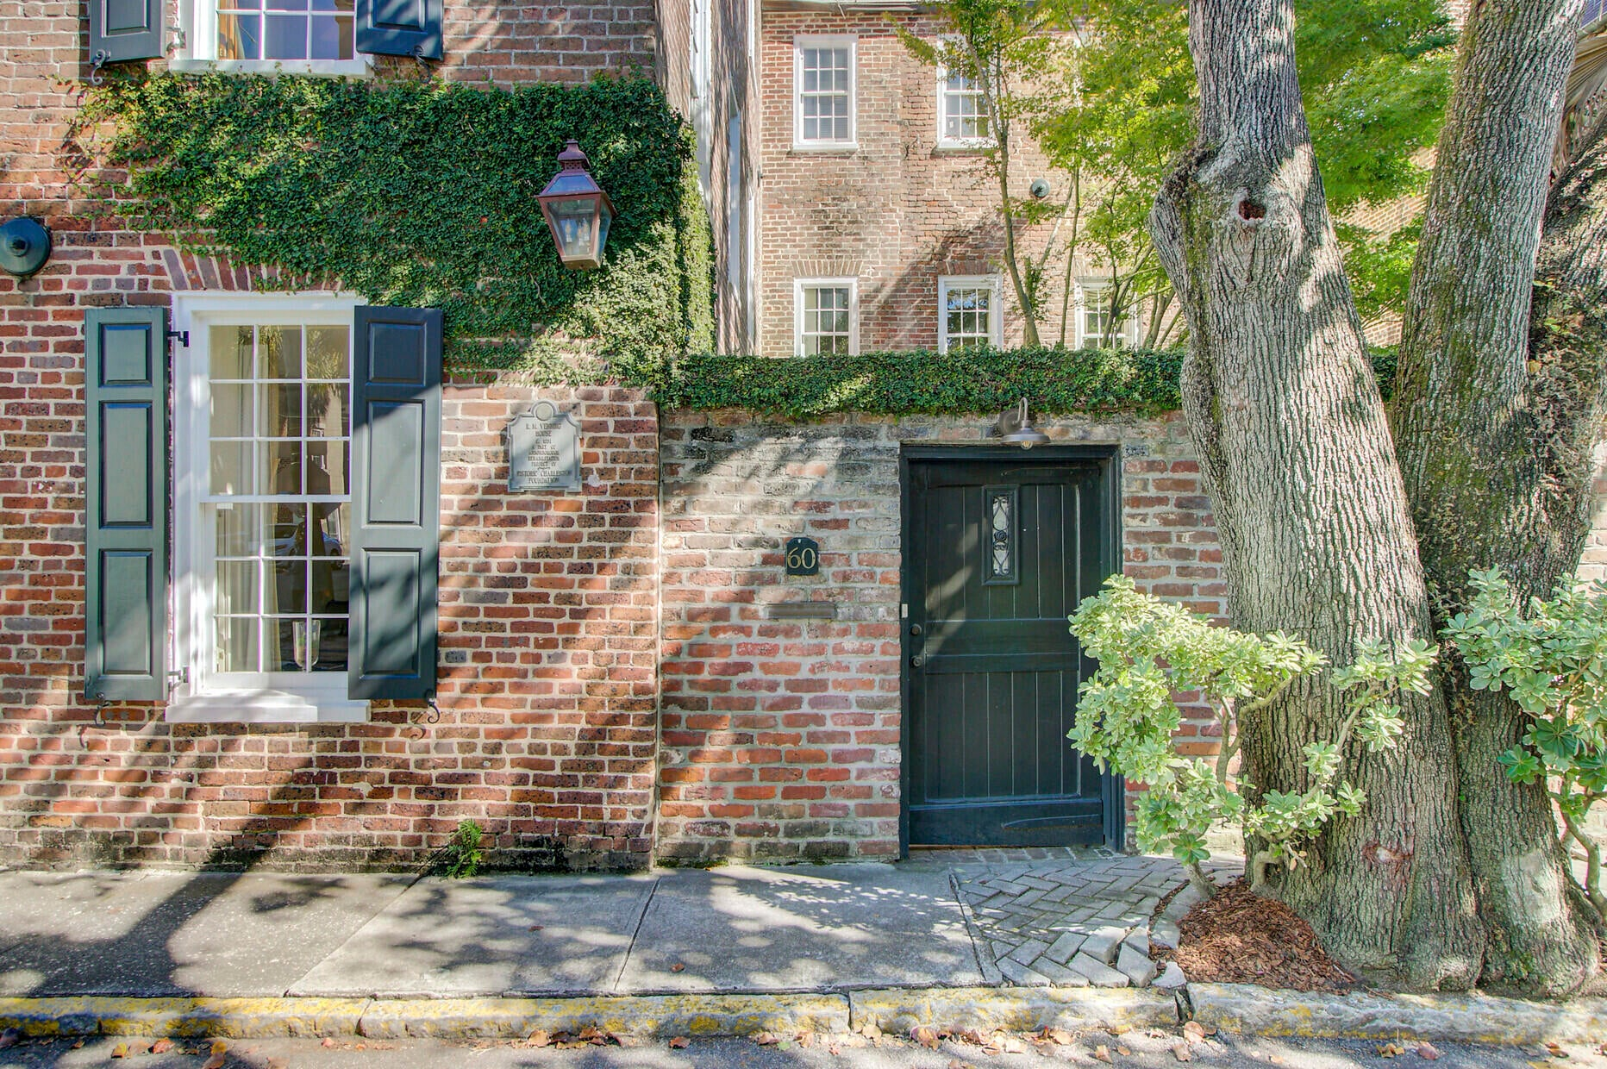
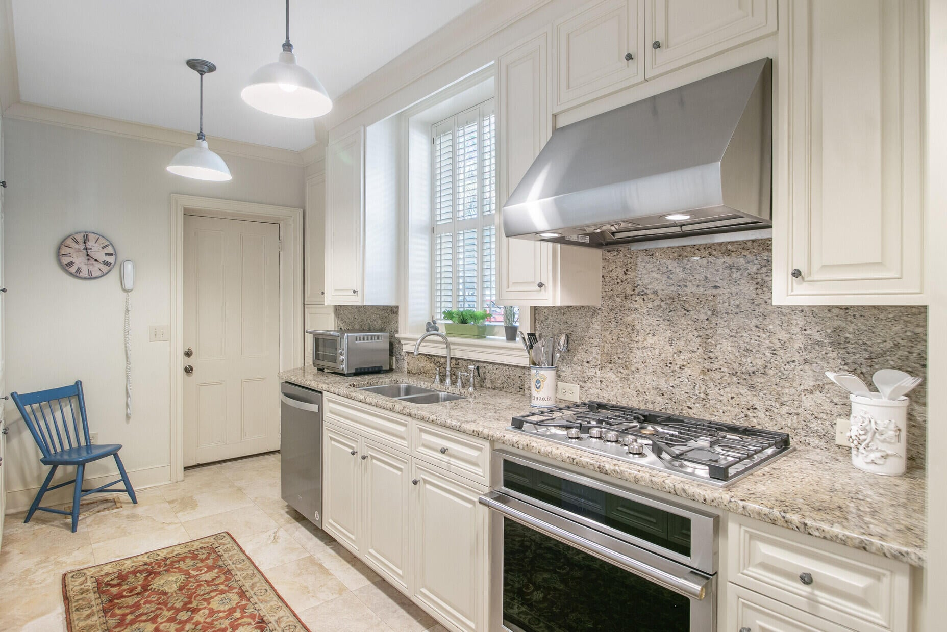
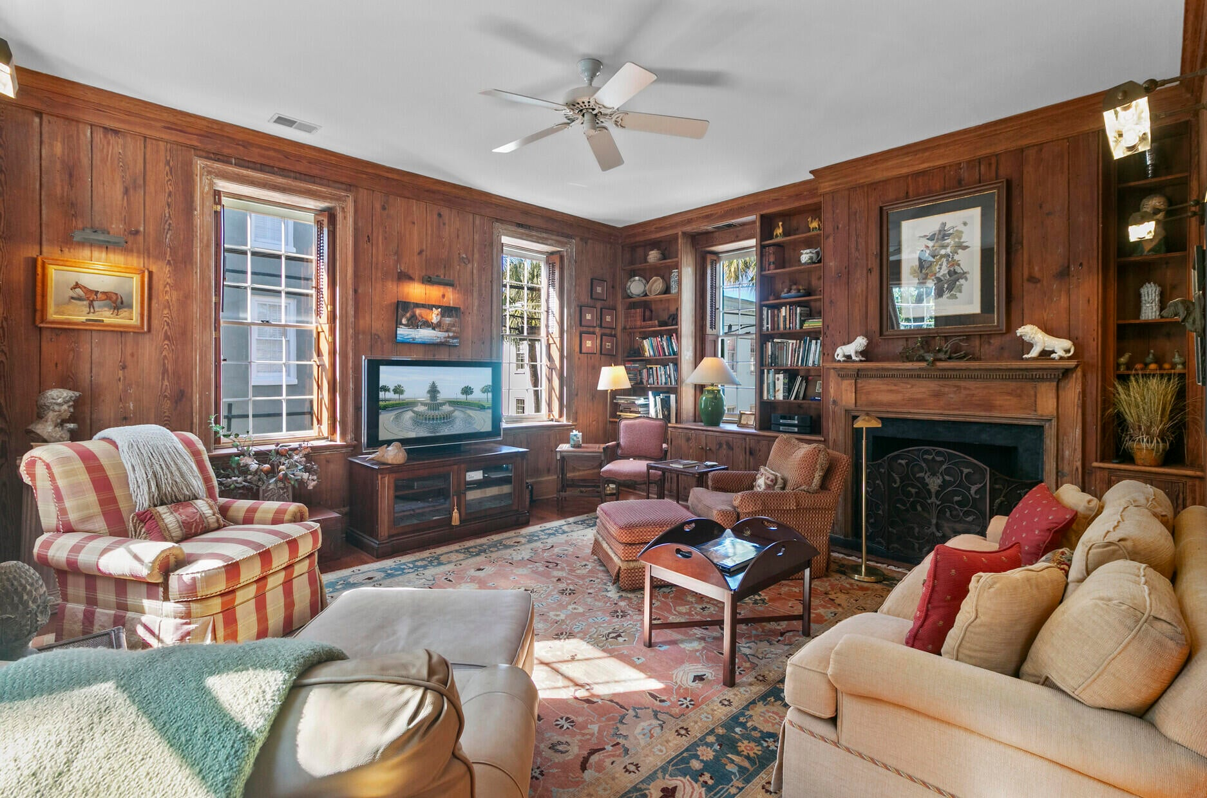
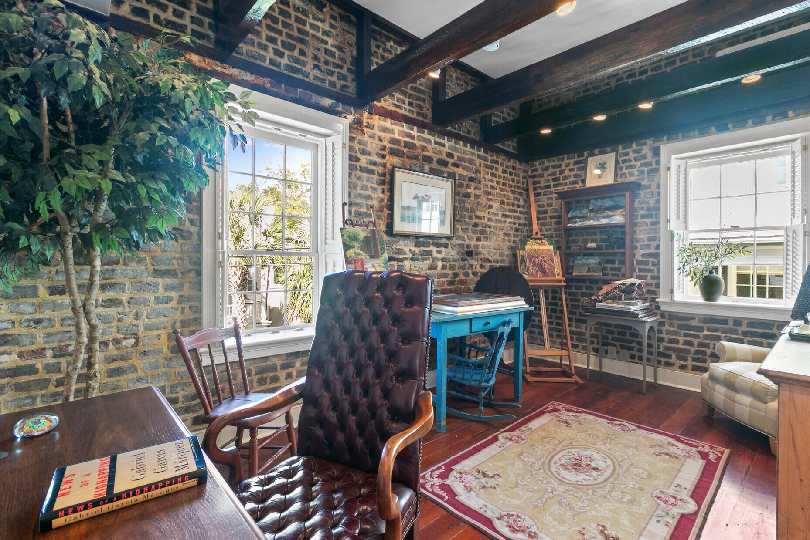
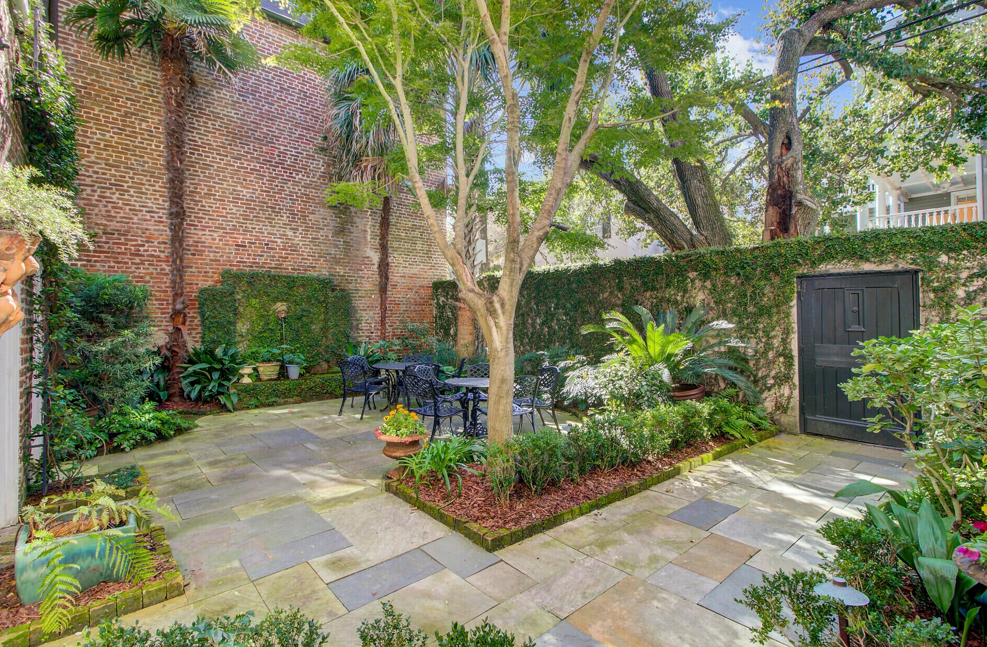


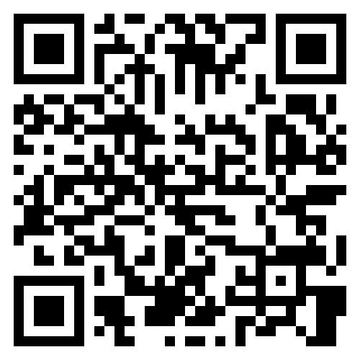
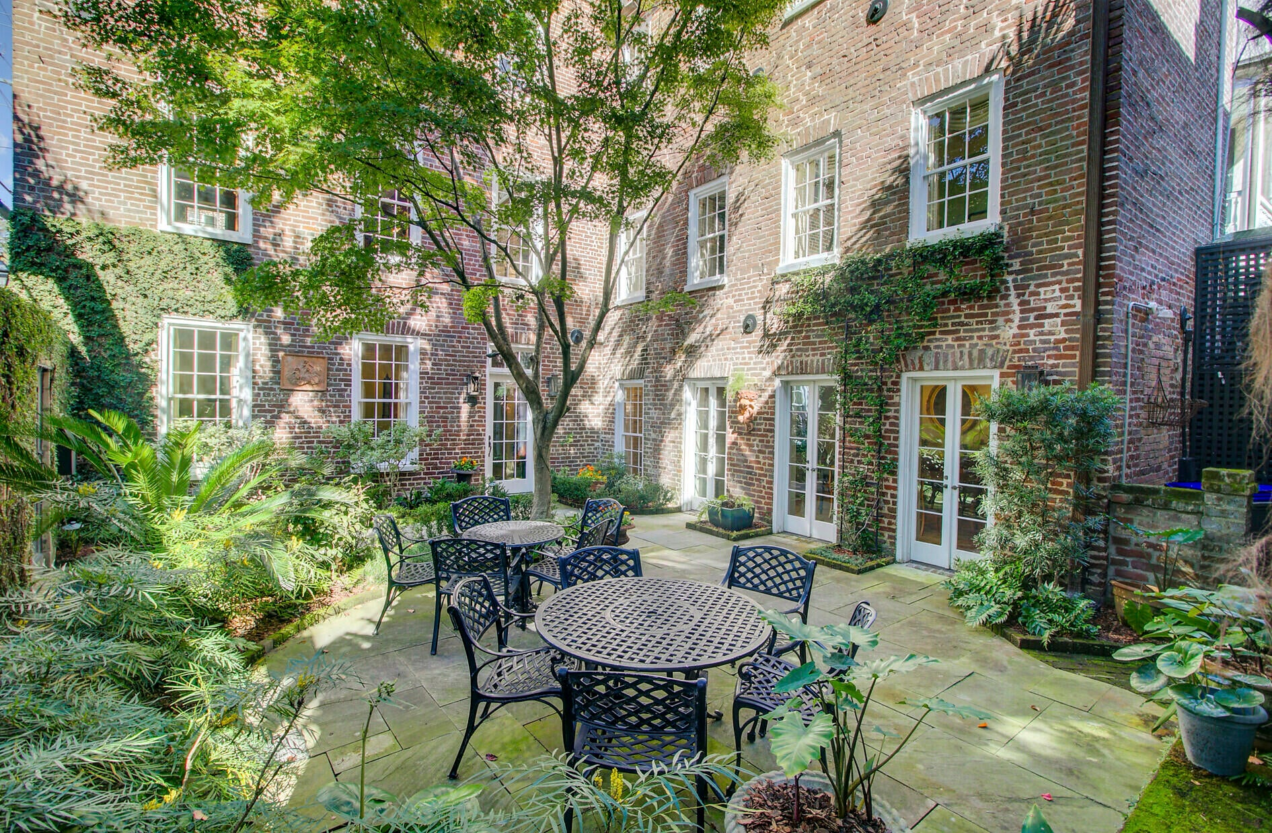


Own a Piece of Charleston History
Property Site
Video Tour
Storybook
60 Anson Street
Ansonborough | Charleston, SC 29401 | MLS# 25031170 | $2,990,000
Experience the timeless elegance of Charleston living at 60 Anson Street, the historic R.M. Venning House (circa 1851).
Located in the coveted Ansonborough district, this 4-bedroom, 2.5-bath residence blends historic character with modern luxury—featuring heart pine floors, exposed brick, a stunning art studio, and a serene private courtyard.
Enjoy the walkable downtown lifestyle, steps from King Street’s finest restaurants, boutiques, and galleries.
🏡 Your chance to own a rare piece of Charleston’s storied past is here.
📲 Call Ellen O’Neil at 843-300-8530 to schedule your private tour today!
Property Site | Video Tour | Storybook
Ellen O'Neil
Broker/Owner, ABR, e-PRO, CNE
Charleston Realtor of Distinction
843-300-8530
www.EllenONeilProperties.com

