Slide 1
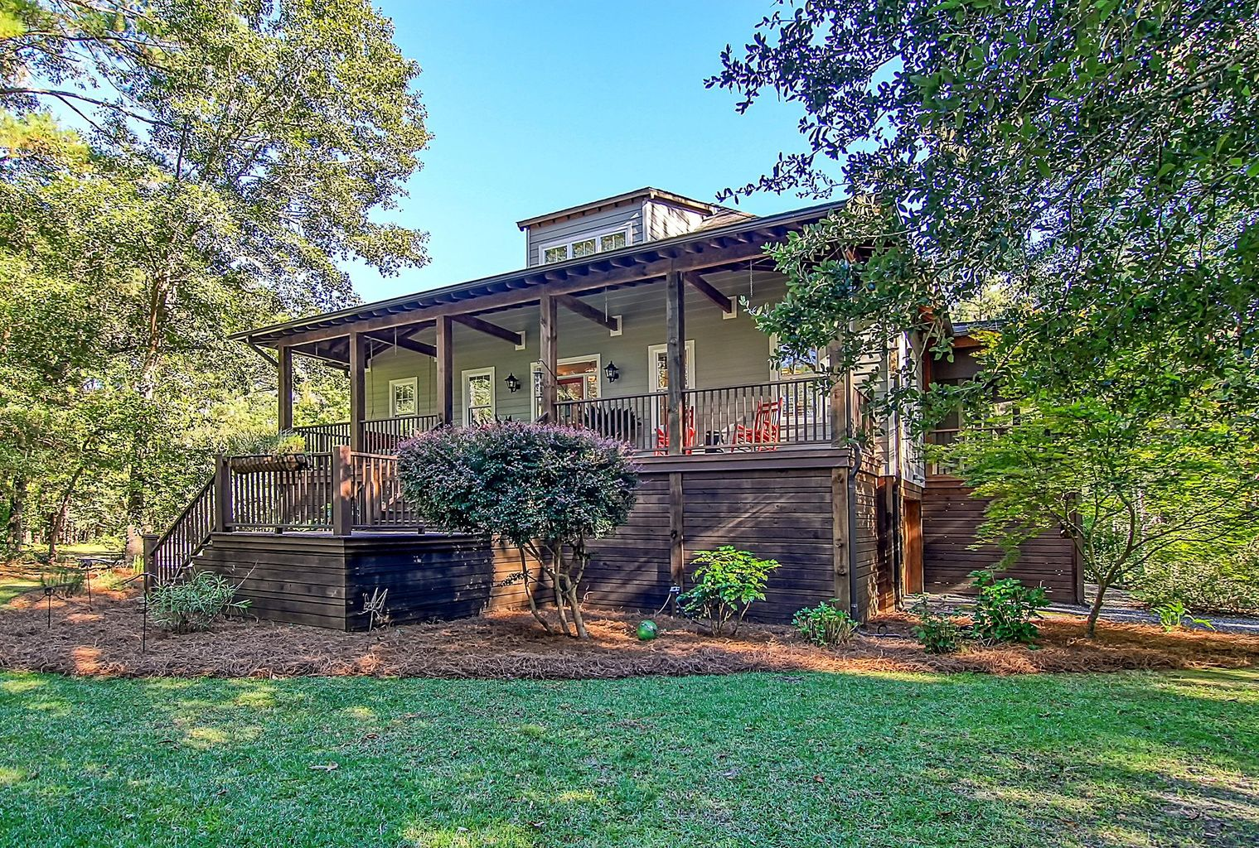

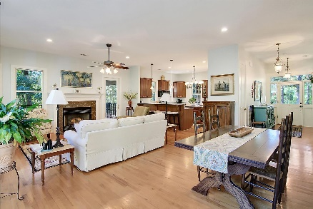


Back On The Market
At Reduced Price!
OPEN HOUSE
SATURDAY 12-3
Open House Saturday 12-3
6103 Hazelhurst Lane
The Village at Shilelagh Oaks | Ravenel, SC 29470 | MLS# 22025939 | $875,000
If you long for the serenity of natural, wooded surroundings, but also desire a home with updated, modern features in a convenient location, then this spacious custom-built home with an in-law suite on 2.85 acres is for you! A ground-level in-law suite with a private entrance and a family room, a kitchenette, a bedroom, and a full bathroom offer plenty of great possibilities for the homeowner, including multi-generational and long-term options. Wooded surroundings part as you follow the circular drive past a manicured lawn and mature, native shrubbery and trees. This private, park-like setting overlooks a spring-fed freshwater stream- you could even fish from your backyard! A full, inviting front porch welcomes you. The moment you enter the home, you'll be amazed by the abundant natural light, the 10' ceilings, the 8' solid wood doors, gleaming wood floors, high-end finishes, and a great open floor plan. To the left of the entry, double doors lead to an office/bedroom with crown molding and a chair rail. The living and dining rooms offer an incredible space to relax by the fireplace and enjoy the views from the expansive wrap-around screened porch. From the screened porch and the deck, you will love enjoying the sounds of the local birds and watching all the native wildlife while gazing at the yard and water views. The kitchen is a chef's delight with Italian marble countertops, abundant cabinetry, an island, a pantry, and a breakfast bar. The main level primary bedroom has access to the porch as well as two walk-in closets and an en-suite bath with a dual sink vanity, a step-in shower, and a jetted tub. Head to the upper level to find a roomy bedroom with a sitting area and a full en-suite bath. The ground-level mother-in-law suite or space for guests features LVP flooring, a bedroom, a full bathroom, a kitchenette, a living room, and interior and outside access. This property also has a two-car tandem garage, a recently installed extra septic field, a new well pump, a new filtration system, and A BRAND NEW HVAC in July 2022! The large patio with a built-in fire pit is perfect for oyster roasts, BBQs, roasting marshmallows, and enjoying the water views. This property is located 13.7 miles from I-526, 19 miles from downtown Charleston, and 20.5 miles from Charleston International Airport. Don't miss out on this great home!
Book your showing today!
Amanda Kennedy-Colie akcolie@mattoneillteam.com 843-224-5865

