Slide 1
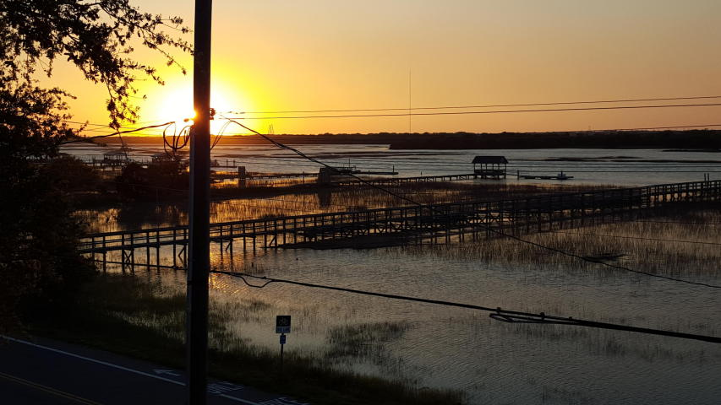
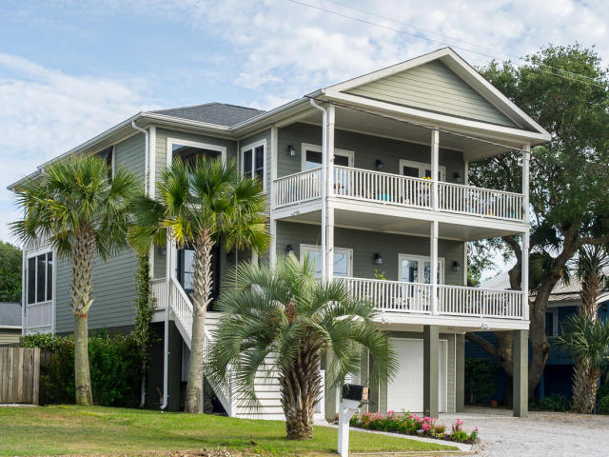
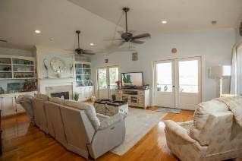
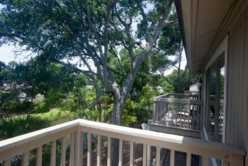
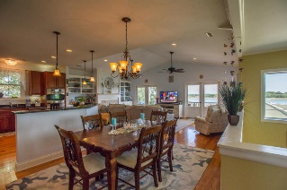
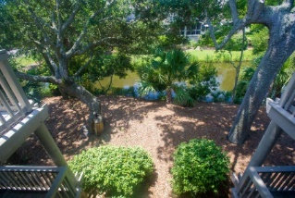
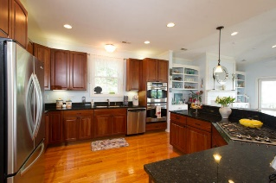
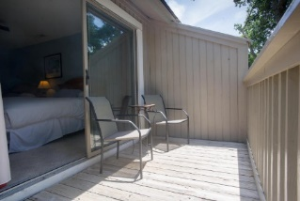
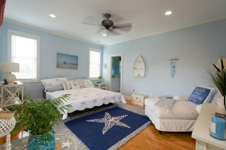
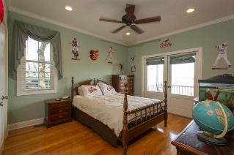
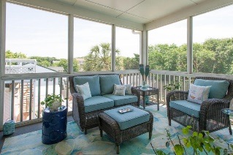
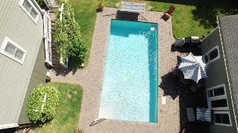


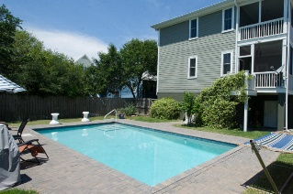
610 Palm Boulevard
Isle of Palms
MLS# 16014021
$1,700,000
OPEN HOUSE SUNDAY 2-4
Check out this Isle of Palms property with Hamlin Creek and Intracoastal Waterway views for under $2 million! This island jewel has expansive views from the IOP Connector to the Ravenel Bridge. A must see! The home has everything including double front porches overlooking the breath taking waterways, a three stop elevator, an 18,000 gallon saltwater pool, and even a pool house! This great find offers all this, plus it's literally steps from the beach! Built in 2008, this immaculate home has no need for updates. The reverse floor plan boasts hardwood floors throughout, a lovely kitchen with Uba Tuba granite counter tops, custom cherry cabinetry, and tons of counter space. The GE profile appliances include double wall ovens and a gas cooktop. The spacious family room includes a gas fireplace and two sets of french doors that open onto a large porch overlooking the creek, marsh wildlife, and fabulous sunsets. The master is nicely appointed with a private screened-in porch overlooking the pool area. It's ensuite includes a large walk-in closet, sunken tub, separate shower, and double granite vanity.
Downstairs you will find three bedrooms, including a second master suite with a walk-in closet, nicely appointed ensuite, and a private screened-in porch that also overlooks the pool. There is a nice sitting room or formal living room just off the 3rd and 4th bedrooms that could be converted into a 5th bedroom, if needed. Just off the extra sitting room and 3rd bedroom is another balcony that overlooks the creek.Other features of the home include a Rinaii tankless water heater, dual zone HVAC system, a small office nook off the second master, and a true laundry room. The oversized double garage has room for numerous vehicles, extra storage, as well as plenty of space for a small workshop. The pool house is a wonderful feature of the home that includes a bar area, kitchenette, and it's own garage that's great for yard equipment and extra storage. This extra 650+ of sq. footage is perfect for a man cave or party room with plenty of room to shoot pool or play ping-pong. The nicely landscaped yard has an irrigation system. There's plenty of space to add a small vegetable garden or build an outdoor kitchen.This home has never been a rental, so it is in wonderful condition and has many possibilities including a full time residence, a second home, or it could become a very nice vacation rental. Don't miss this opportunity to own a piece of Paradise!
Carey Nikonchuk
(843) 276-1701 M
cnikonchuk@gmail.com
www.palmettoproperty.net

