Slide 1
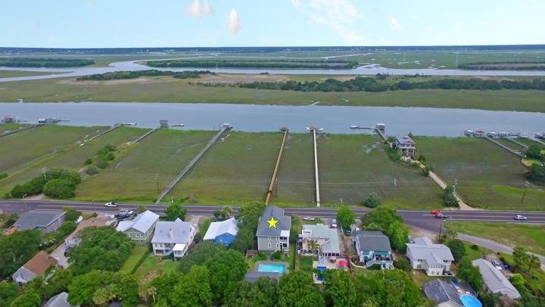
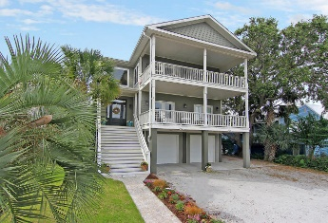
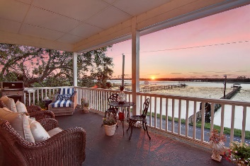
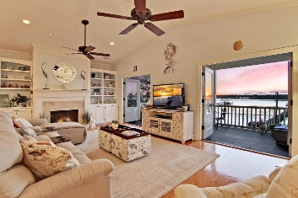
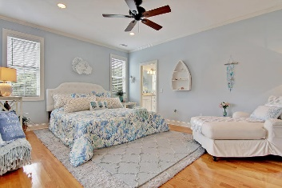
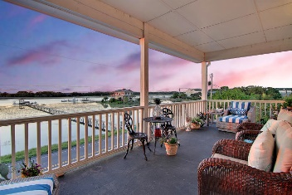
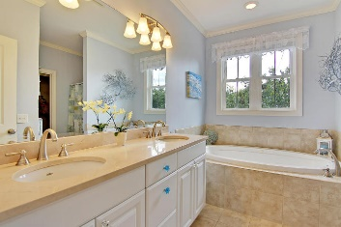
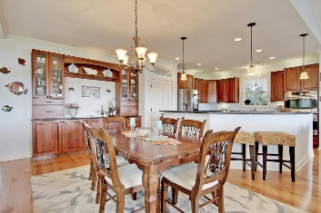
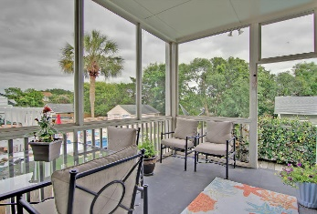
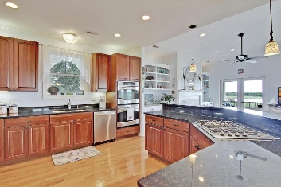
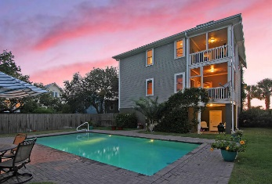
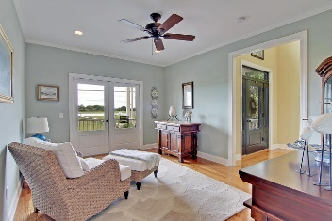
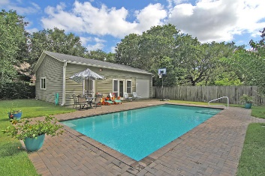
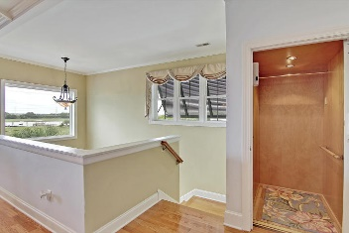
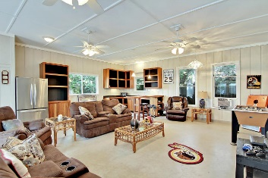

Amazing Sunsets at an Amazing New Price!
Price Reduced!
610 Palm Boulevard
Isle of Palms, SC 29451 ~ MLS# 17016611 ~ $1,399,999
Island living, bathing at the beach & poolside relaxation are some of the things you can expect to enjoy at this gorgeous Isle of Palms home. Incredible views of Hamlin Creek from the 2 front porches. Conditioned pool house not counted in square feet!! Since the home is 3 stories high, you get a vantage point for unbelievable sunsets and views of the Ravenel Bridge. The home main living space is an open concept, dining/living combo & kitchen with 3-stop elevator access from the garage area. Wood floors, granite counters, a breakfast bar, built-ins & fireplace all help make this space very inviting. Each level boasts a master suite with screened-in porch & the pool house is a great space to entertain right next to the pool. This home is a little slice of heaven you don't want to miss!
Additional features include:
Double front porches to enjoy the views and lowcountry climate
18,000 gallon saltwater pool with pool house for hot summer days
Beautiful kitchen with granite countertops, custom cherry cabinets, a gas cooktop, and double wall ovens
The roomy family room is the perfect place to relax and enjoy water views with a cozy gas fireplace, built-ins, and access to the porch through French doors
The spacious master suite includes a private screened porch and a master bathroom with dual vanity, granite counters, a walk-in closet, and soaking tub, and a separate shower
Rinaii tankless water heater
Second master suite and two additional bedrooms
Extra large two car garage with lots of room for storage
Hamlin Creek and Intracoastal Waterway views
Steps from the beach!
Book your showing today!
Matt O’Neill matt@mattoneillteam.com 843-532-4220

