Slide 1
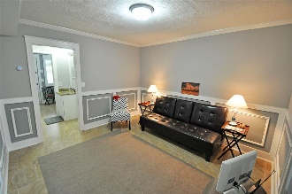
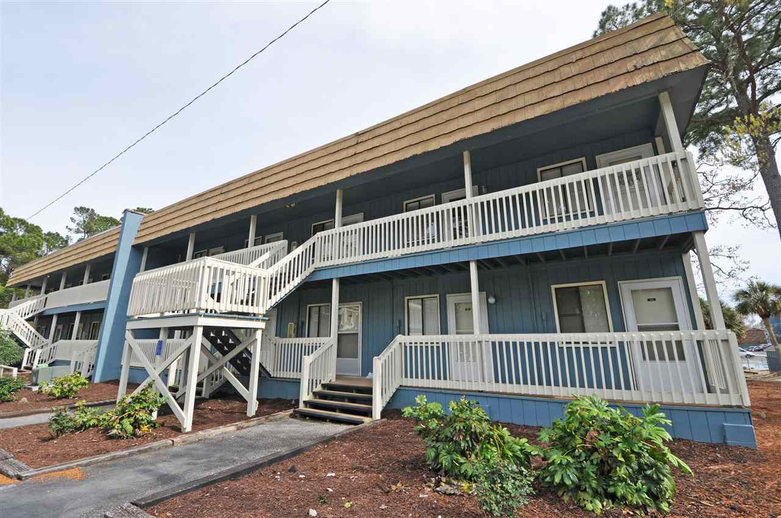
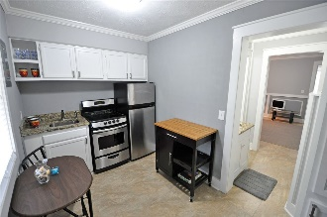
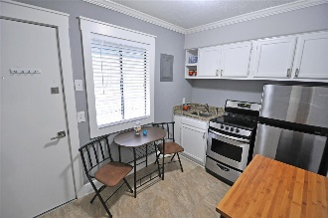
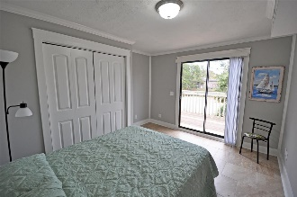
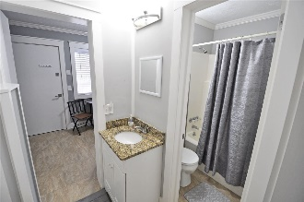
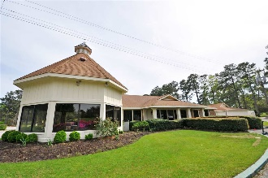
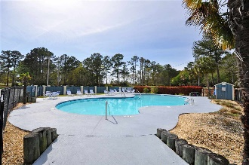
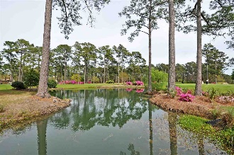
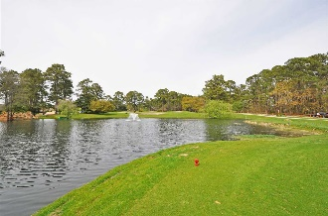
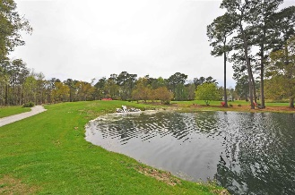


Small Condo…
BIG VALUE!
610 Putter's Lane #202
Eagle Lake & Golf Condominium Complex
Little River, SC 29566
MLS# 1807841 ~ $46,900
What a BUY! The beautiful Eagle Nest community, conveniently located in the historic hamlet of Little River near all major highways, attractions, shopping and dining provides a unique, pristine environment for this one-of-a-kind one bedroom, one bath condo with wonderful front views of the popular Eagle's Nest Development, Lake and Golf Course. It is tucked away, too, though, and secluded for safely strolling or puppy-walking among the lovely foliage of its quiet surroundings, tree-lined entry lane and grounds. Yet it is right off Highway 17, near Highways 9 and 31, and only minutes away from everything, including the Cherry Grove and other North Strand beaches. Low- to mid-rise Eagle Lake and Golf Condominium Complex also includes a large community picnic/grilling area and inviting outdoor swimming pool. The deck directly off the bedroom has nice views of the spacious community commons and the pool, located to rear of the property, which is charming and well maintained. This building is a low-rise and the unit is on the second floor with appealing views; steps are adjacent to plentiful parking. Front entry is near the stairs. You walk directly into a beautiful updated, workable kitchen with over-sized ceramic tile flooring, carried throughout; stainless steel appliances and granite counter tops. There is room for a breakfast nook and even a pantry! The kitchen leads to a functional hallway with ready access to the HVAC and hot water heater, cleverly camouflaged by unique design features; a full bath with tub/shower and a sink perfectly placed in the hall as well. This utility sink has a matching granite counter top to those in the kitchen. The HVAC is new, state-of-the-art and carries a 10-year warranty! The living space is roomy and classic; pleasing gray tones and cottage-inspired decor are accented by crisp white trim and sculpted ceilings, also carried throughout. There's plenty of room for a sofa bed for those visitors who pop in at the beach. Light fixtures are upgraded, too. The bedroom has a big, double-door closet, space for a full bed and even some extra space for such items as deck furniture. It has lots of natural light and high ceilings, with a direct view and access to the deck overlooking the expansive commons. This pleasing room welcomes relaxation. This nicely redecorated condominium offers a fabulous location and simple beach living, a perfect getaway for a second or vacation retreat; rental/investment property; or primary care-free residence, befitting the new turnkey, smaller-house alternative-living craze. Furniture is negotiable. This condo gives up nothing to size or to decor, however, and is a very BIG value in a sophisticated package. Purchase now at today's opportune prices and move in before summer. What a BUY!
Deborah Collins
843-424-9013
dctidewater@yahoo.com
Connie Ross-Karl
702-306-2643
conniesross@aol.com
NEW WAY PROPERTIES MYRTLE BEACH

