Slide 1
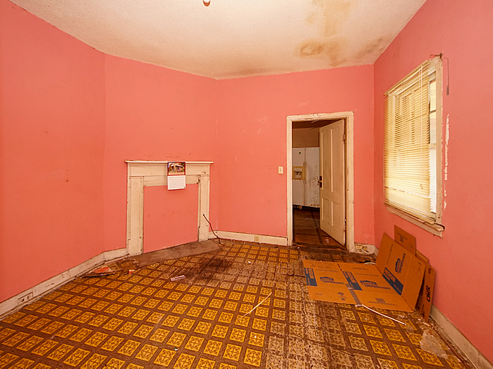
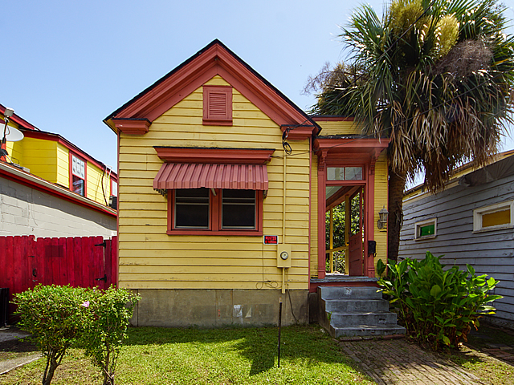
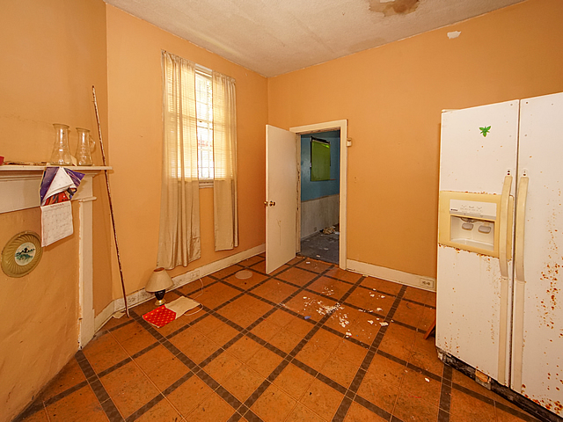
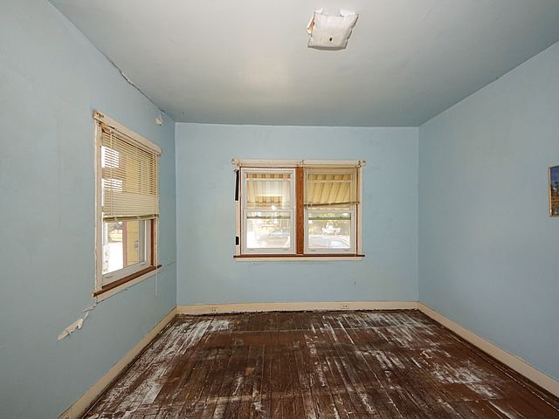
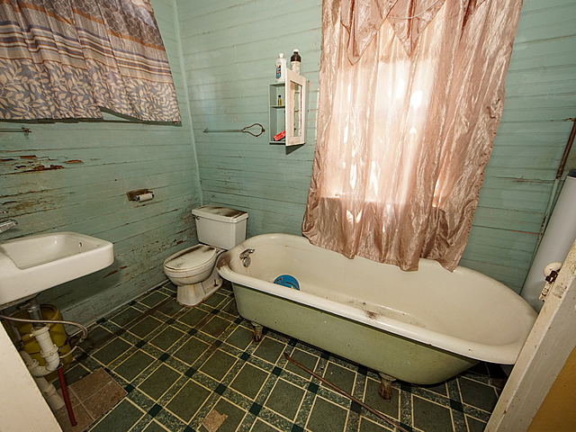
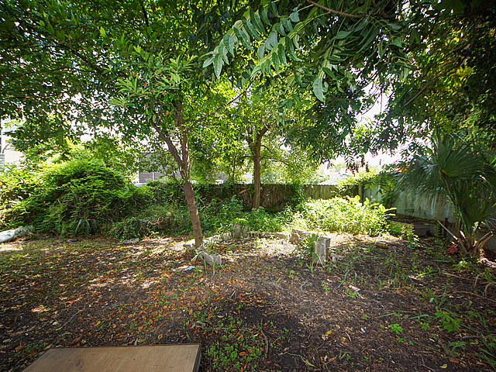
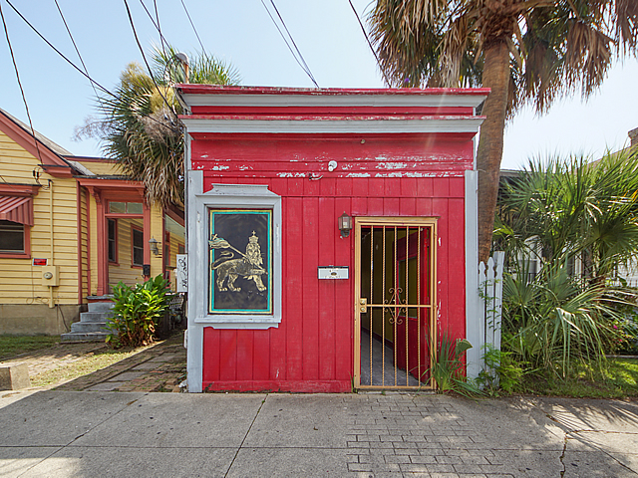
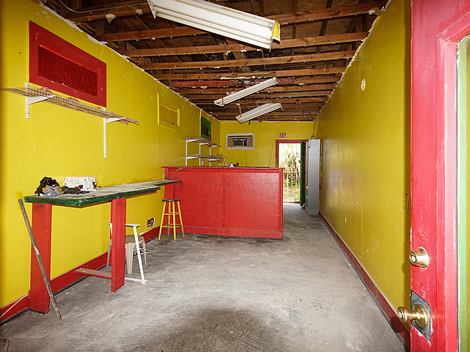
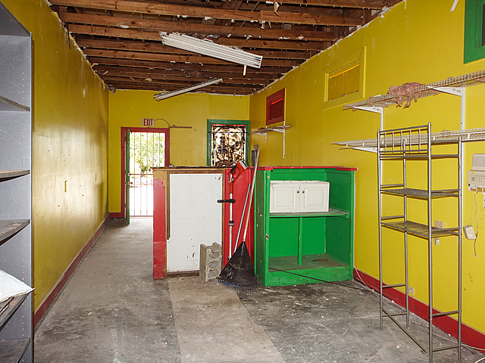
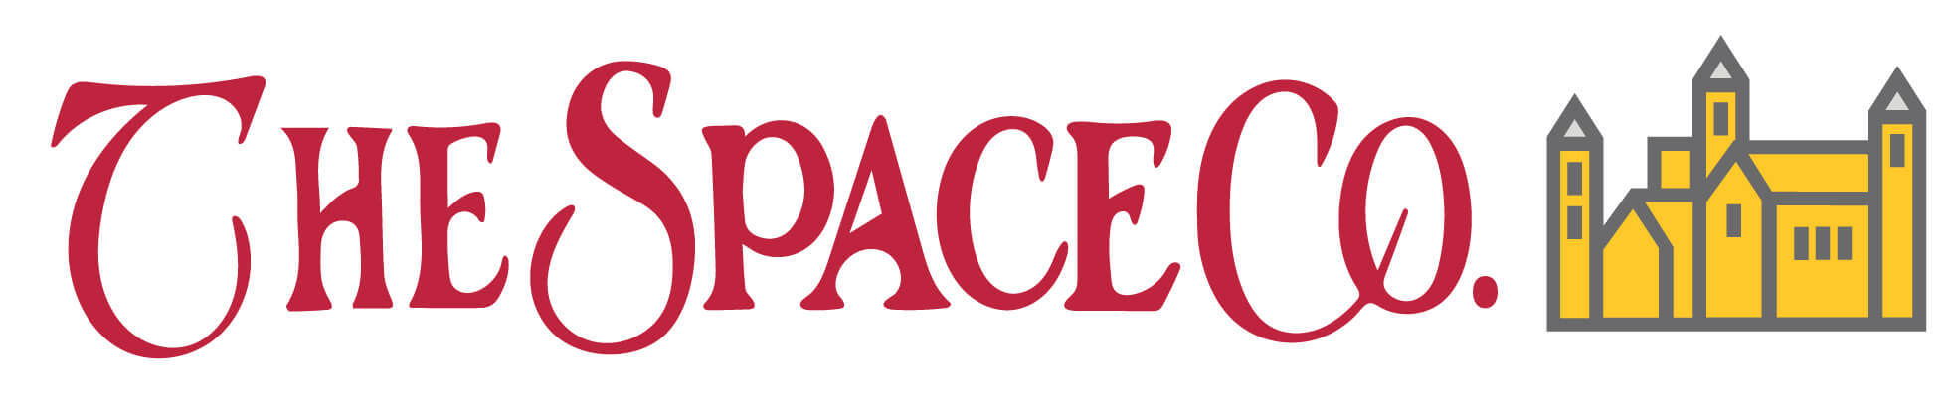
610 Rutledge Avenue
Charleston, SC 29403 ~ $425,000 ~ MLS# 20018243
REDUCED!
Rare Downtown property. Oh the possibilities!
This is a single-family house that is 860 square feet. Also on the property is a 348 square foot building that was formerly an art gallery. The rear yard has two storage sheds. This property needs total renovation but there are endless options to work/live in a great area. Walk to Hampton Park and enjoy all of the great new spots on Huger Streets. Wonderful opportunity!
Renata Smalls
stinsonspace@bellsouth.net
www.thespacecompany.com
O 843-577-2676 | M 843-864-3990

