Slide 1
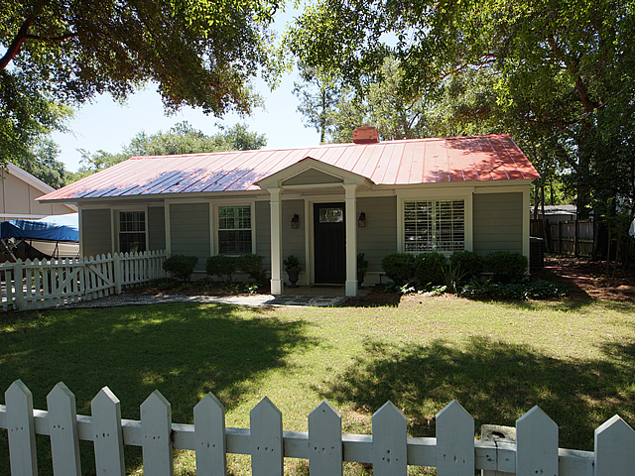
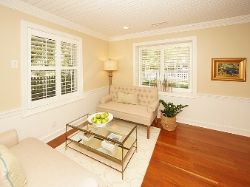
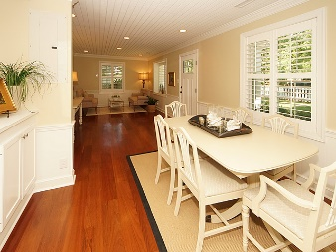
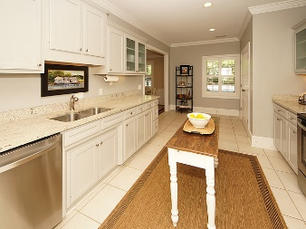
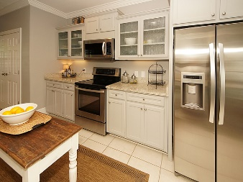
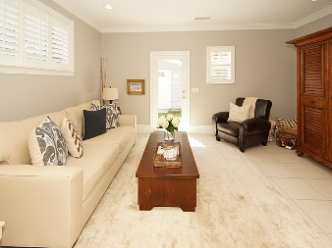
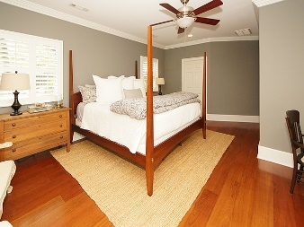
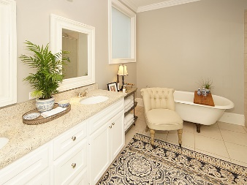
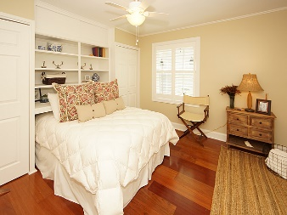
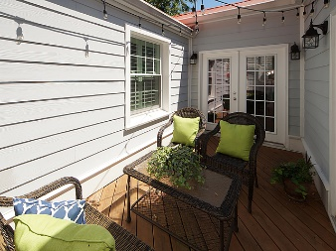
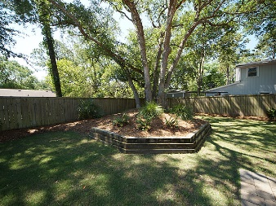



611 Mccants Drive
Old Village
Mount Pleasant, SC 29464
MLS# 17014086
$725,000
3 Bedrooms ▪ 2 Baths ▪ 1,973 sq. ft.
Open House ~ Sunday ~ 1-4
Just Listed + Open House Saturday 1-4
Charming, move-in ready cottage in the heart of Old Village and Old Mt. Pleasant! Centrally located, within walking distance of Mt. Pleasant Elementary and Moultrie Middle Schools, Pitt Street Bridge, Alhambra Hall, Old Village dining, shopping and the harbor. This one level home has undergone a large addition and complete renovation with 3 bedrooms, 2 full baths and 1,973 sq. ft. The living room/dining room combo has wide plank hardwood flooring, wood paneled ceilings, custom built-ins and crown molding. The recently added kitchen has custom cabinets, granite countertops, stainless appliances with built-in microwave and wine fridge. The kitchen is open to the new den/keeping room with tile flooring, recessed lighting, ceiling fan, and French doors. Large master bedroom new addition with French doors, hardwood flooring, walk-in closet, and Ensuite with tile flooring, large tiled shower, claw foot tub, dual sink vanity and granite countertops. There are two other bedrooms with hardwood flooring, built-ins, and a Jack and Jill bath. The home has plantation shutters, smooth ceilings, crown molding, built-ins, and ceiling fans throughout. The French doors off the kitchen and master open to an adorable courtyard and outdoor patio for relaxing or entertaining. The property features one car detached garage, boat storage, cement plank siding, privacy fenced backyard with beautifully landscaped live oak, picket fence in front, a metal roof, and new HVAC! This adorable cottage has it all, and is located within 10 minutes of downtown Charleston, Sullivan’s Island beaches, and Shem Creek. Don’t miss this one, it’s a gem!
Jennifer Nipper, Realtor®
(843) 478-1800 | jen@AgentOwned.com
www.AgentOwned.com
The AgentOwned Realty Co | 824 Johnnie Dodds Blvd | Mt. Pleasant, SC 29464
Real Estate • Mortgage • Insurance

