Slide 1
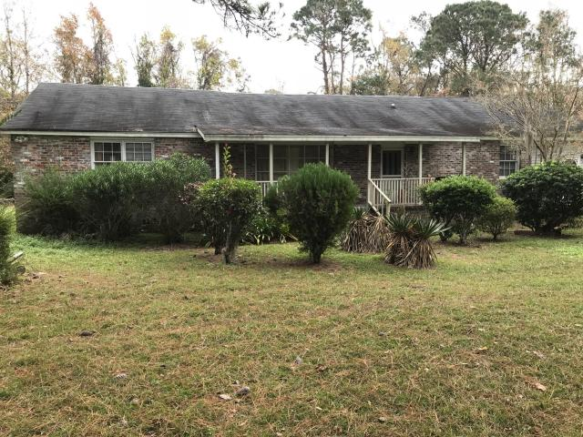
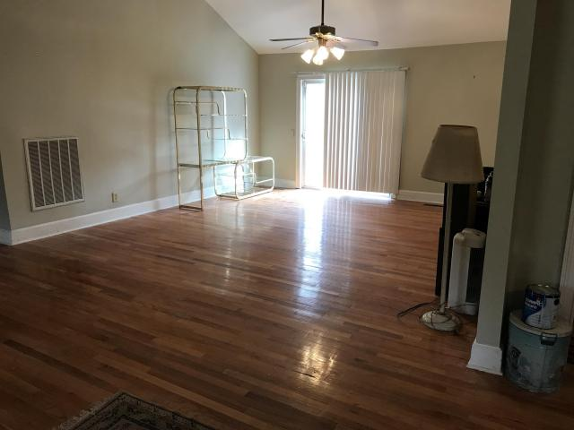
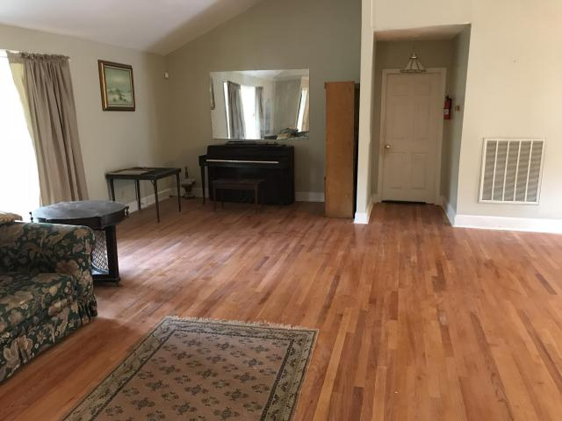
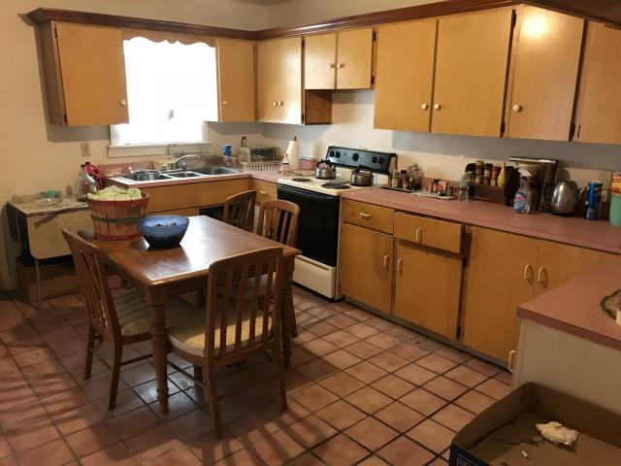

Ideal Home On 4.78 Acres
Country Setting…Close To The City
Buyer to receive 5 Day/4 Night cruise for 2.
~ ALSO ~
$1,000 Bonus to the Agent
Ratify by July 31, 2015, and close by August 30,2015
$500 Bonus
$1,000 Bonus
4% Commission
6125 Maybank Highway
Rockville ~ Wadmalaw Island, SC 29487
MLS# 17032380 ~ $425,000
Nice secluded Large, brick ranch home 3 bedrooms, 3 bathrooms built in 1992 and sits on 4.78 acres. Enjoy the beauty and peacefulness of country living. Plus, the home has been divided into an apartment area ideal for renters. Home features large dining/living room with hardwood floors, master bedroom with 2 walk in closets, garden tub and large eat-in kitchen. Home has full front porch with deck in the back great for out door parties. The home needs a little upgrading and has many excellent features. An great home to escape the overcrowding city life. Come see ASAP!
Short Sale
Edward Washington
843-737-3347
ewashington@exitlowcountry.com
Exit Realty Lowcountry Group
3618 Ashley Phosphate Rd
North Charleston, SC 29418
exitlowcountry.com

