Slide 1
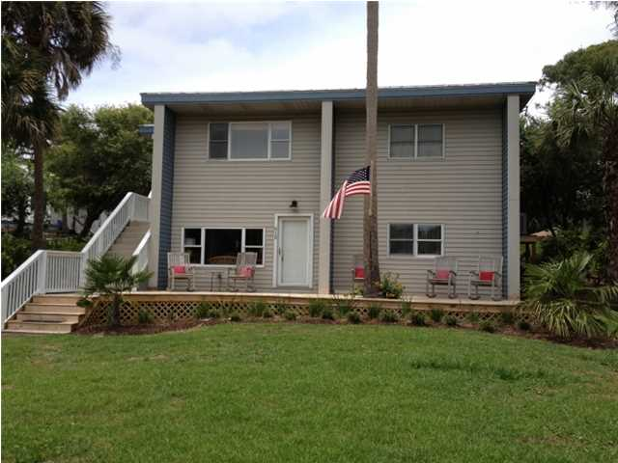
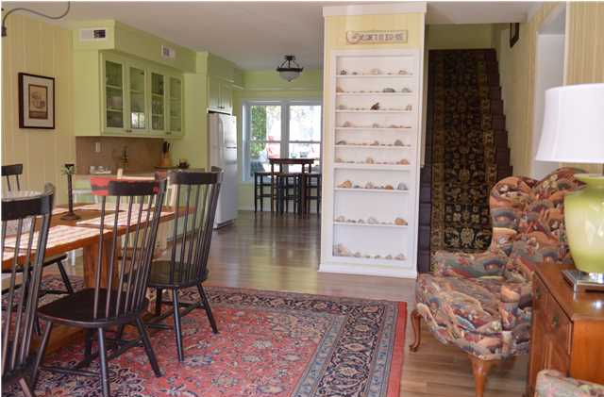
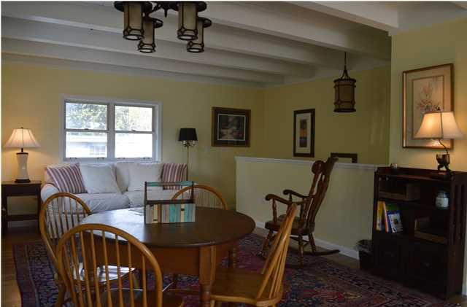
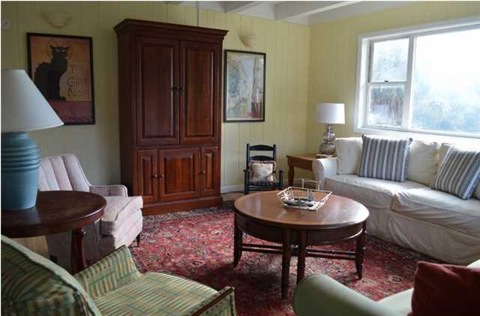
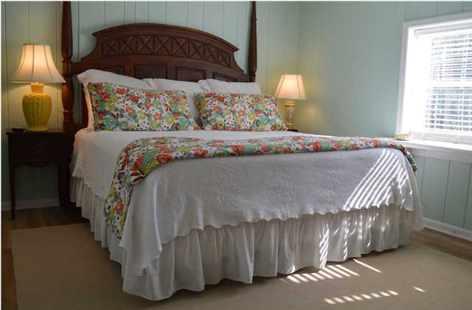

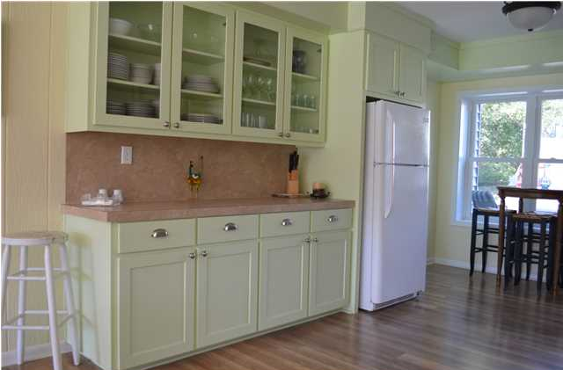
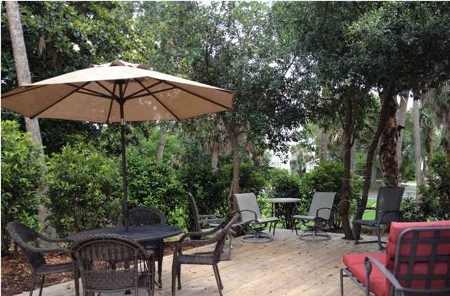
612 East Ashley Ave
Folly Beach, SC ~ MLS# 2710483 ~ $629,000
This is a completely renovated and remodeled third row Folly Beach house which has the potential of extra living space from a storage building on the property.
Gross rental income (rent + tax + cleaning) from VRBO for the past twelve months was $62k+. Owners also used the property during offseason.
Owners are motivated to sell.
Macon Sheppard
Mobile - (843) 442-7550
macshep11@gmail.com
Harbourtowne Real Estate | 672 Marina Drive, Ste 110 | Daniel Island, SC 29492

