Slide 1
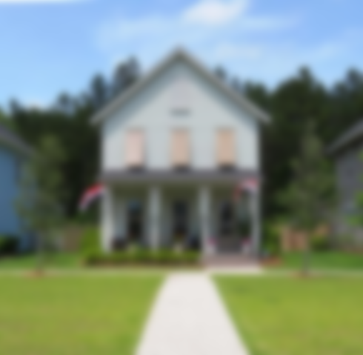
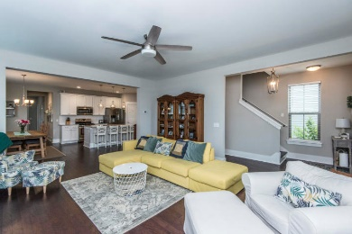

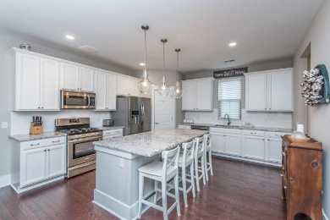
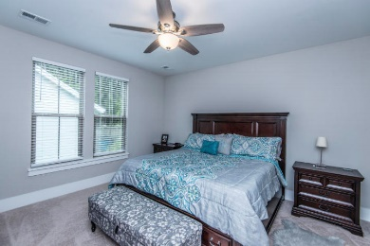
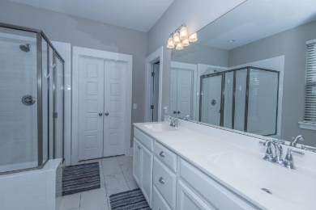
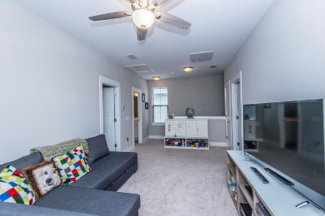
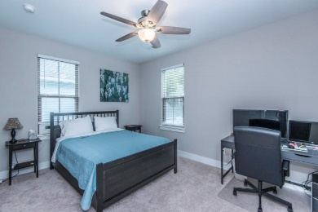
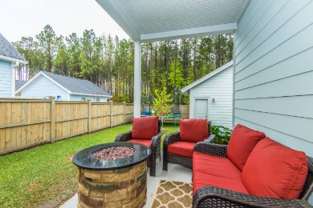
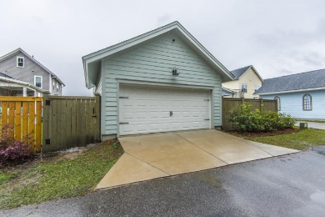


Best Lot in Nexton!!
Bring Your Buyers!
612 Long Meadow Street
Nexton ~ Summerville, SC 29486
MLS# 19009707 ~ $389,900
Nexton!! Beautiful home on the best lot in Nexton! Backs to woods, Long Meadow Park in front; lots of room to play! Welcome to this barely lived in, open plan, with beautiful upgrades! Enter to the foyer with large family room to the left, straight to gourmet kitchen. Kitchen is open to family room and gorgeous! White cabinets, large island allowing the family to hang out with the cook, gas stove, lots of work space and cabinets. Pantry. Eat-in area off the kitchen allows for farmhouse table to accommodate a crowd. Perfect set up for everyday family time or for entertaining. Off the kitchen back hallway leads to the half bath, laundry room, mudroom, and large master bedroom. Master is tucked away for privacy and includes walk-in closet, dual sinks, water closet. Upstairs find 2 nice size bedrooms, loft for separate family room or office, and full bath. Front bedroom has walk-in closet. The backyard is fenced. 2 car garage is large and allows for extra storage. Woods behind home for added privacy. Nexton has lots of green space, a community pool and play area. No need to wait for new construction. This is the perfect home for your family!
Laurie Loparo
(843) 442-1290 | laurieloparo@gmail.com
www.lauriesellscharleston.com
Carolina One Real Estate | 873 Orleans Road, Ste 102 | Charleston, SC 29407-5753

