Slide 1
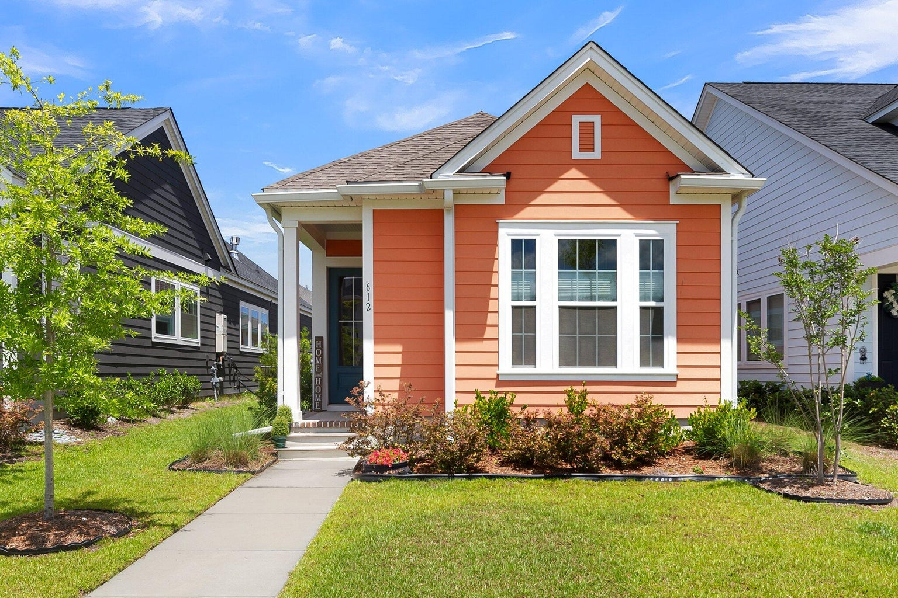
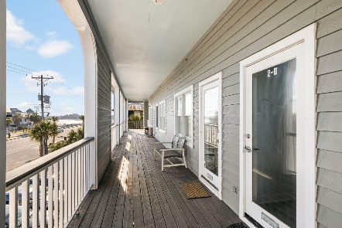
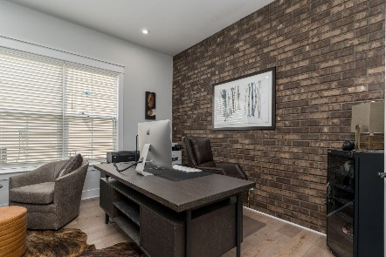
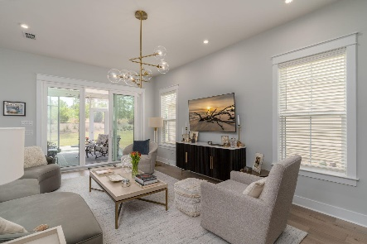

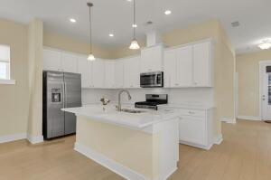
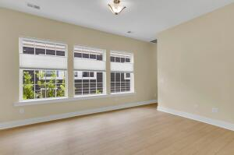
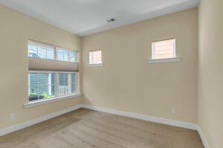
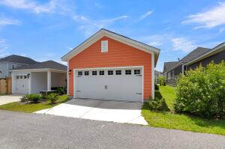
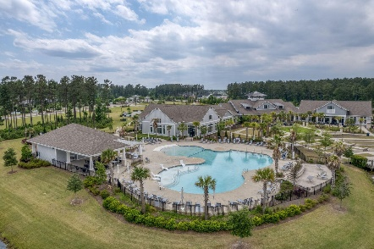
612 Blueway Avenue Nexton | Summerville, SC 29486 | MLS# 24012679 | $372,499
Darrell Creek Elevated Home With Elevator & Salt Pool
Coral Cottage in a Sea of Blue
Co-sponsored by
Offering $3000
Lender Credit
This lovely Halston A floorplan by David Weekley has been lovingly maintained and barely lived in. the sellers really put a lot of thought into this home. From upgrades , to paint, to special blinds and maintenance, you will be amazed at the care that has gone into it. The detached 2 car garage provides space for parking or storage. As you approach this beautiful corral colored home in the sea of blue houses the curb appeal just sparkles. Coming into the home from the front door, you are met with a guest bedroom and full bathroom at the from of the home. Walking further in you are met with a wonderful flex space that can be used as an office, a dining room, a formal living, etc. The automated blinds make it easy to control the light in the room. If you are looking for a house with bright natural light, this is the one. The specialized blinds allow you to pull down from the top to allow light and keep privacy, or go up from the bottom traditionally. The transom windows in both the flex space and the Master bedroom are remote controlled/automated. Walking a little further in you are met with the great room, kitchen and eat in area. You won't miss a thing when entertaining in this space. The kitchen is well appointed with plenty of counter and cabinet space, upgraded cabinets with pullouts, drawers for your pots and pans, stainless steel appliances and gas range. The Master is at the back of the home for privacy and has a walk in shower, water closet and dual sinks. The addition of a utility sink on the back porch and the paved walkway between the house and detached garage add a nice touch to function and form. With everything that this house and Nexton have to offer, check this home out quickly before it's gone.
Rochelle Rennert
843-847-9694 | rochellesellscharleston@gmail.com | www.RochelleSellsCharleston.com
AgentOwned Premiere Group, Inc. | 219 N Highway 52 Ste A | Moncks Corner, SC 29461-3926

