Slide 1
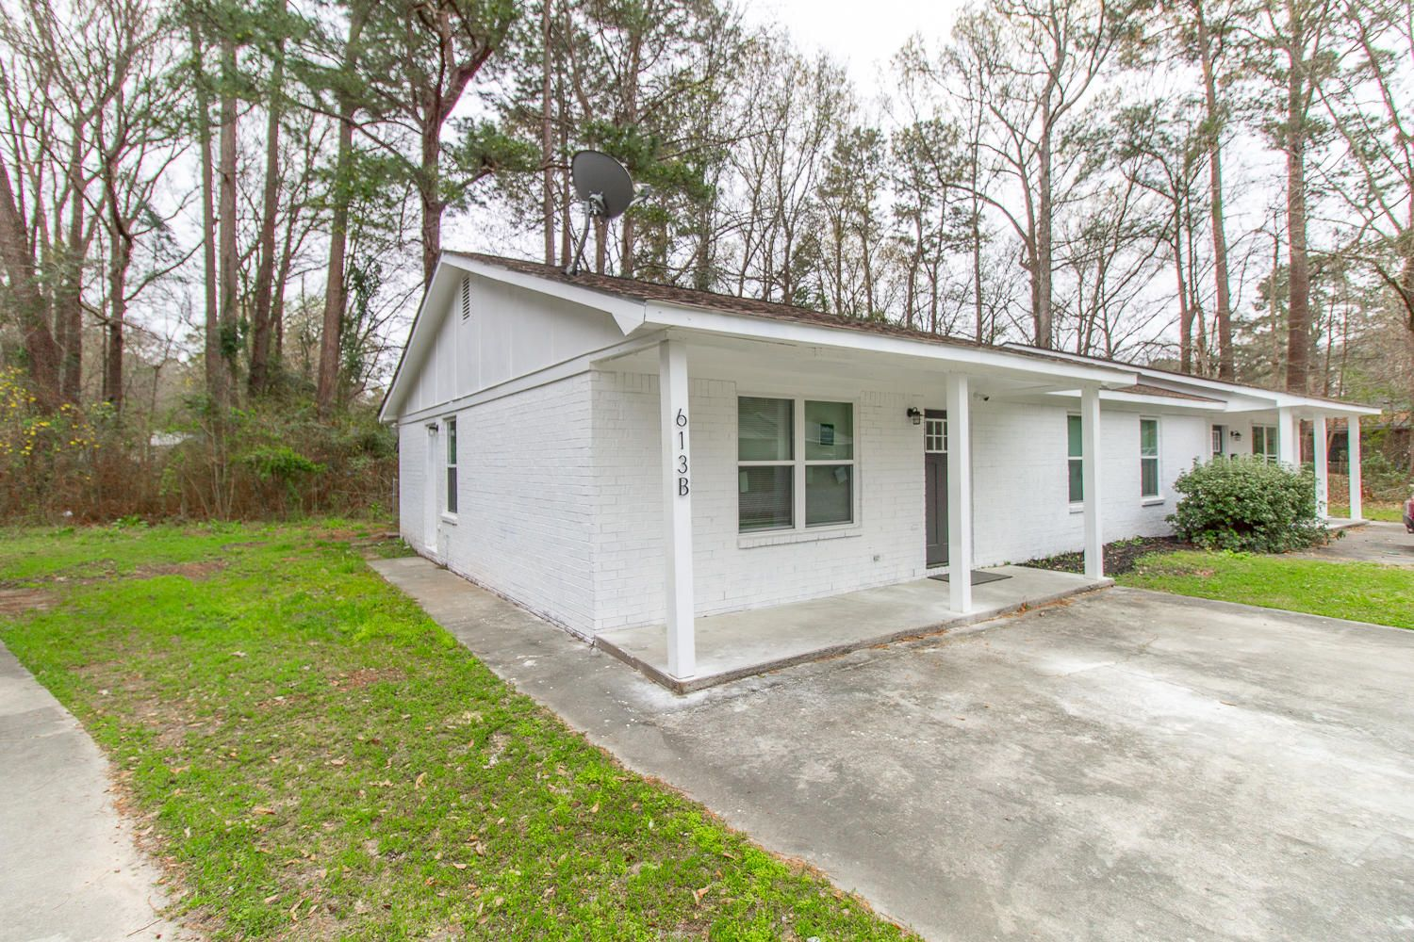
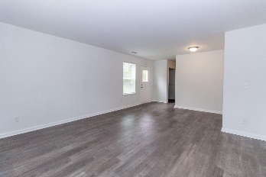
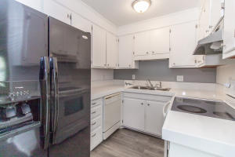
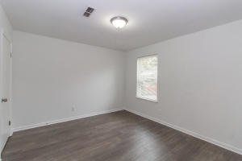
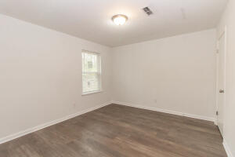
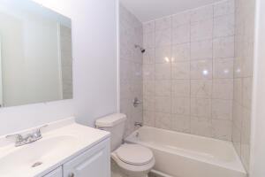
613 Bob-O-Link Court
Plantation Ridge | Ladson, SC 29456
MLS# 21021276 | $299,000
$2,000 income producing property! Completely remodeled duplex ready to go with tenants in place! One lease is month to month so move in one side and rent the other! Roof is less than a couple years old. HVAC in great working condition. Updates include new windows, paint, new bathrooms tubs and vanities and hardware, outlets, water heater, and more! Too many to list, but this duplex is worry free. 2 units with 2 bedrooms and 2 bathrooms, both 950 sq ft. Both rent for about $1,000 with room to grow. Great DD2 locations with Oakbrook school a few minutes away. Don't miss this opportunity.
Sean Harrington
(843) 226-9652 | sean@milerproperties.com

