Slide 1
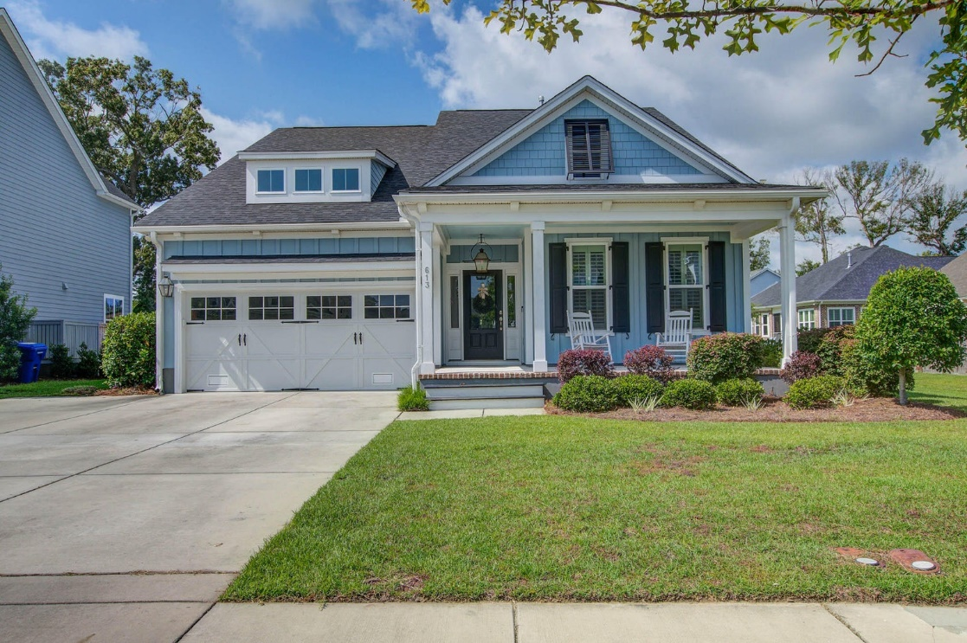
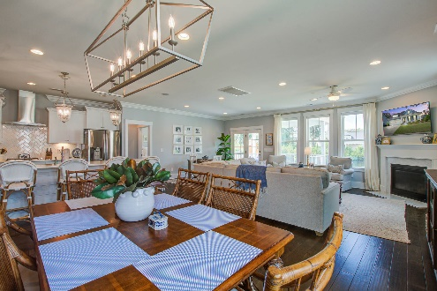
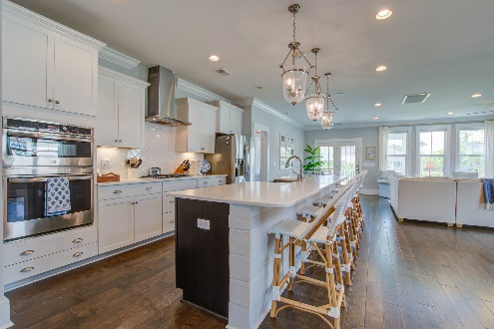
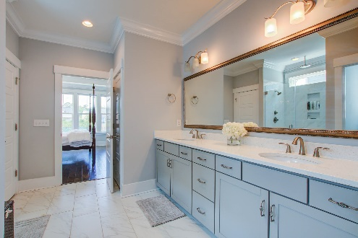
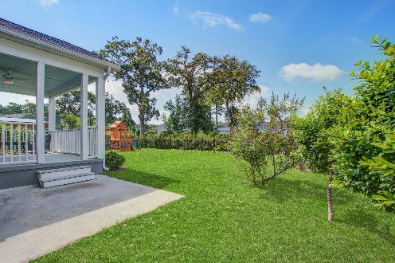


Open House Saturday Aug. 5th 12 - 4
NEW PRICE!
613 Mackay Trail
The Village at Stiles Point · Charleston, SC 29412
MLS# 23016042 · $1,080,000
Michael Dew
O 843-769-5100
M 843-870-7000
michaeledew@gmail.com
www.michaeldewrealestate.com
Absolutely gorgeous home on James Island. 5 bed 3 bath in highly sought after neighborhood of The Village at Stiles Point. Enter from the welcoming front porch adorned with a gas lantern to the beautiful foyer with judges paneling. Hardwood floors through out main floor with high ceilings and crown molding. Additional recessed lighting has been added. Open floor plan with gourmet eat in kitchen with large island and pendant lighting. Quartz counter tops with tile back splash, gas cook top with hood vent, double wall ovens, and huge walk in pantry are also included. Kitchen overlooks dining area and family room with fireplace. Master bedroom ensuite on main floor in rear of the house with 2 additional bedrooms and bath in front of home. Upstairs is a large flex space with 2 more bedrooms and bath. Fabulous covered porch overlooking fenced yard with beautiful pond view. 2 car garage with additional parking in driveway. Whole house generator! Tankless water heater! Fabulous location. Convenient to schools, shopping, restaurants, Folly Beach and downtown.
AgentOwned Charleston Group
902 Savannah Hwy
Charleston, SC 29407
Real Estate ● Mortgage
Insurance ● Business Brokerage

