Slide 1
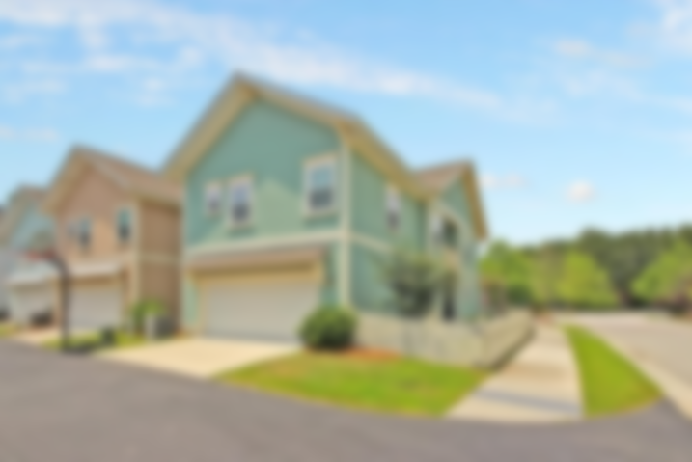
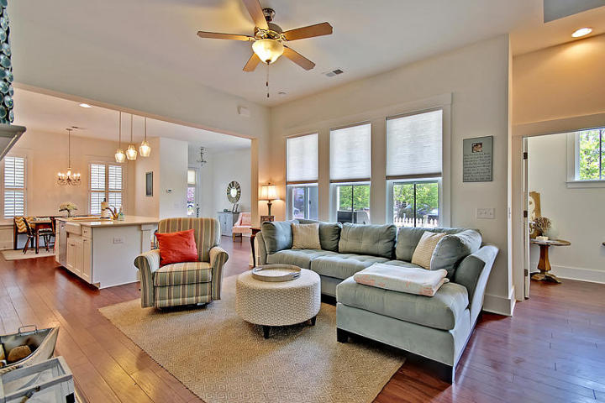
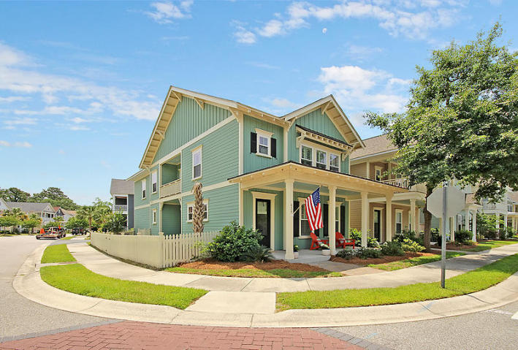
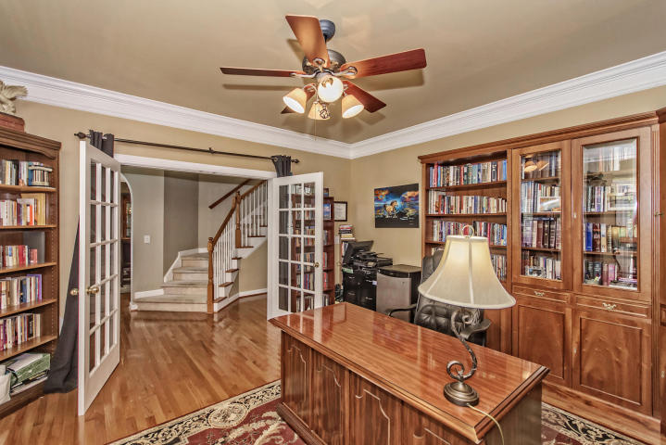
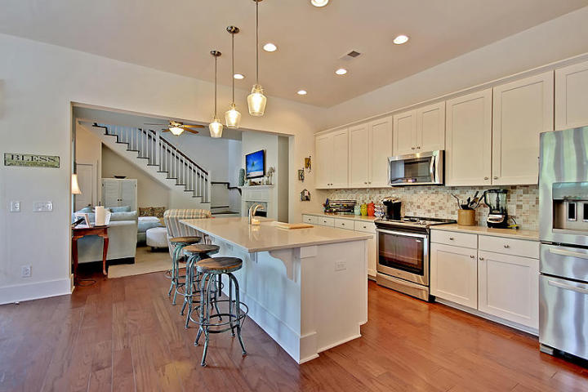
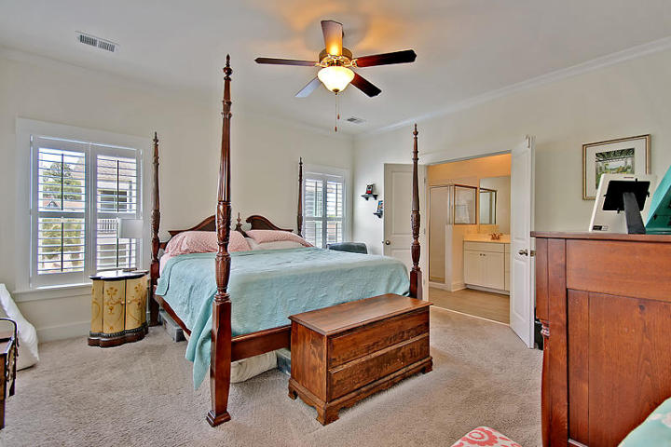
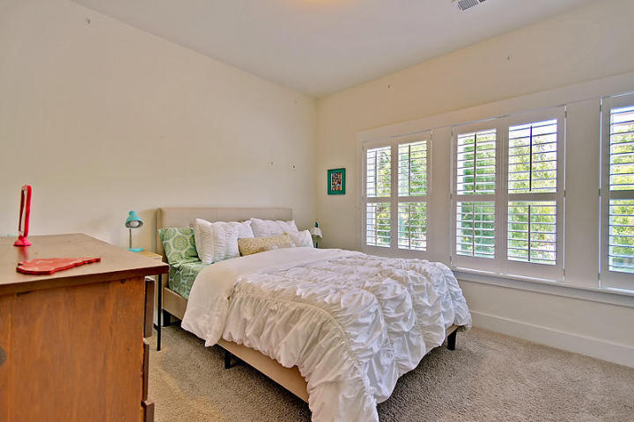
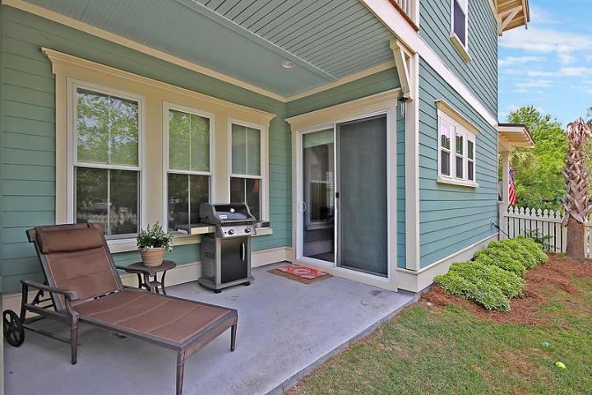
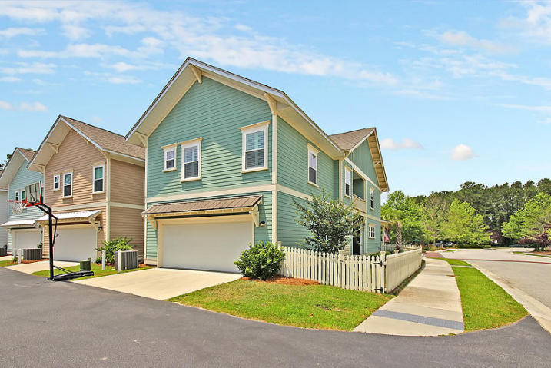

#1 Deal In Mount Pleasant
614 Ellingson Parkway
Moultrie Park ~ Mount Pleasant, SC 29464
MLS# 17013128 ~ $449,900
3 Bedrooms ~ 2½ Bathrooms
Absolute Bargain!
Unbelievable Price!
Location, Location, Location!
Convenient to local schools, I-526, CHS airport, downtown Charleston, recreation center, parks, local shopping and restaurants. This home is almost brand new and priced low and firm for your pre-approved buyer who wants a great deal on the nicest house in Mount Pleasant. Hurry, it won’t last long at this low, low price. Do your buyer a favor and submit a squeaky-clean full-priced offer today and save yourself all the fun of a full-priced counter offer.
Chip Walsh
843-822-4663
chipwalsh@gmail.com
The Boulevard Company, LLC
35 Broad Street
Charleston, SC 29401
www.TeamWalshRealEstate.com

