Slide 1
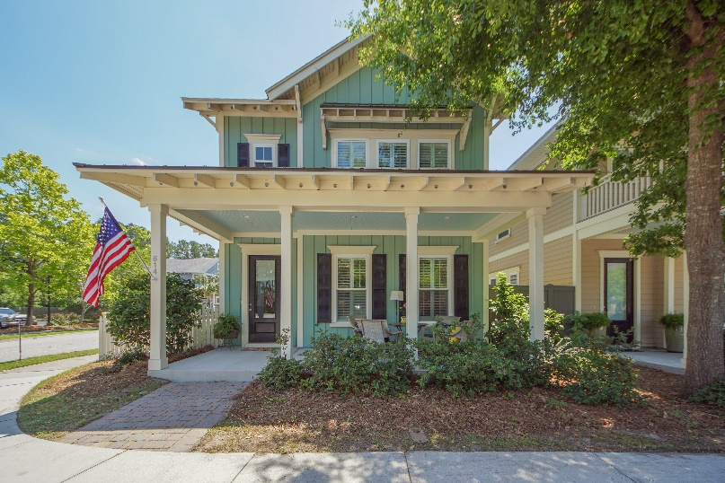
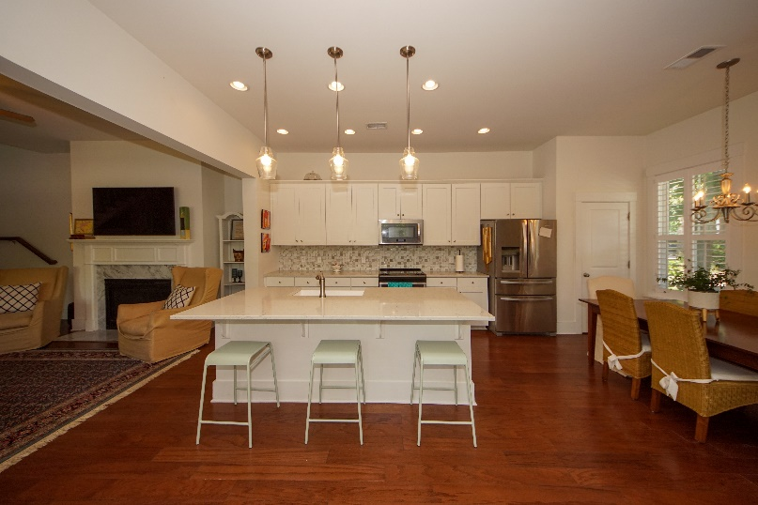
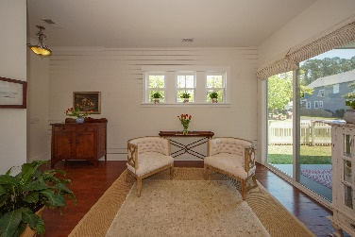
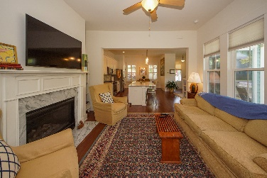
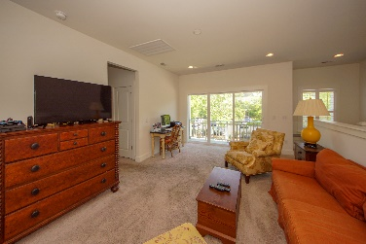
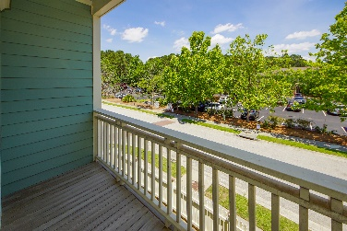
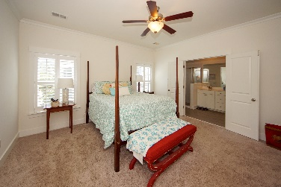
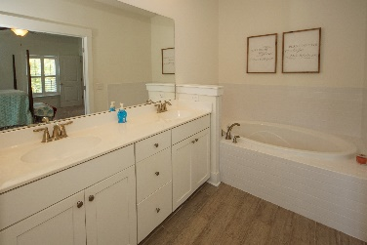
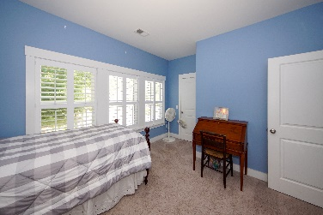
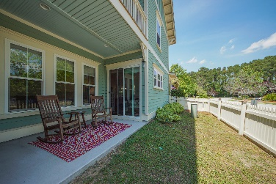
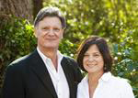

Potential Short Sale!
Open House Saturday from 12-3
614 Ellingson Parkway
Moultrie Park ~ Mt Pleasant, SC 29464 ~ MLS# 20011930 ~ $499,999
Location! Location! Location! Minutes to 526 in much desired Mt Pleasant with excellent schools. Belle Hall Elementary and new high school within walking or biking distance. Right around the corner is Mt Pleasant Recreation center with indoor pool and a variety of programs for children and adults. This adorable home is very low maintenance for professionals who would rather spend their weekends on the water with family and friends. The very open floor plan has a bright, inviting kitchen and is open to dining and family room with fireplace. Upstairs are 3 bedrooms, 2 baths and a huge loft. which is currently used as a home office and kids tv room. Schedule an appointment to see this hidden gem today. NO FLOOD INSURANCE REQUIRED!
Chuck & Edy Mimms
Cell 843-224-9507
Office 843-530-8100
www.sanddollarsc.com
www.facebook.com/Sanddollarsc
Sand Dollar Real Estate Group | 2205 Middle Street | Suite 203, Mailbox 2 | Sullivans Island, SC 29482

