Slide 1
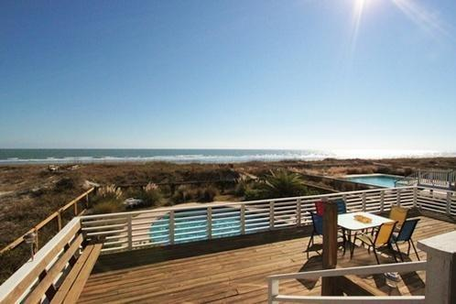
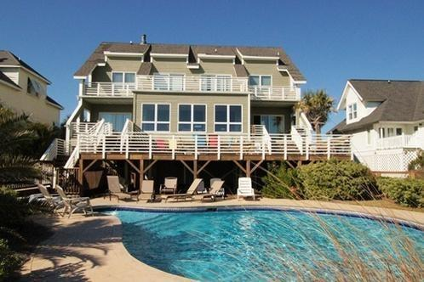
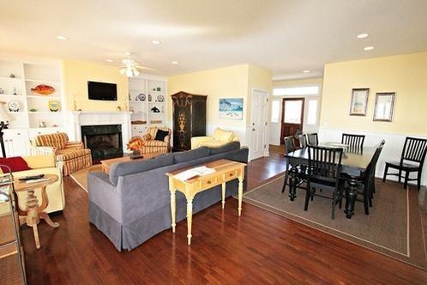
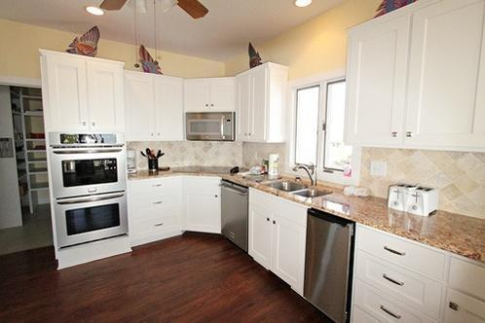
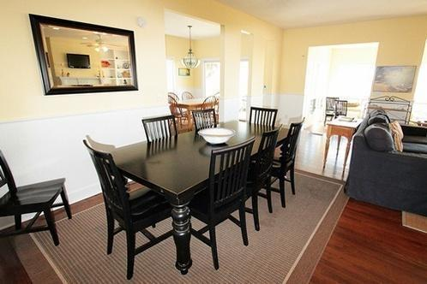
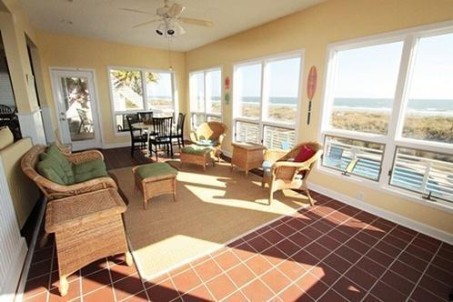
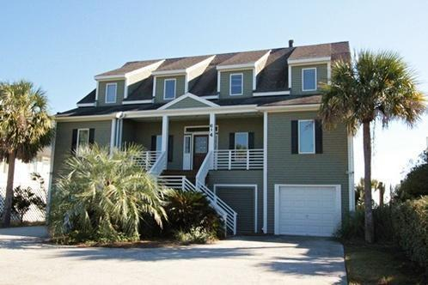
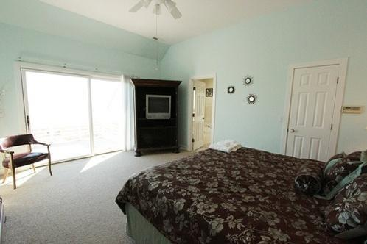
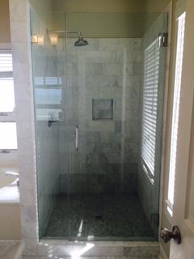
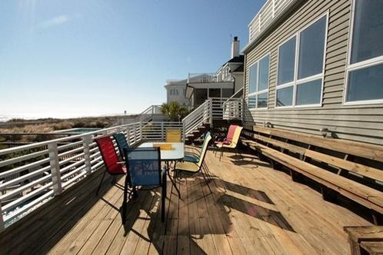
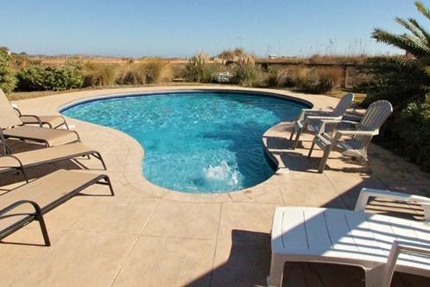

Best Deal on Front Beach! Bring all Offers!
614 Ocean Boulevard
Isle of Palms, SC 29451 ~ MLS# 14031443 ~ $2,795,000
Wonderful opportunity to own this spectacular Oceanfront home with all the bells and whistles! This home is located in one of the most sought after sections of beachfront on the Isle of Palms. Close enough to walk to the village area but definitely a quiet section of the Island. 614 Ocean is sitting on well over a half an acre of a beautifully landscaped oceanfront lot. This six bedroom home is perfect for fun family year-long living, second home or an income producing rental. The large open floor plan makes this home ideal for entertaining or hosting large family gatherings. There are spectacular ocean views from almost every room in this spacious, custom home.
The Master Bath has just been renovated and it truly makes the Master Suite a special place, with its own private deck overlooking the Atlantic ocean! There are many special features in this home, they include an alarm system, two outdoor showers, three parking spaces in the garage along with plenty of parking in the driveway, tons of storage, high ceilings ,gas fireplace and built-ins, large decks, beautiful pool and patio leading out to the private boardwalk down to the beach. Priced to sell, this one will not stay on the market long!
Holly Covington
Office - 843-971-1312
Mobile - 843-442-4560
hcovington@thebeachcompany.com

