Slide 1
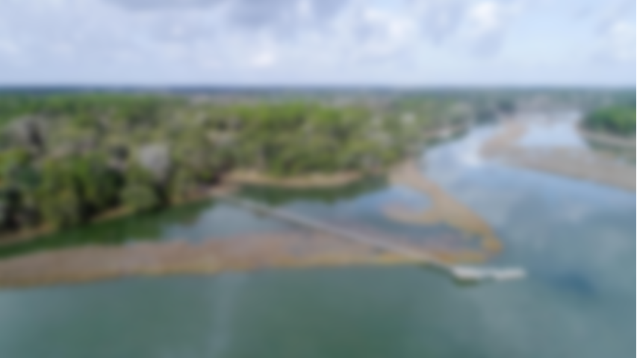
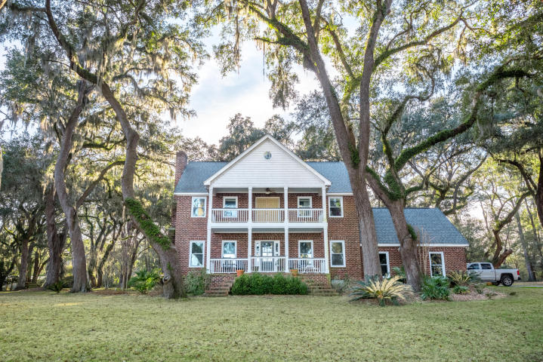
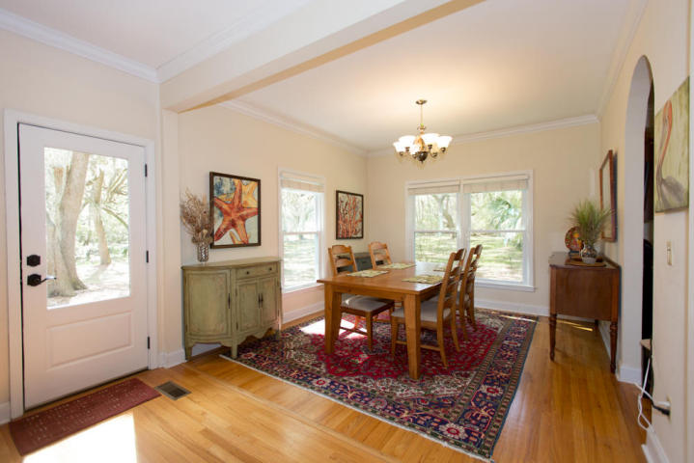
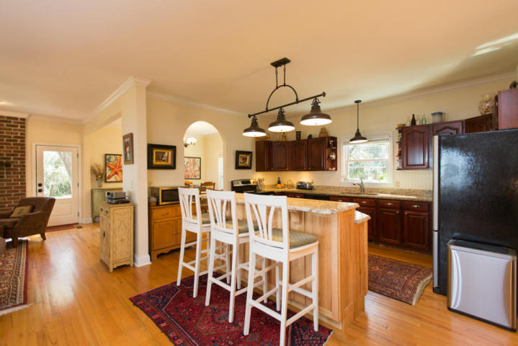
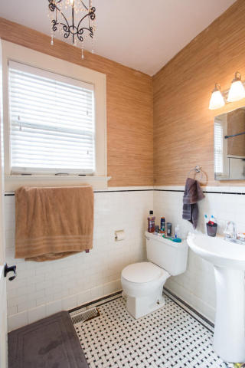
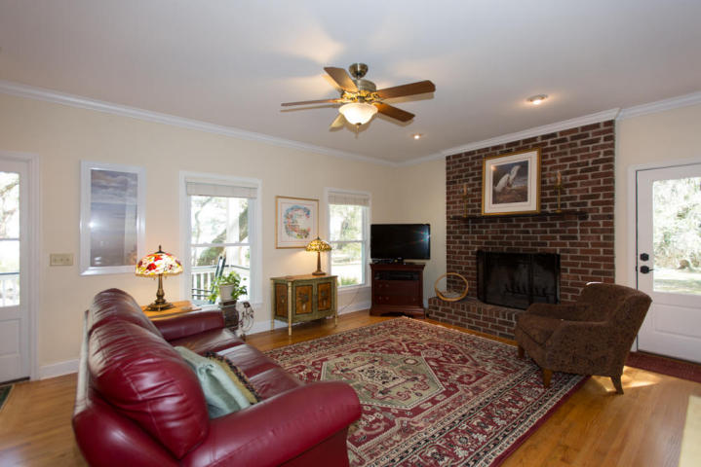
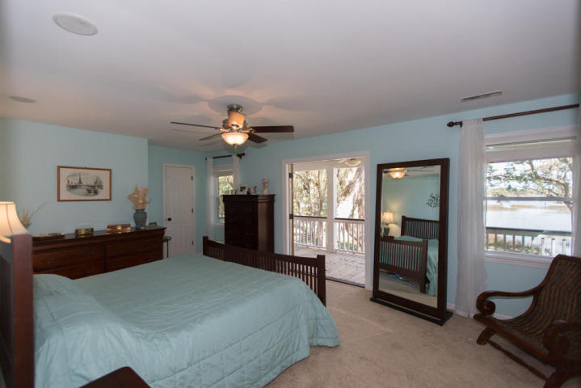
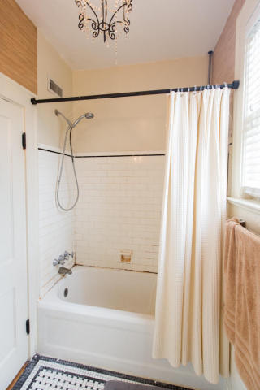
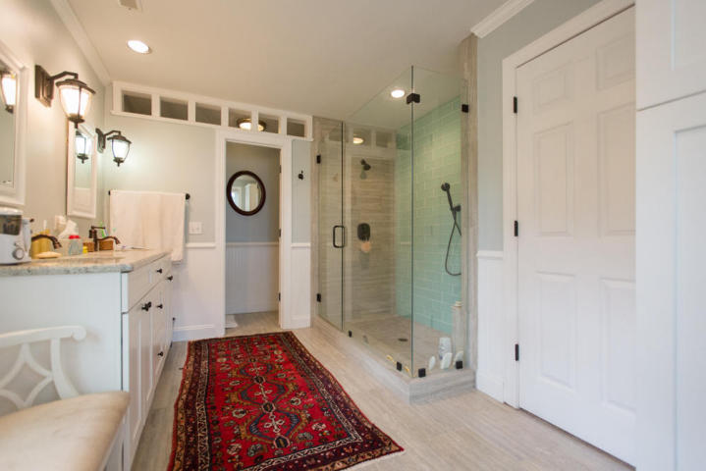
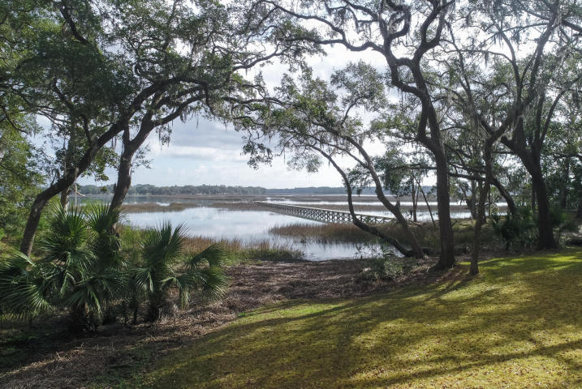
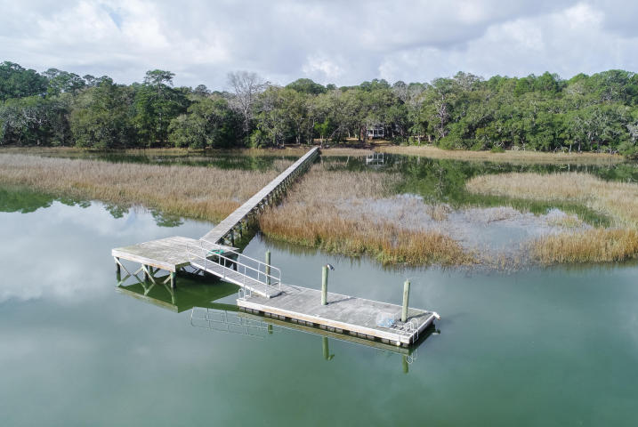
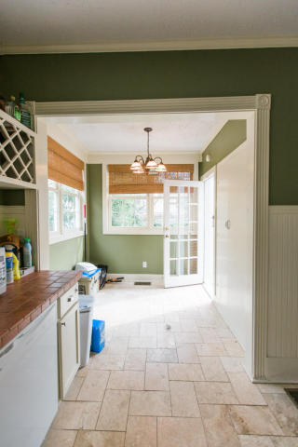

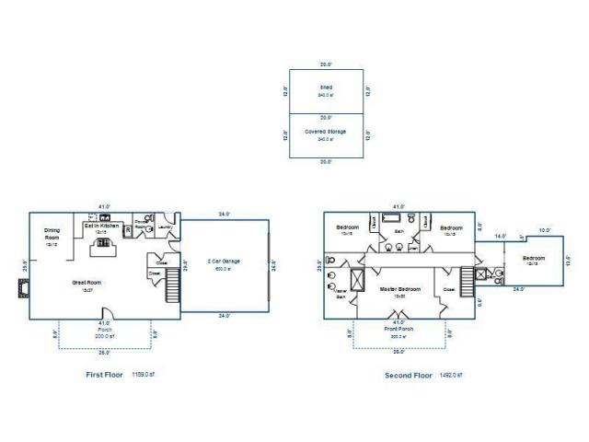
6150 Rockefeller Road
Yellow House ~ Wadmalaw Island, SC 29487
MLS# 18004929 ~ $1,125,000
Elevated brick home on 5 acres with deep water dock. Come enjoy the lowcountry! Four bedrooms/3.5 baths. Open floor plan with views everywhere. Master bedroom is upstairs with new bath, private porch and a huge walk in closet. Spacious third floor could be finished off for more space. See the photos, video, floor-plans and more online and then come see for yourself!
Marion Jackson
Mobile - (843) 442-4404
marionjacksonrealtor@gmail.com
Charleston Property Brokers | 151 St. Philip St. Apt A | Charleston, SC 29403

