Slide 1
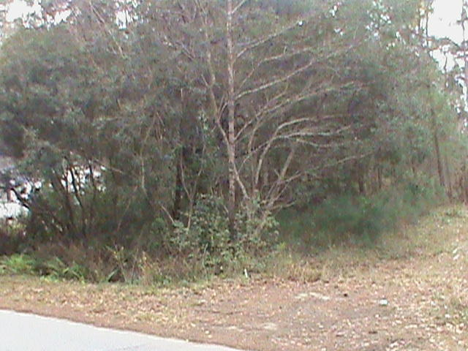

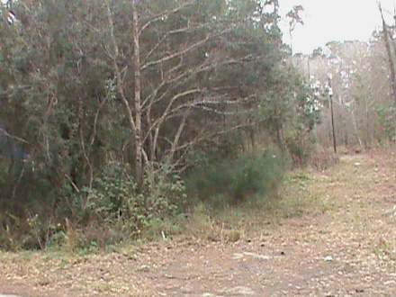
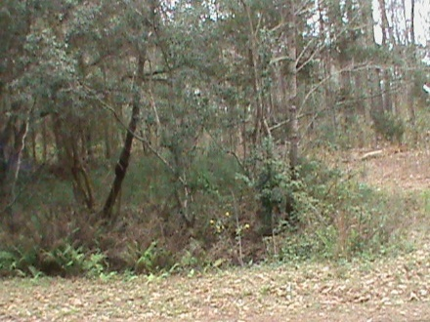
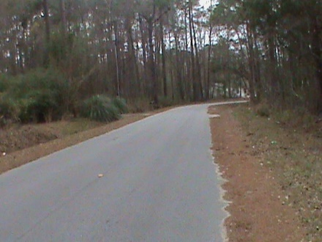

Vacant Lot
Perfect for a Couple
6159 Smith Road
Ravenel Acres ~ Ravenel, SC 29470 ~ MLS# 17005456 ~ $19,500
Come build your new home!
Quite location. water available, and septic. A mobile home once occupied the property in the past.
Coastalina Realty of Charleston
916 Palm Blvd
Ste 101
Isle Of Palms, SC 29451
Sandra Moultrie, REALTOR
(843) 532-9715
sandra_moultrie@bellsouth.net
coastalinarealtyofcharleston.com

