Slide 1
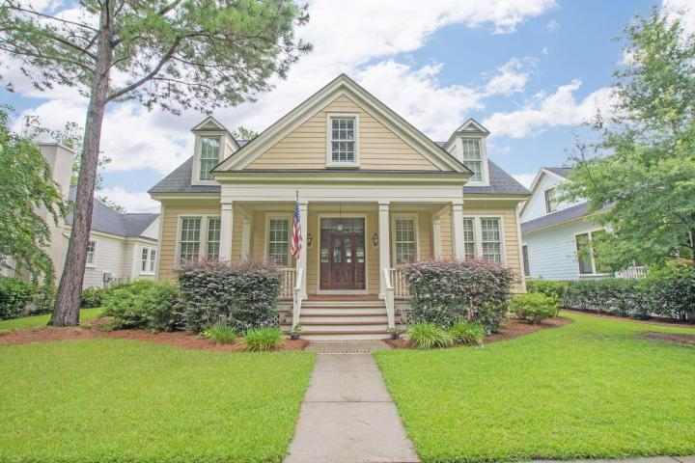
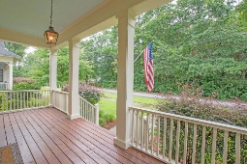
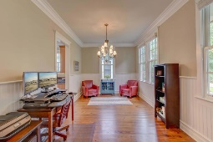
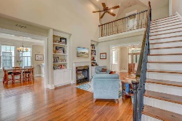
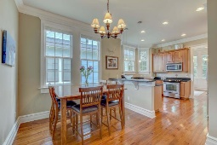
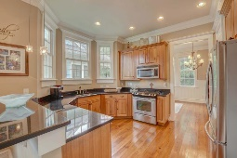
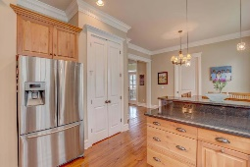
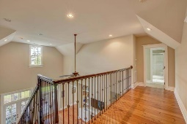
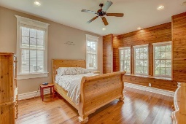
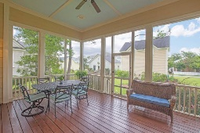
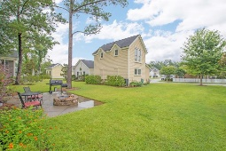
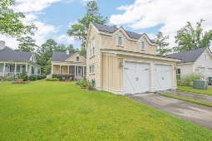
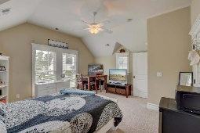


Gorgeous Summerville Home
Detached MIL Suite w/ Rental Income Potential
615 N Hickory Street
Daniels Orchard
Summerville, SC 29483
MLS# 18021204
$414,900
5 Bedrooms | 4½ Baths | 3,031 sf
Exquisitely crafted Summerville luxury home - close to everything the Lowcoutnry has to offer & zoned for Dorchester District 2 schools! Part of the original series of upscale homes built in Daniel's Orchard, this Master-Down beauty epitomizes Lowcountry style with a mahogany front door, elegant gas lamps & a wide front porch overlooking a quiet street - perfect for rocking chairs & sweet tea! This home was originally built for the developer's daughter & it shows in the quality: 5'' antique heart pine floors, crown molding, wrought-iron railings, cement plank siding, fully encapsulated crawlspace & much, much more! Enjoy entertaining friends & family on the patio & huge screened-in back porch. As a bonus, earn some extra rental income from the detached MIL suite. Book your showing today!
The main house is 2720 SqFt with 4 bedrooms & 3.5 baths & the detached MIL Suite adds an additional 312 SqFt & its own full bath.
Another example of the extra quality of this home is the engineered truss system subfloor that is of a much higher grade than a standard built home.
The location of Daniels Orchard truly is centrally located with easy access to I-26 (Most Lowcountry jobs are a manageable drive from here), Downtown Summerville & extensive shopping - all while residing within the renowned Dorchester District 2 school zone.
Jim Brantley
(843) 412-7647
brantleyjim@gmail.com
AGENTOWNED PREMIERE GROUP | 1800 TROLLEY RD | SUMMERVILLE, SC 29485

