Slide 1
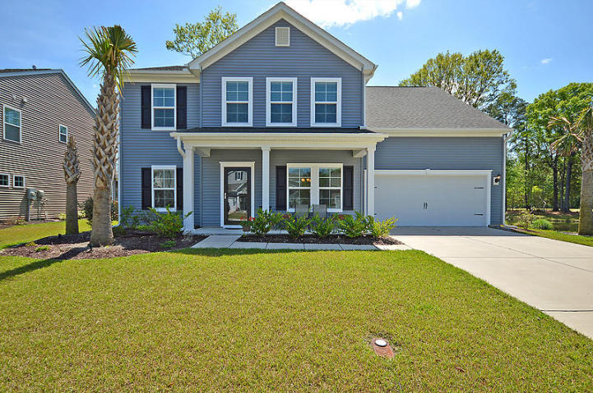
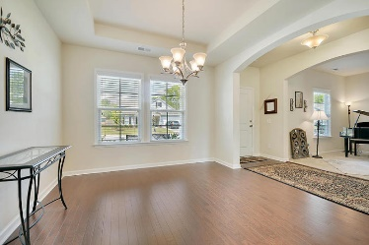
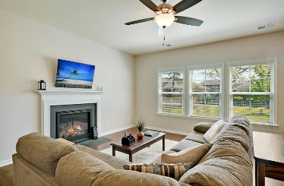
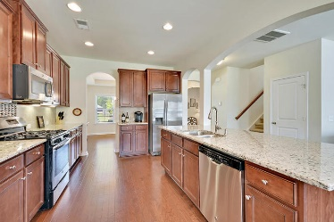
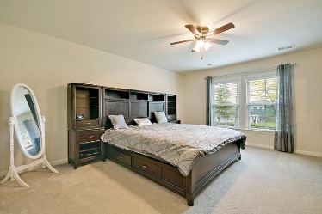
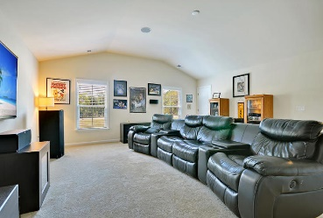
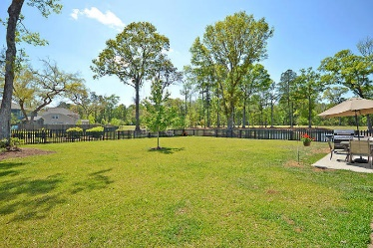
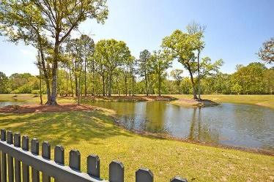

615 Pasdalum Court Grand Bees · Charleston, SC 29414 MLS# 18009809 · $399,000
Gorgeous Listing
New Listing with Awesome Lot & Pond Views!!
Beautiful 4 bedroom, 2.5 bath home on large, PRIVATE, fenced lot with awesome water views of pond! This home has a tandem garage which allows garage parking for 3 vehicles. From the covered front porch you enter the foyer with handsome engineered hardwood floors and an abundance of natural light. The dining room is on the right and flex space which could be an office/music or living room is on the left. Continuing in is the gourmet chef's eat-in kitchen with HUGE island, granite counter tops, 42'' cabinets, stainless steel appliances, tile backsplash and GAS stove. The kitchen is open to the family room with gas burning logs fireplace. Finishing off the first floor is a nice guest bath. Upstairs is the master suite that overlooks the large backyard with ensuite spa-like master bath with dual sinks, relaxing soaking tub, separate shower, and walk-in closet. There are 3 additional big bedrooms and ALL have walk-in closets and share a full bath. The forth oversized bedroom/bonus room is set up as a phenomenal media room equipped with 7.1 channel surround sound speakers that any movie lover enthusiast would envy. Also, there is a very large walk-in easy access attic storage area off the hallway. Grand Bees is a wonderfully landscaped community. The neighborhood is close to parks, walking trails, local shopping and grocery stores and is a short drive to downtown Charleston with 5-star restaurants, world class shopping and iconic history as well as a short drive to the beaches, the airport, Boeing and Daniel Island. This home has it all-an entertainers dream! Call today to be the first to see!
Stan Huff
843-670-2835 stan.huff@agentowned.com
Jill Marcacci
843-297-5590 jill@agentowned.com
www.agentownedrealty.com
AgentOwned Realty Co. Preferred Group, Inc. | 824 Johnnie Dodds Blvd | Mt Pleasant, SC 29464

