Slide 1
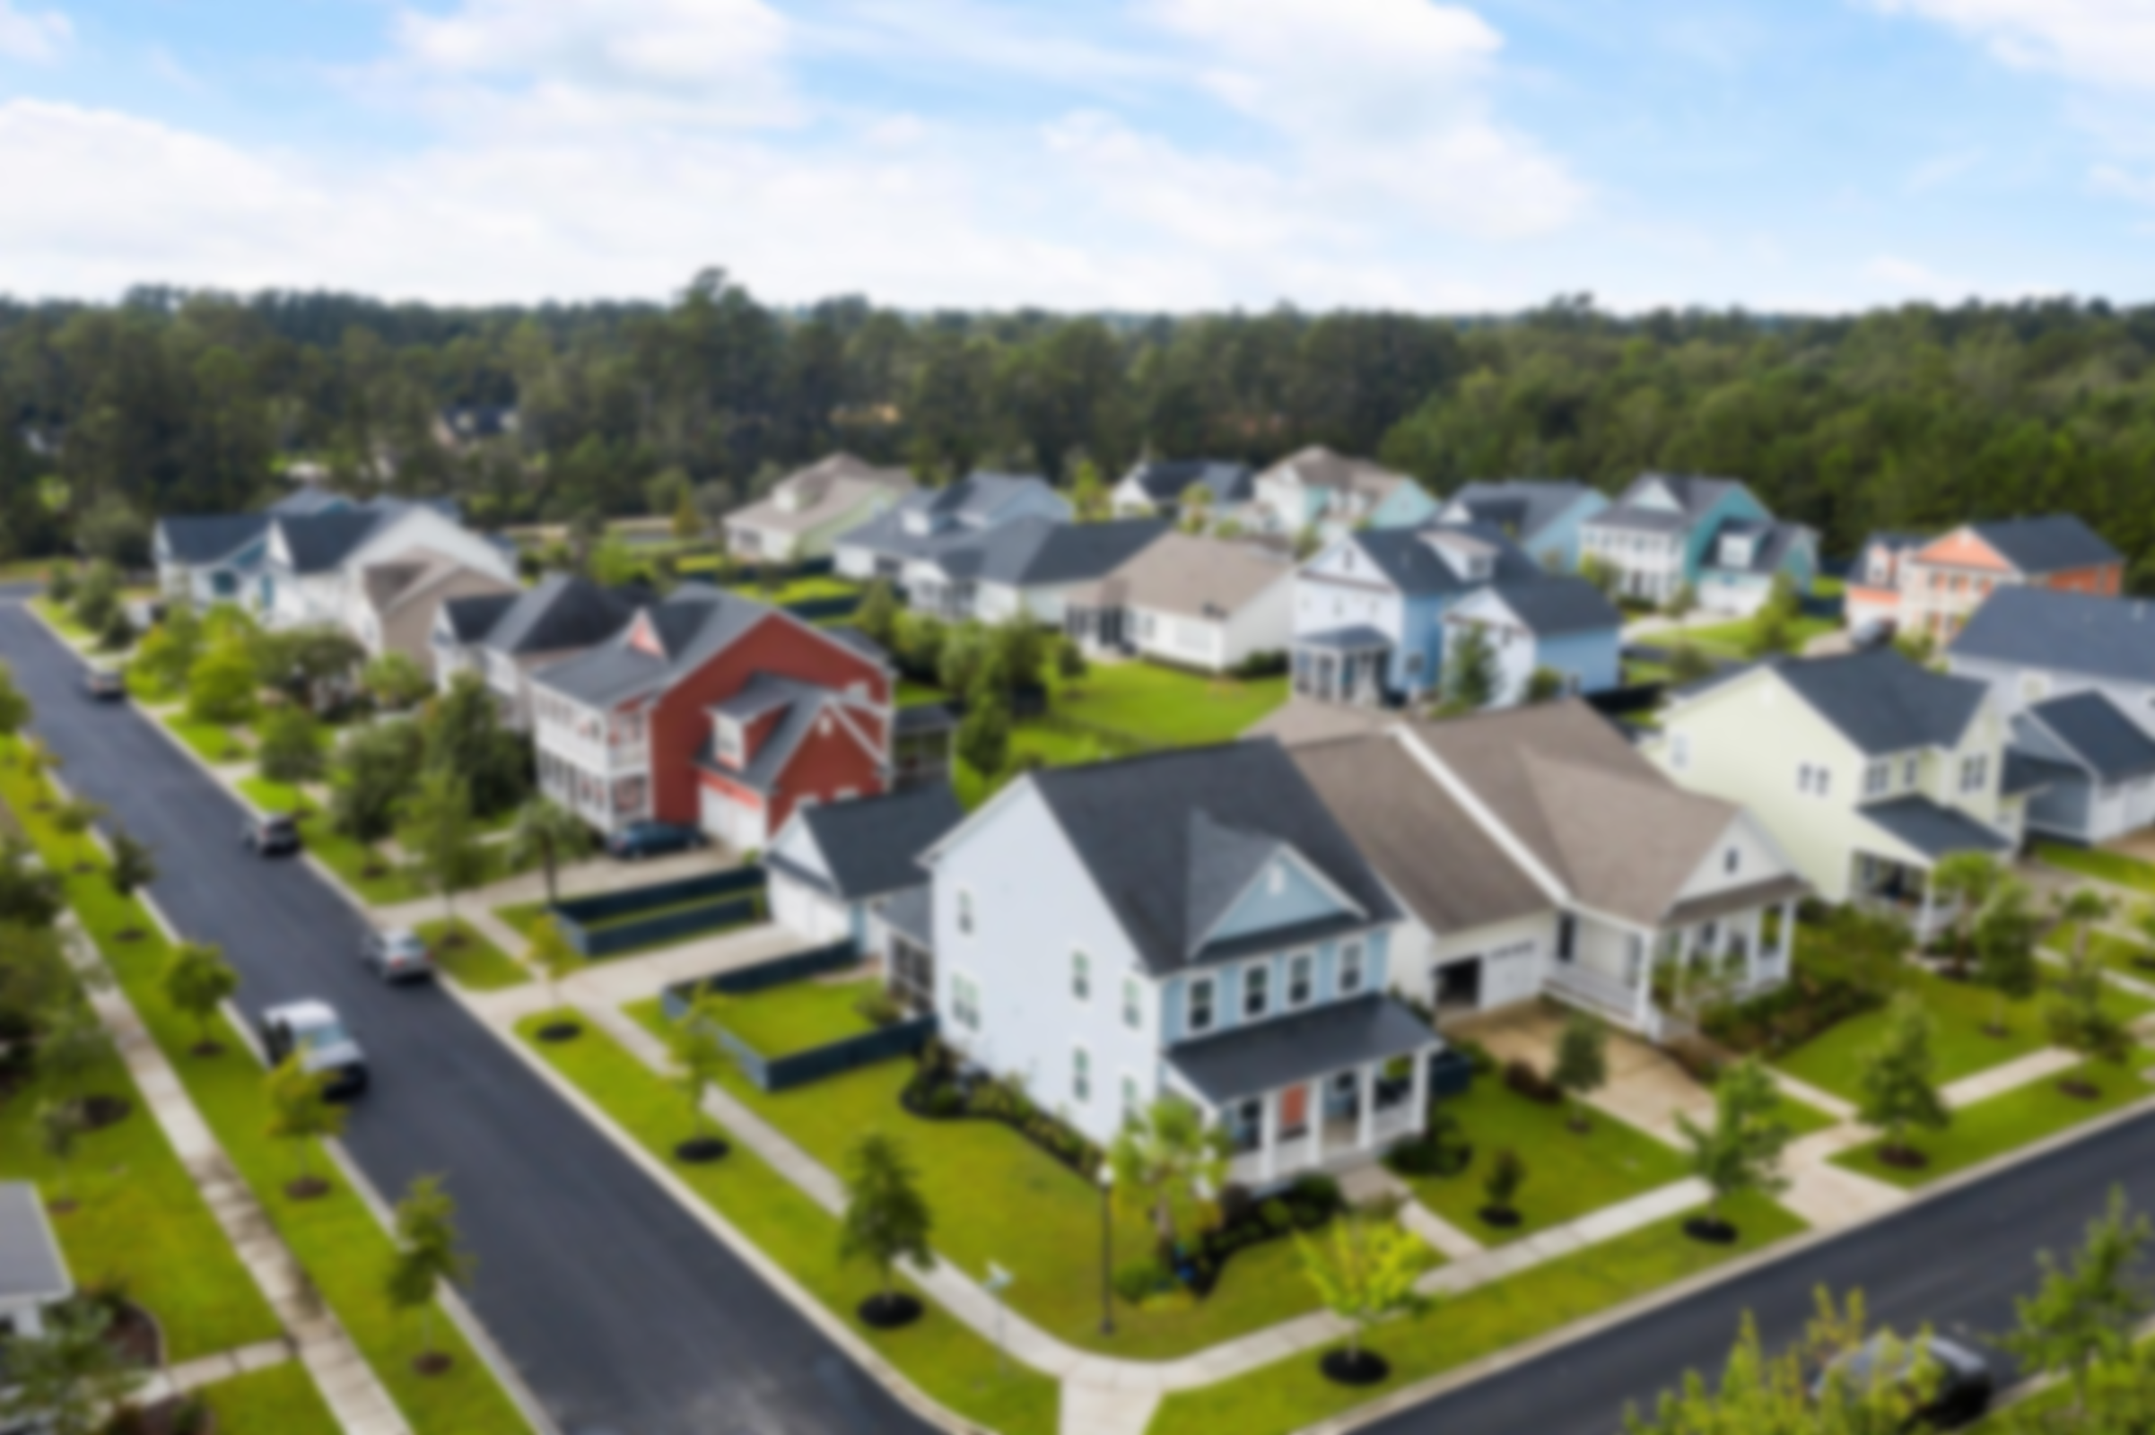
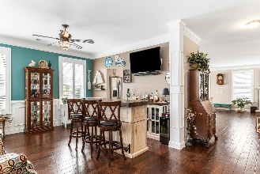
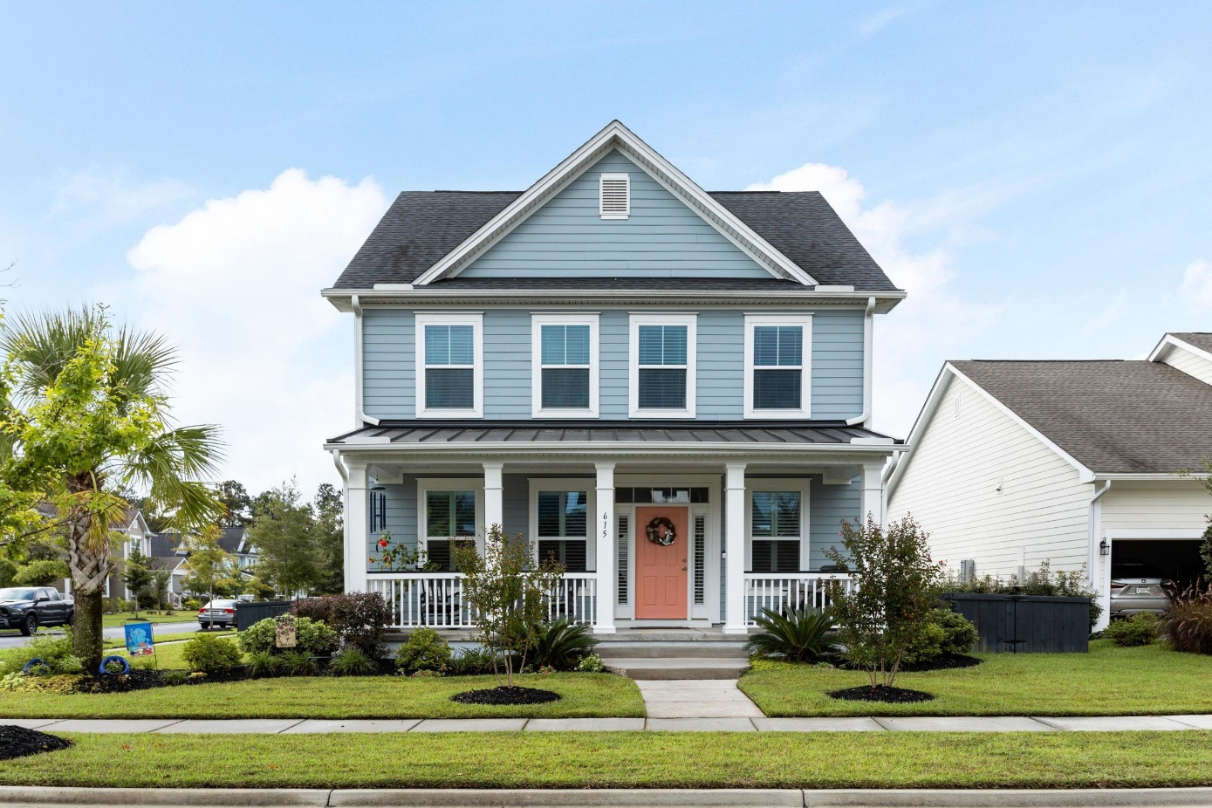
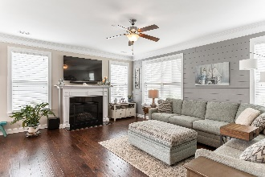
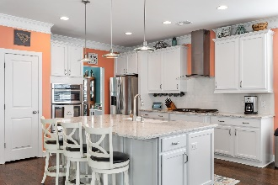
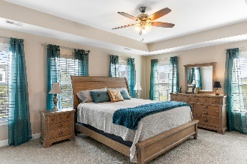
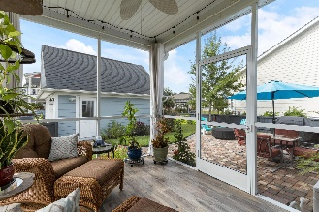
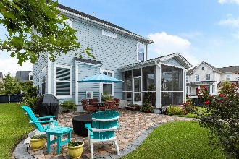
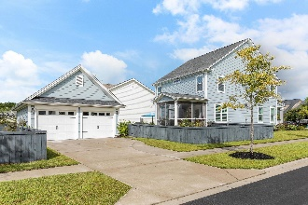
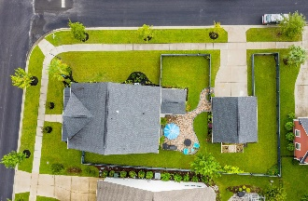


Welcome To Your New Home!
615 Van Buren Drive
Carnes Crossroads | Summerville, SC 29486
MLS# 20026021 | $379,900
This stunning home has everything that you need and more. Why build and wait when you can have so much more right away? Once you walk through the door you will notice that this home has been meticulously maintained with many option upgrades. This home offers an extensive upgraded trim package, gourmet kitchen with built-in oven and microwave, white cabinets, quartz counters, farmhouse sink, vent hood that actually vents outside, hardwood floors throughout the main, plantation shutters, shiplap walls in family room, formal dining can be used for office or sitting room (currently used as a pub), brand new carpet and padding on 2nd floor, laundry room has upper cabinets for storage. The oversized owner's suite has the ultimate closet complete with California Closet organizer. The backyard is your own private oasis with a screen porch that has wood-look tile flooring and opens to beautiful custom paver patio for entertaining and a place to put your own fire pit. The backyard has more space than you would expect and offers flower gardens as well as a raised vegetable garden bed. Exterior has gutters installed, irrigation and was painted in Spring 2019. Sidewalks and driveway are pressure washed every year. Residents have access to the community pool, Green Barn (clubhouse), several stocked lakes (one has a dock for kayaks and fishing), dog-park and multiple playgrounds around the neighborhood as well as miles of walking/biking trails to explore. Take a quick golf-cart ride or stroll up to the pool and local restaurants this home is only a few streets away. Carnes Crossroads is a sidewalk lined master planned community with convenience as top of mind ~ schools, places of worship, medical facilities, restaurants, shopping and retail stores are all within the neighborhood footprint.
Sarah Gipe Yandle Cell 843-991-1161 | sarah.gipe.yandle@carolinaone.com
Carolina One Real Estate | 195 W Coleman Blvd | Mt Pleasant, SC 29464-3495

