Slide 1
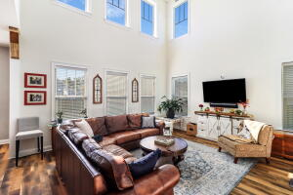
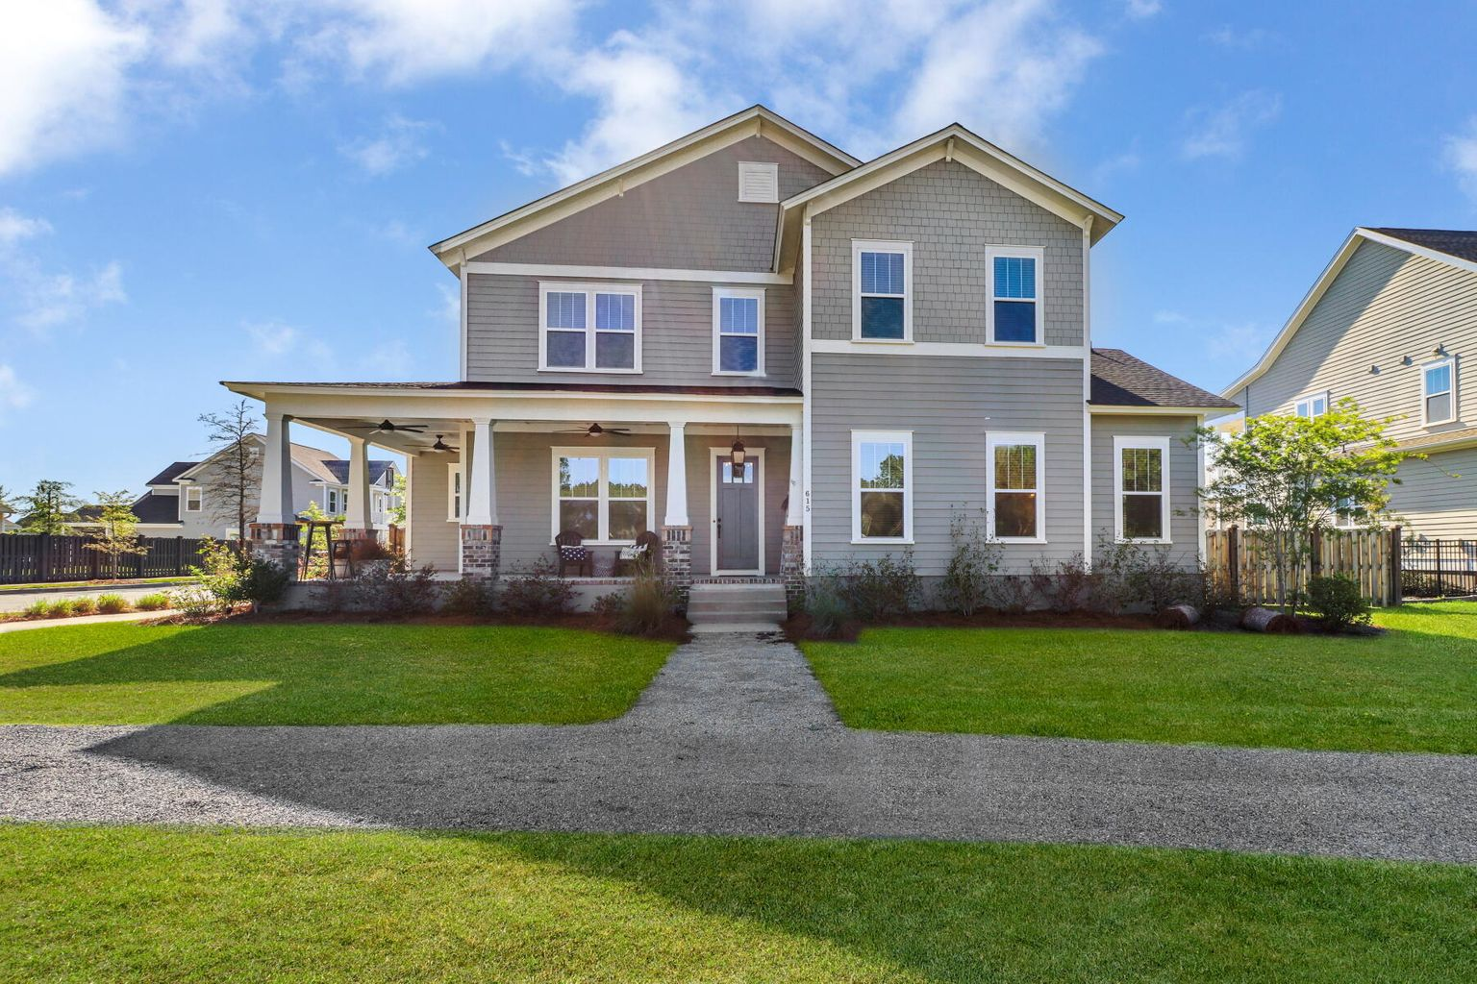
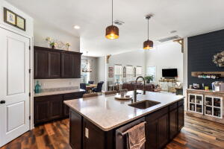
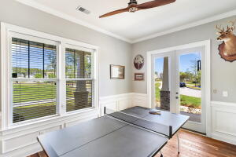

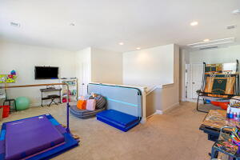
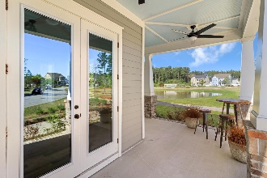
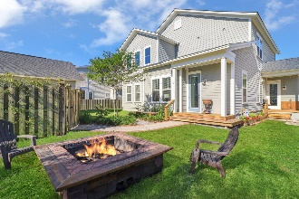
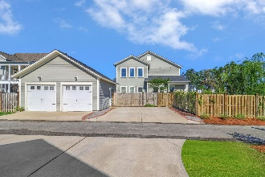


615 Water Lily Trail Summers Corner | Summerville| MLS# 22008883 | $635,000
A Must See in Summers Corner!
Open house 5/14 ~ 12-2pm
Welcome to 615 Water Lily Trail located within the wonderful Summers Corner neighborhood! Conveniently located near several amenities, 18 mins to the Town of Summerville, and 43 mins to downtown Charleston! From the inviting wrap around front porch, to the gourmet kitchen, to the huge first floor master suite, this home is sure to check off all your wants and needs. Enter through the spacious foyer that leads to the open concept family room, kitchen, and separate dining area. The family room has wonderful natural light, two story ceiling height and plenty of room for furniture arrangement. The kitchen becomes a gathering place when company arrives. Grab a seat at the large kitchen island, or converse while having a dinner party in the separate dining area. There is ample amounts of cabinet space for all your kitchen accessories along with a butler's pantry equipped with a wine fridge. The huge master suite has beautiful views of the pond, a sitting area, dual walk-in closets, and a large en-suite with dual vanities, a tiled shower, and a tiled surround garden tub. Three additional bedrooms and two more full bathrooms are on the second floor along with a nice sized loft. Bring the family and friends outside to entertain around the large firepit or enjoy an outdoor game in the spacious backyard. This home has so much to offer along with many upgrades! Schedule your showing as soon as possible so you don't miss out in owning this wonderful home!
Brandon Ray
(843) 499-1928
brandon.ray@carolinaone.com
www.therightrayhome.com
Carolina One Real Estate
900 N Main St
Summerville, SC 29483

