Slide 1
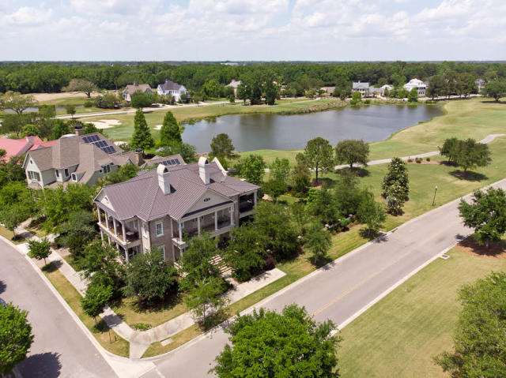
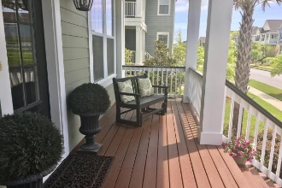
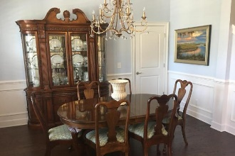
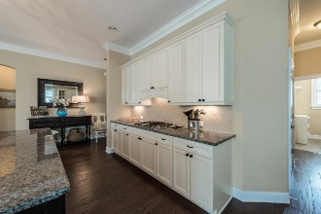
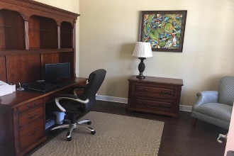


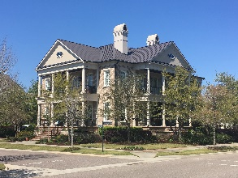
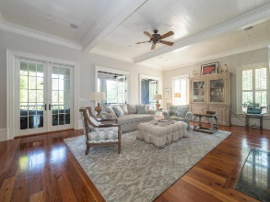
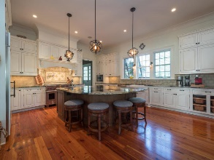
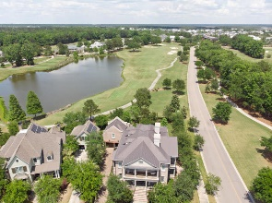


616 Cattle Street
Daniel Island Park ~ Charleston, SC 29492
MLS# 18011227 ~ $1,999,900
Price Reduced $100,000
Golf Course Views From 6 Porches
5 Bedrooms / 5.5 Baths
6,596 Sq Ft
Beautiful Gardens And Yard
Open Floor Plan
Elevator
Wine Room
Outdoor Kitchen/Entertaining Area
Don't miss out on this wonderful opportunity!!
Donna Landry
Mobile - (225) 921-2111
donna.landry@cbunited.com
Coldwell Banker Residential Brokerage
1127 Queensborough Blvd. 103
Mt Pleasant, SC 29464
Betsy Sarsfield
(724) 816-9445
betsysarsfield23@gmail.com

