Slide 1
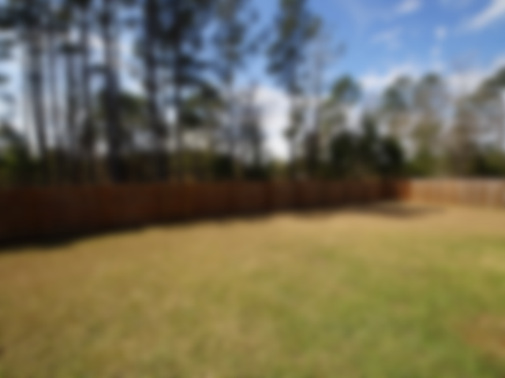
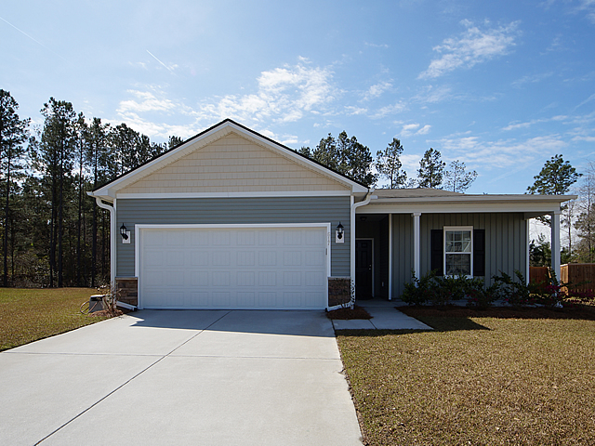
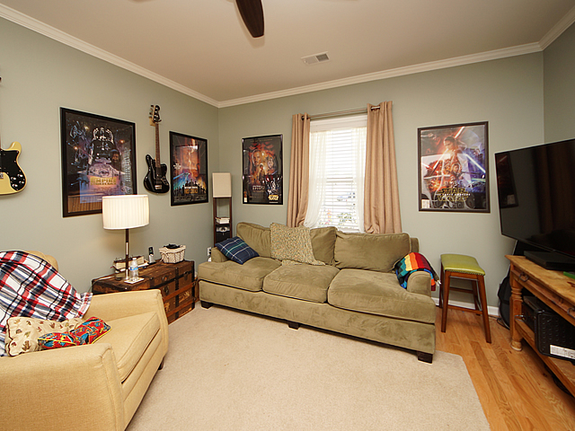
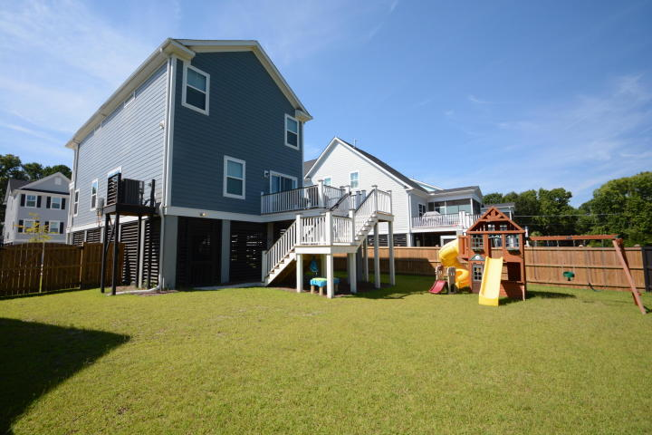
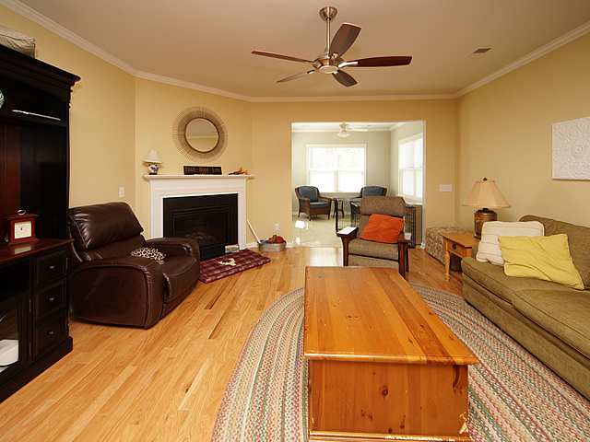
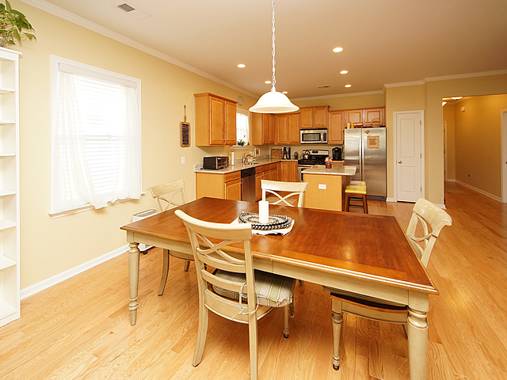
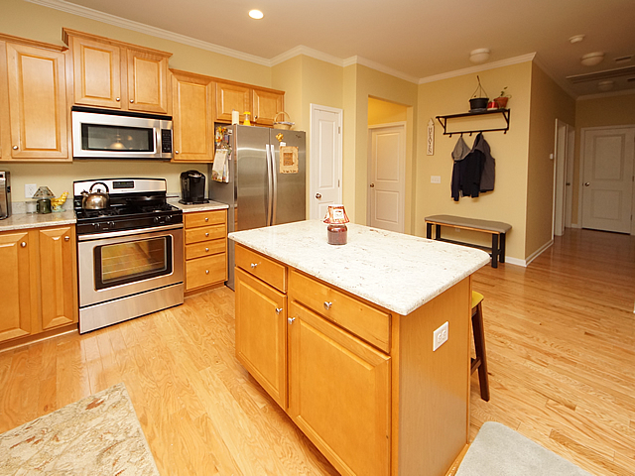
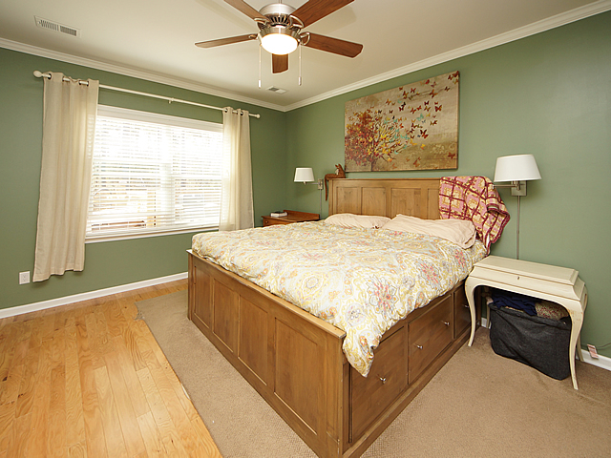
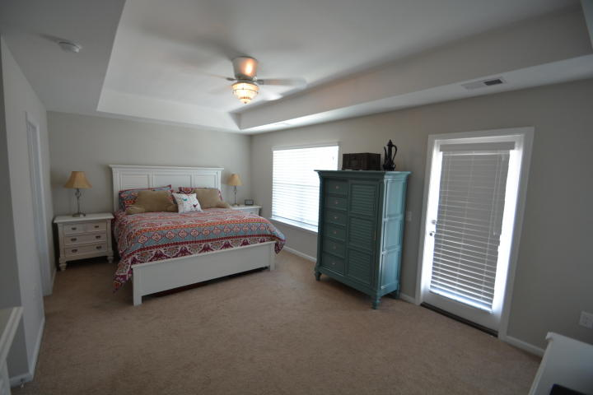
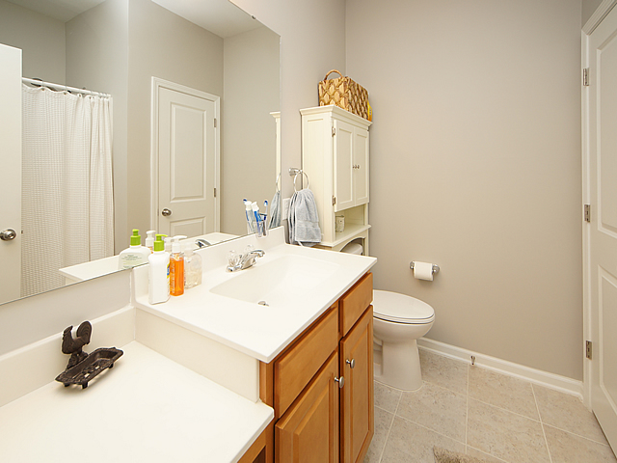
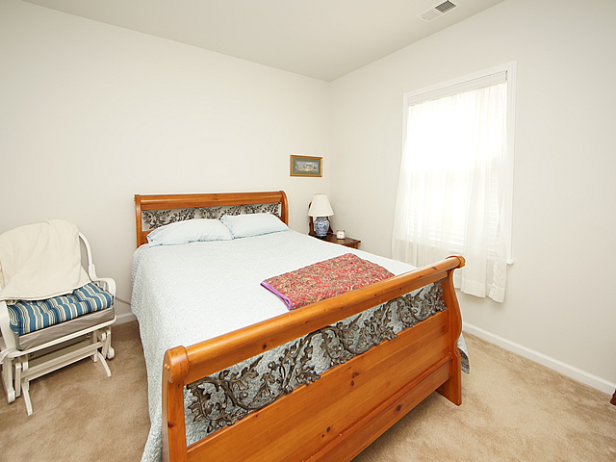
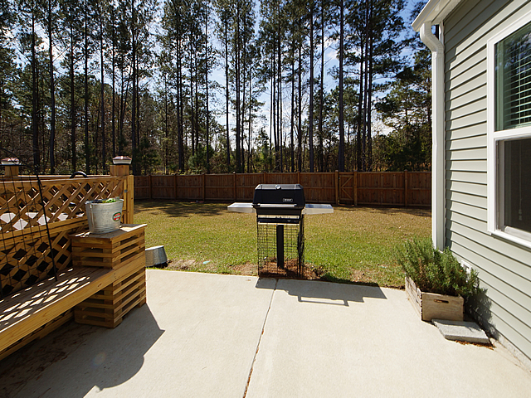
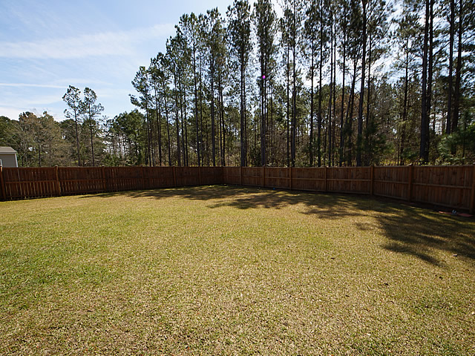
Handicap Accessible 1 story in Cane Bay Plantation
617 Bridgewater Court
Summerville, SC 29483
MLS# 18010058 ~ $262,000
One of the largest and most private lots in Cane Bay!
Also, a big plus this home offers is handicapped accessible features that can stay with the home or be removed depending on the new owners preference. This large Cul-de-sac lot backs up to a large wooded buffer adding to the private enjoyment this home has to offer. This one story home has been maintained meticulously and it shows. The home is set upon a very high lot with privacy fence. There are very few one story homes available on the market and this one is priced right, so don't miss this opportunity to own an almost brand new home with possibly the largest/nicest lot in Cane Bay. Cane Bay is close to shopping and the schools are right in your neighborhood...it's an all inclusive neighborhood that is hard to beat!
Johnny Crosby
(843) 270-9407
jcrosby@propertyadvisorsinc.com
www.charlestonhomeproviders.com
Brand Name Real Estate
4 Carriage Lane Suite 106
Charleston, SC 29407
Michael Albenesius
(843) 343-5870
m.albenesius@gmail.com

