Slide 1
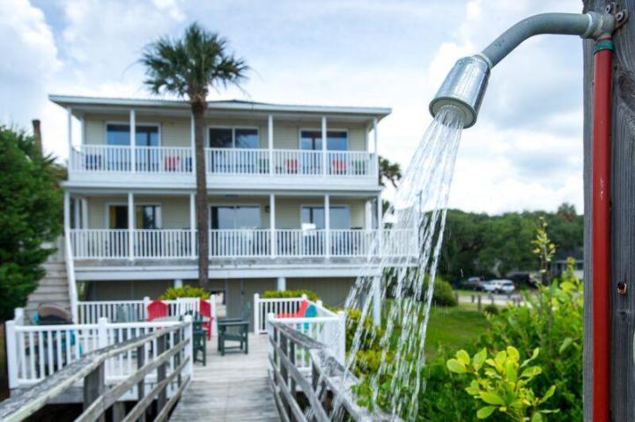
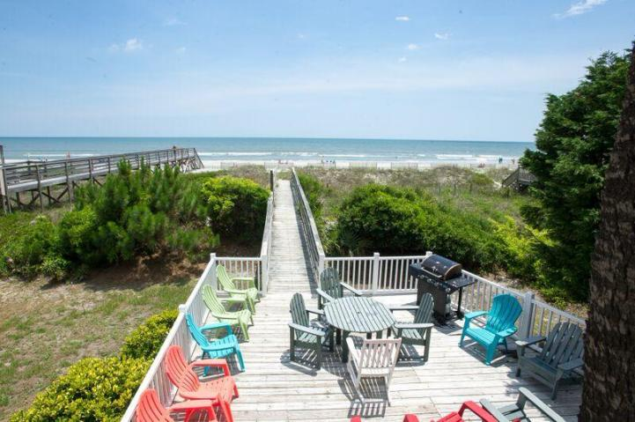
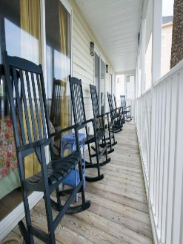
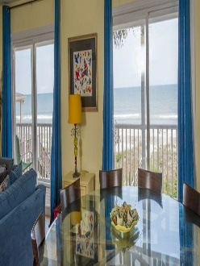
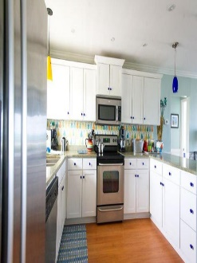
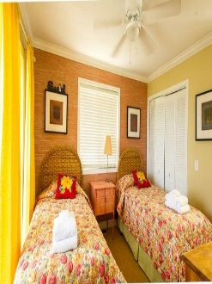
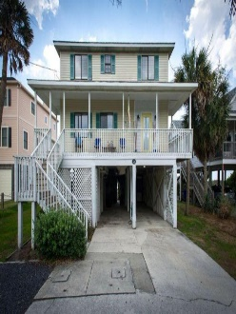


Ocean Front ~ $100,000 in Rental Income
617 W Ashley Ave
Folly Beach, SC 29439
MLS# 15015155
$1,500,000
****FIRST TIME ON MARKET SINCE 1990 and strong rental income****
Stunning oceanfront home that sleeps 21 people comfortably. Owner has meticulously kept this home in tip top shape and is a must see. Interiors have too many upgrades to list here. Great flow of space and the views, sunsets and porches are fantastic. Home is on the highly sought after WEST SIDE of Folly beach. GREAT HOME FOR A PRIVATE RESIDENCE or, continue with income producing tenants.
Bryan Thompson
Office - (843) 769-5100
Mobile - (843) 452-1686
bryan.thompson@agentownedrealty.com
www.bryanthompsonrealestate.com
AgentOwned Charleston Group | 902 Savannah Hwy | Charleston, SC 29407-7802

