Slide 1
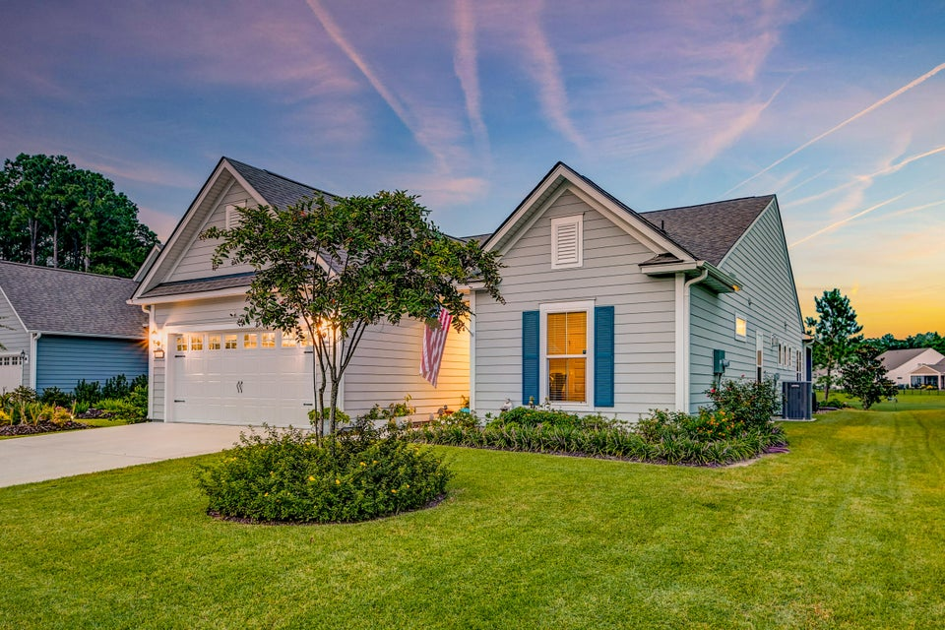



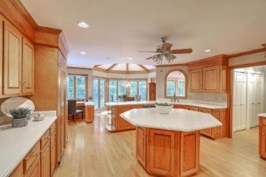
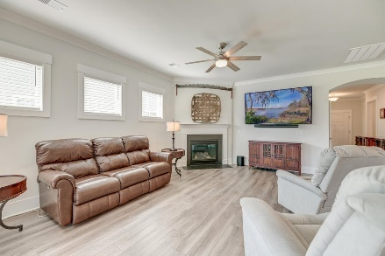



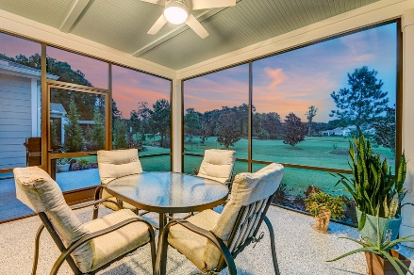

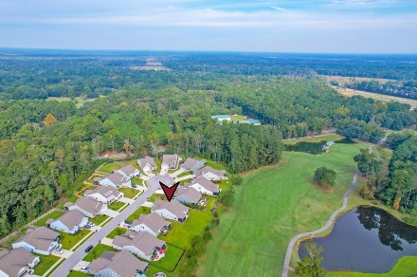
Parkshore Marshfront
Dream Home in Stono Ferry
6180 Wilkes Pond Drive
Reserve at Stono Ferry | Hollywood, SC 29449 | MLS# 24025122 | $715,000
Welcome to your dream home on the Links at Stono Ferry Golf Course in the prestigious Reserve at Stono Ferry! Imagine starting and ending each day enjoying the golf course views from the comfort of your home and backyard. Ranked Top 15 Courses You Can Play in SC (2021) by GolfWeek and awarded the Charleston Area Golf Course of the Year Award, the Links at Stono Ferry offer a fun and challenging golf experience in an incredible Lowcountry setting. Enjoy marsh and water views as you traverse this exceptional course, then head back to your home within this remarkable community. Situated at the Women's tee box on the #3 Fairway, this single-story home was built in 2022 and delivers luxury, upgrades, and style. From the moment you arrive, the attractive exterior and curb appeal draw you in, hinting at the beauty within. Step inside to be greeted by upgraded LVP flooring, crown molding, and a sun-drenched open floor plan.
Situated in the sought-after golf community of Stono Ferry, home to the annual Steeplechase of Charleston horse race, this property offers both exclusivity and convenience. The Club at Stono Ferry offers a fantastic fitness center as well as The Stono Grill, offering delicious breakfast and lunch options. Stono Ferry is also home to the Stable at Stono Ferry, perfect for those who prefer to board their horse close to home. Located just over 1 miles from Old Wide Awake Plantation, 7.7 miles from West Ashley Circle, 10.3 miles from I-526, and 15 miles from downtown Charleston, you'll enjoy easy access to shopping, dining, and entertainment. Don't miss the chance to call this extraordinary property home!
Caroline Treece ctreece@mattoneillteam.com 843-754-0050

