Slide 1
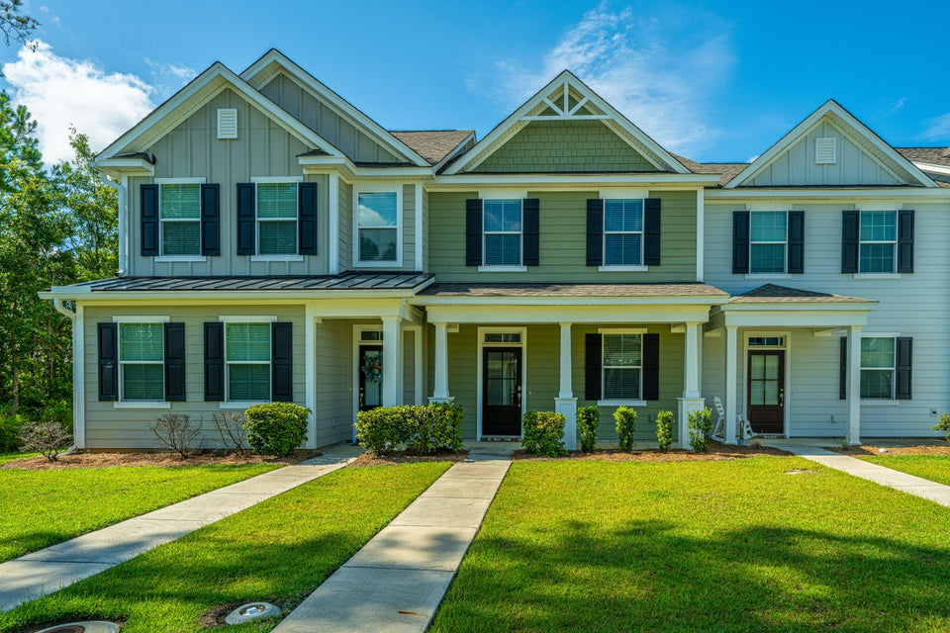
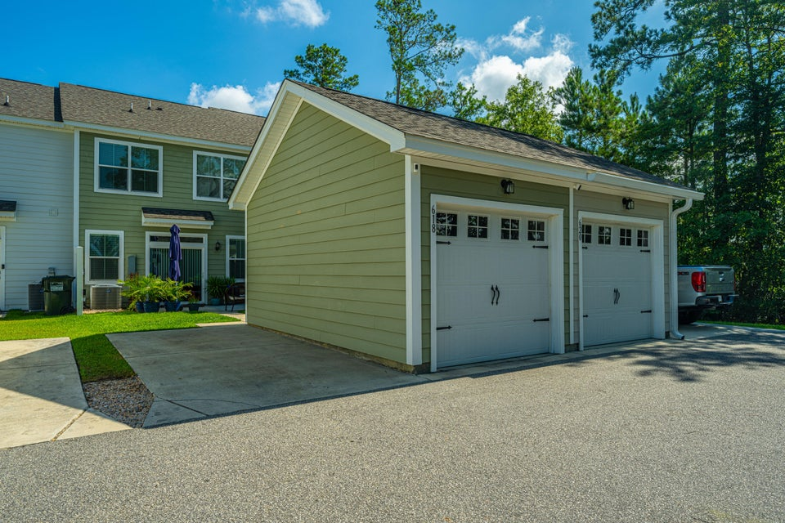
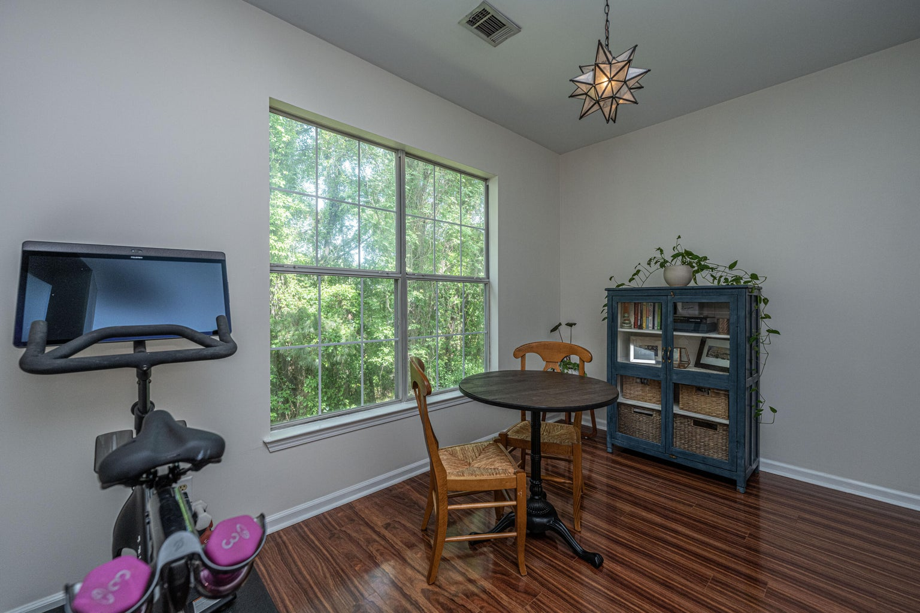
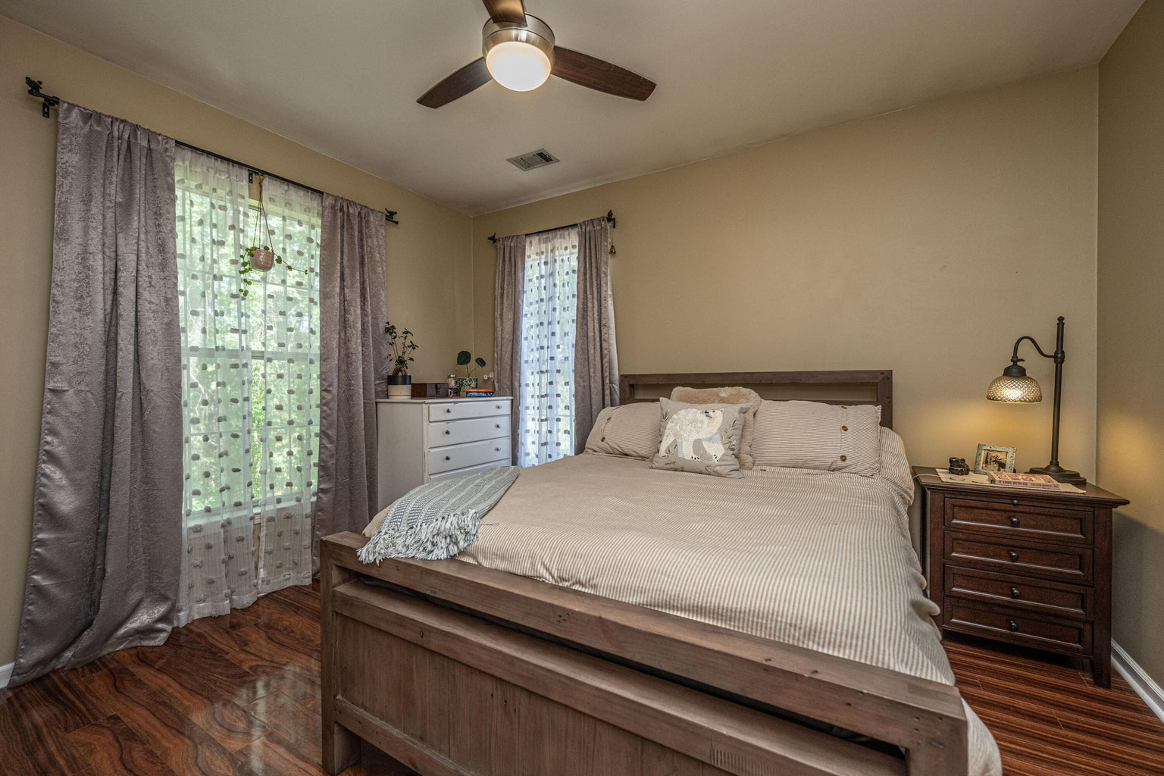



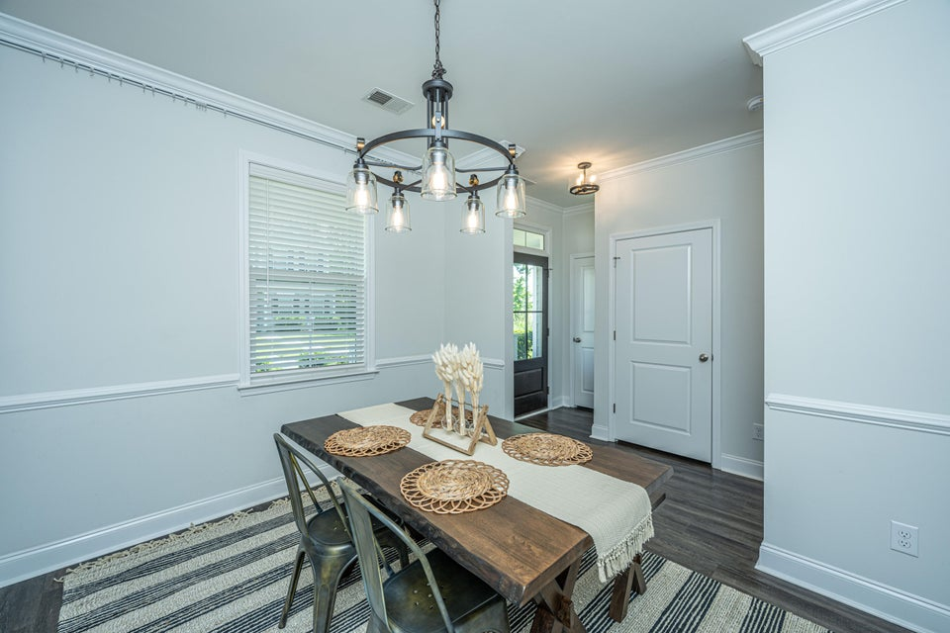
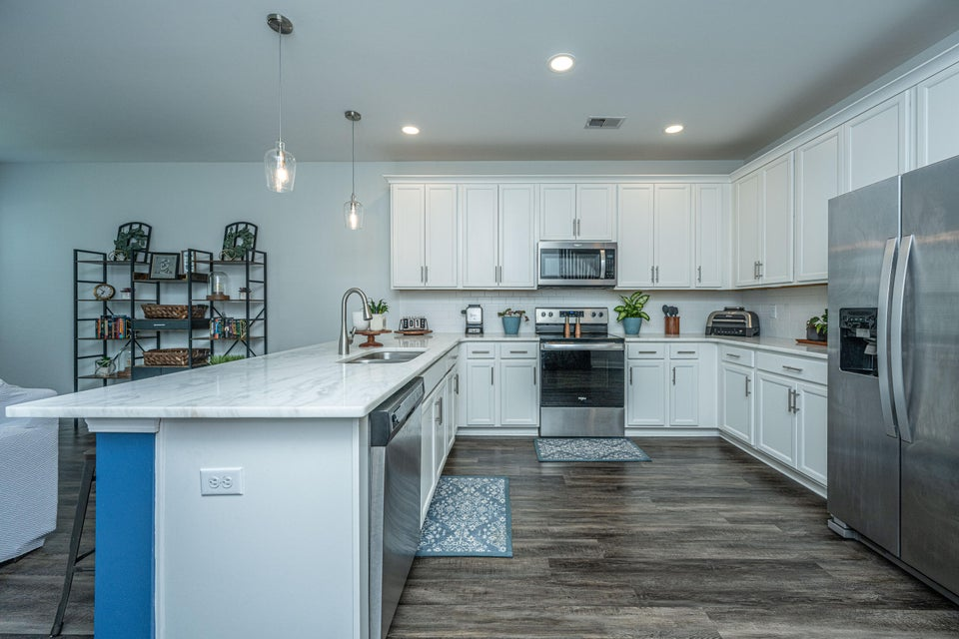
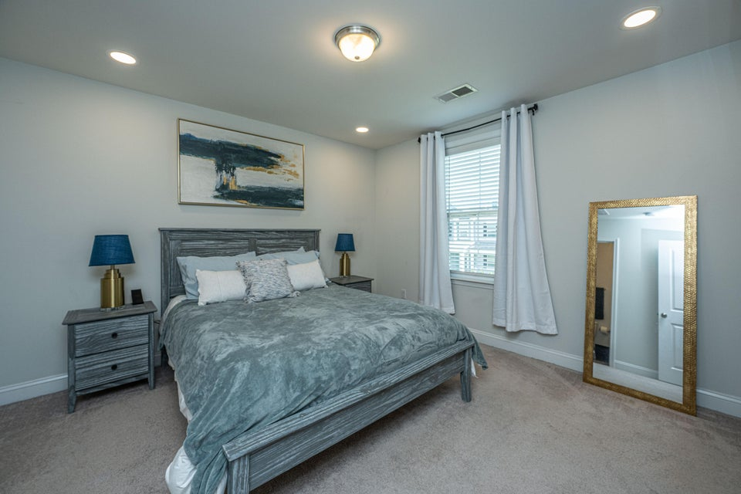
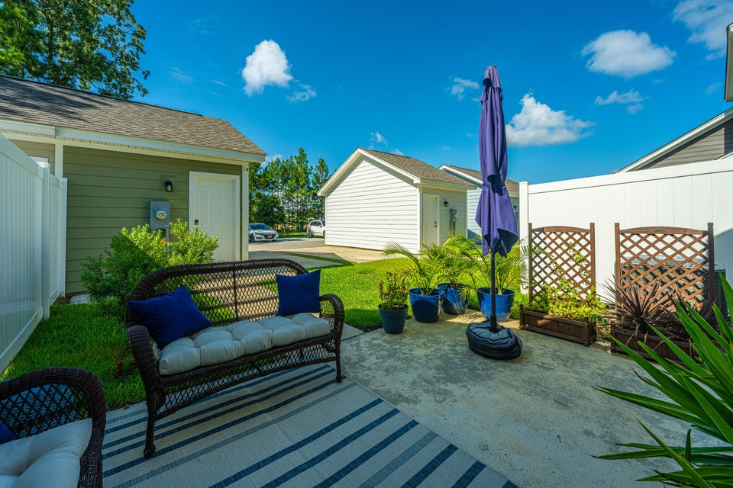

5% Assumable Loan!!!!
This stunning 5br, 4.5ba low country custom built home by Simonini Home Builders has been meticulously cared for situated on a .60 acre heavily treed lot on large pond in private gated community of Popular Grove. This spacious , two story, 4721 square foot home features master bedroom suite on the first level, full front porch, beautiful heart pine wood flooring, large entry foyer which separates the private study from formal dining room, open gourmet kitchen with Wolf 6 burner gas stove, built in SubZero refrigerator/freezer, dishwasher, microwave oven and large pantry. Half bath/Powder room under stairway and large utility room for washer and dryer and deep sink and built in cabinets off hallway. The smaller den with gas log fireplace opens to kitchen and breakfast room. The larger fireplace opens to kitchen and breakfast room and offers expansive views of the water year-round. The living room with its second gas log fireplace is great for entertaining away from dining areas. The large master bedroom suite is located on the first level and has travertine tile flooring in the master bath, his and hers walk in closets, separate vanities, soaking tub, and a large separate shower. There is a game room with separate stairs over the two-car garage large enough for a pool table. The second level boasts 4 spacious bedrooms and three bathrooms. On the rear of home is a large screened in porch and open deck overlooking firepit and pond. To reduce maintenance the exposed wood decking has been replaced with Trex decking and exposed rail caps with PVC. Yard has irrigation system and 120-gallon buried propane tank. Sellers just replaced roof with 50 year architectural shingles with transferable warranty. The two electric water heaters have been converted to a single LP gas fired tankless water heater. New epoxy coating on floors and newly finished walls now in two car garage. Neighborhood amenities include Privacy gate, Boat Ramp, Dock facilities, Exercise area, Pool, RV/boat storage and walking/jogging trails. Don't forget the fantastic equestrian center for your horses!
618 Ravensridge Lane
Foxbank Plantation | Moncks Corner, SC 29461 | MLS# 25014914 | $312,500
Located in the highly sought-after Foxbank Plantation community, this beautifully maintained 3-bedroom, 2.5-bath townhome offers 1,501 square feet of thoughtfully designed living space and stylish upgrades throughout. Built in 2020, this move-in ready home features an open-concept floor plan ideal for modern living and entertaining. The spacious kitchen is equipped with 42'' white shaker cabinets with crown molding, stainless steel appliances, white granite countertops, and a timeless subway tile backsplash. Luxury vinyl plank flooring flows throughout the main living areas, adding warmth and durability. Upstairs, the owner's suite offers a private en-suite bath complete with double vanities and a tiled walk-in shower. Two additional bedrooms, a full bathroom, and a conveniently located laundry area round out the second floor. Additional highlights include a one-car garage, ample storage, and low-maintenance living with landscaping included.
Foxbank Plantation is a master-planned community offering resort-style amenities such as a community pool, scenic walking trails, and on-site retail shops. Foxbank Elementary School is within walking distance, making this a perfect location!
Don't miss your chance to own a turn-key townhome in one of Moncks Corner's most desirable neighborhoods! Schedule your showing today!
4
3
1,844
Robyn Lane
843-222-5599
robynlane01@icloud.com
Jenny Siggelkow
843-901-3494
jcsiggelkow@gmail.com
ERA Wilder Realty
802 Johnnie Dodds Blvd
Mt. Pleasant, SC 29464

