Slide 1
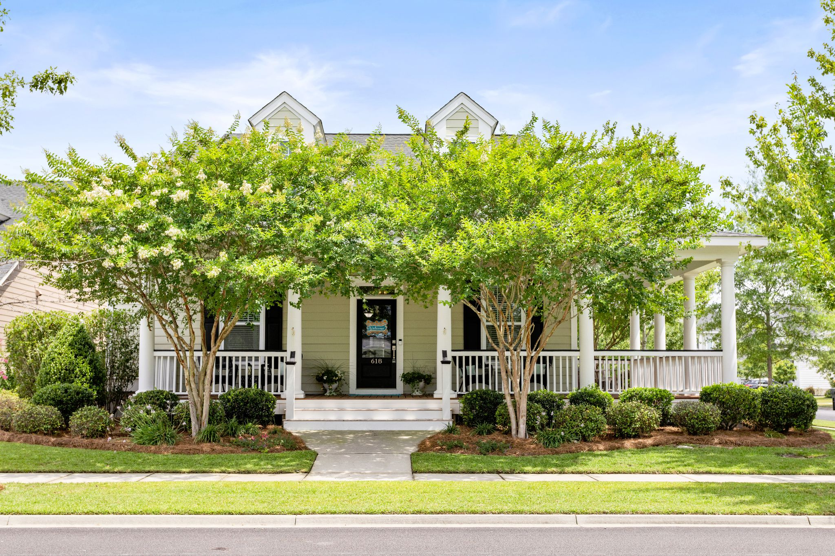

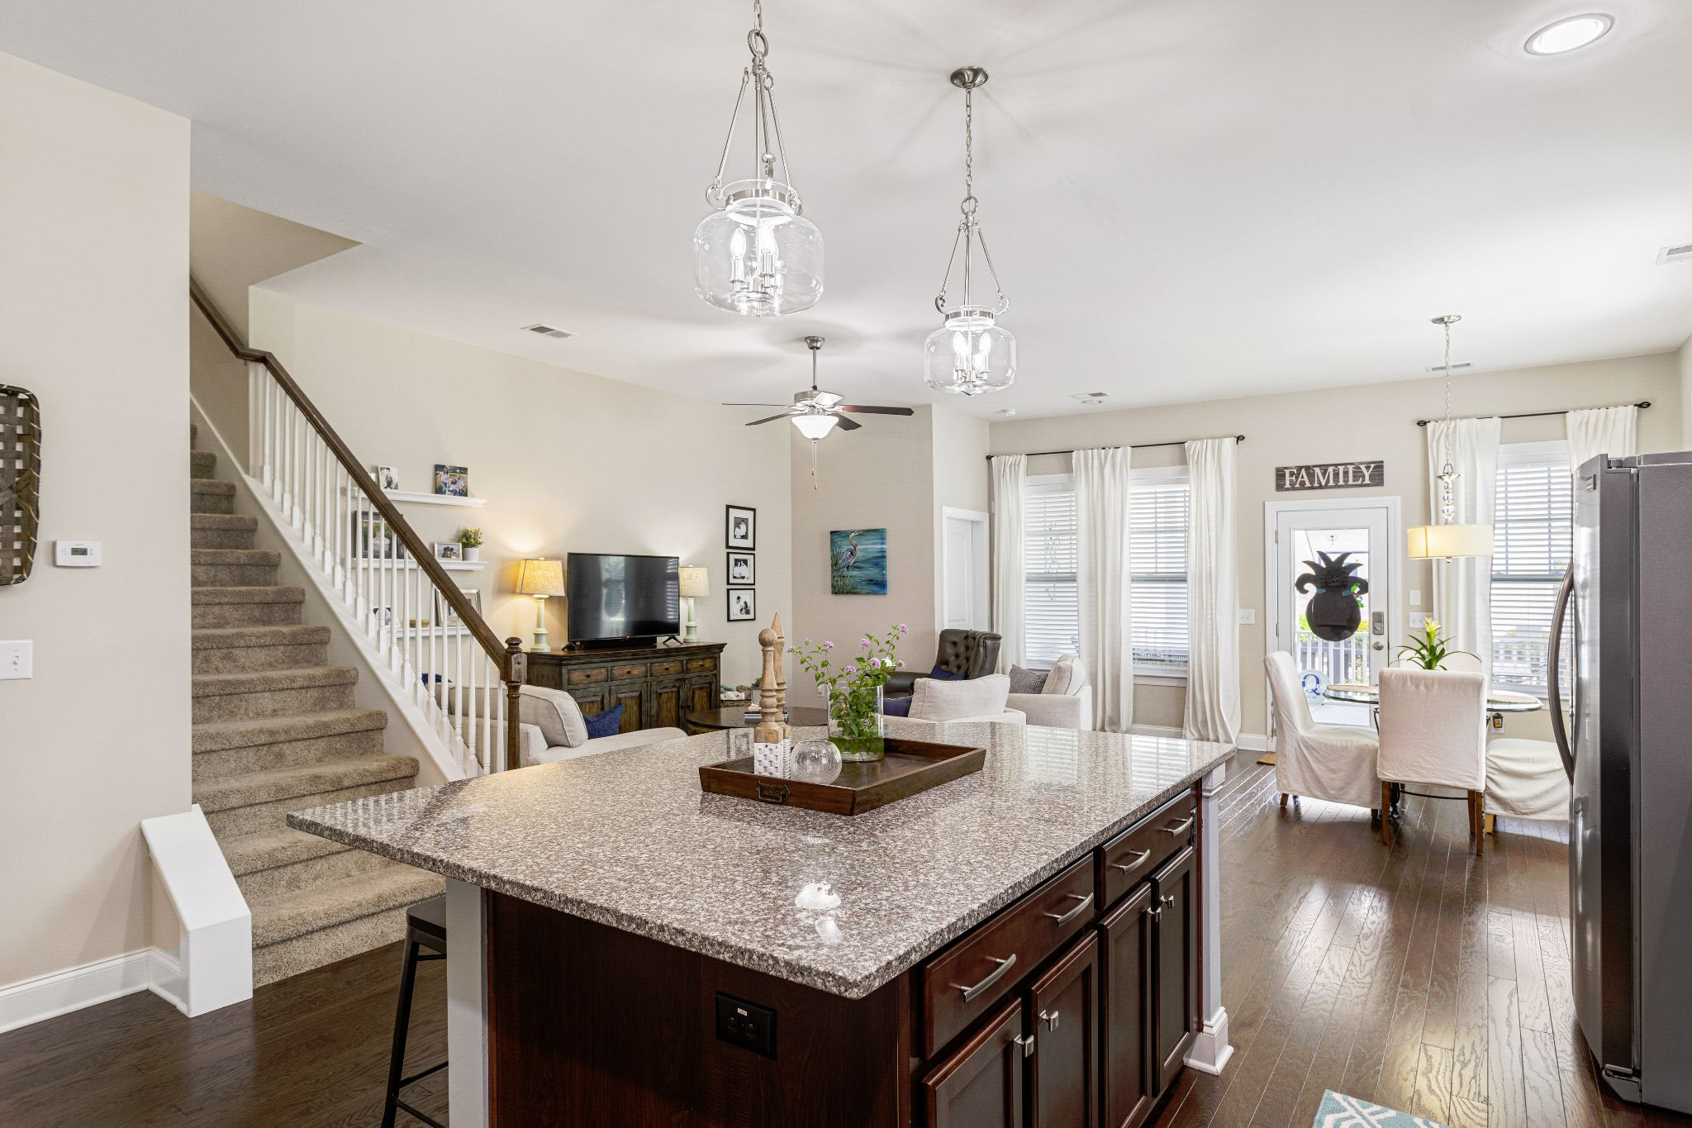
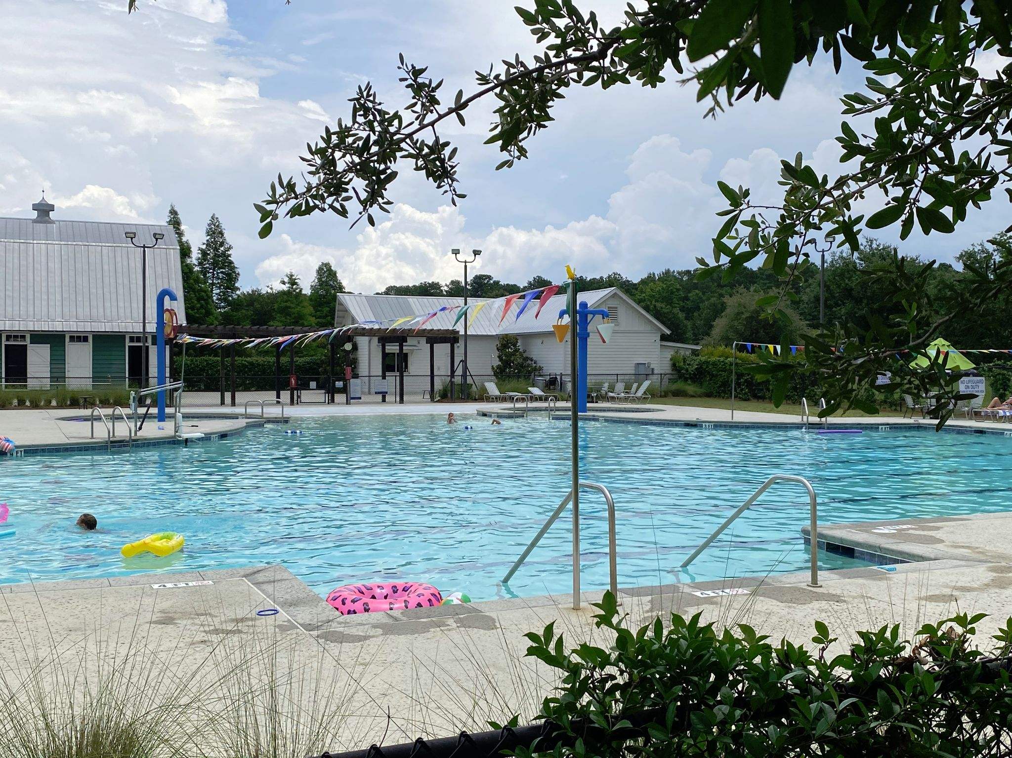

Carnes Crossroads
Move-In-Ready Price adjusted !
Must see 30 second video!
618 Van Buren
All BR’s on main living level
3 Bedrooms + Bonus - 2.5 Baths
Open kitchen w/granite & SS
$565,000
**MOVE IN READY**
MLS # 22015536
HIghly sought-after community with lots of amenities. Conveniently located near shopping, restaurants, medical offices, schools. Home sits on corner lot w/mature landscaping. Bonus room has half bath, and could be 4th BR, office, gym, etc.
Joye Ridgeway
REALTORⓇ
843-270-8665
joyeridgeway@gmail.com
AgentOwned.com
Notes:
DO NOT ALTER LAYOUT. YOUR FILE WILL BE RETURNED OR EDITED IF IT IS RECEIVED ALTERED.

