Slide 1
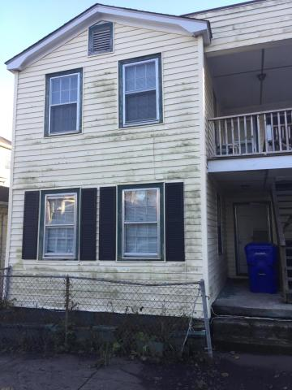
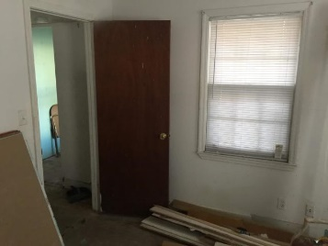
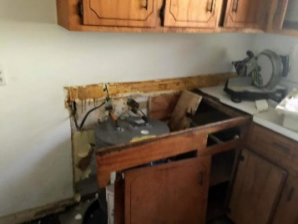
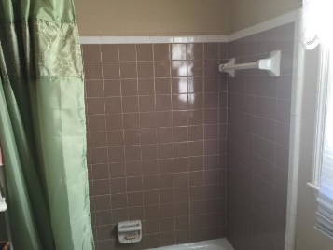
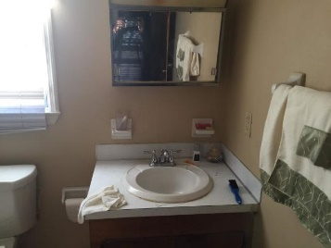
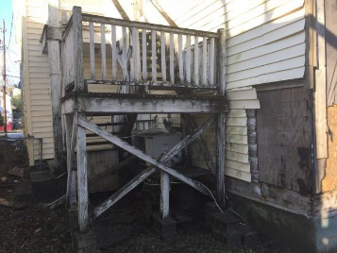
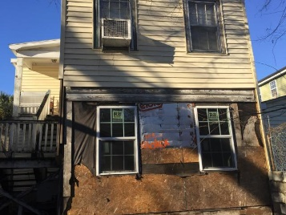

Rare Opportunity!
Investment Property In Historic Downtown
Buyer to receive 5 Day/4 Night cruise for 2.
~ ALSO ~
$1,000 Bonus to the Agent
Ratify by July 31, 2015, and close by August 30,2015
$500 Bonus
$1,000 Bonus
4% Commission
61 Nunan Street A&B
West Side ~ Charleston, SC 29403
MLS# 18033307 ~ $345,000
Attention! Investors and Buyers a great opportunity to own or rent this Multifamily duplex located in Historic downtown Charleston. This duplex features 4 bedrooms, 2 full bathrooms, and two separate Kitchens. Great Location! Walking distance to the Hospital districts, Citadel Military College, College of Charleston, Brittlebank Park, Ashley River Harbor and Joe Riley Stadium. Property being sold 'AS IS CONDITION'' Owners will not make any repairs. A great opportunity to experience the pleasures of southern hospitality in the city of Charleston.
Short Sale
Edward Washington
843-737-3347
ewashington@exitlowcountry.com
Exit Realty Lowcountry Group
3618 Ashley Phosphate Rd
North Charleston, SC 29418
exitlowcountry.com

