Slide 1
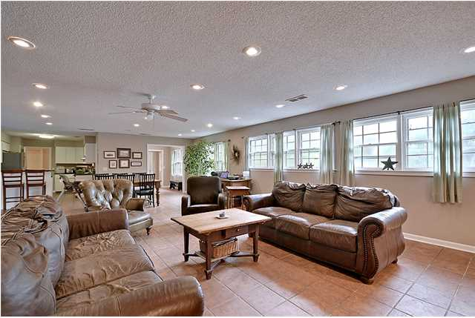
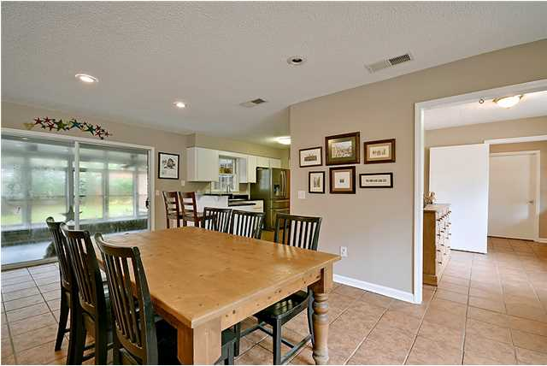
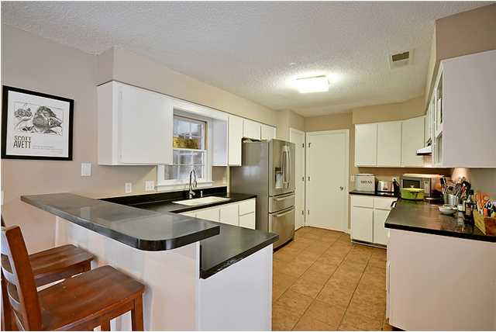
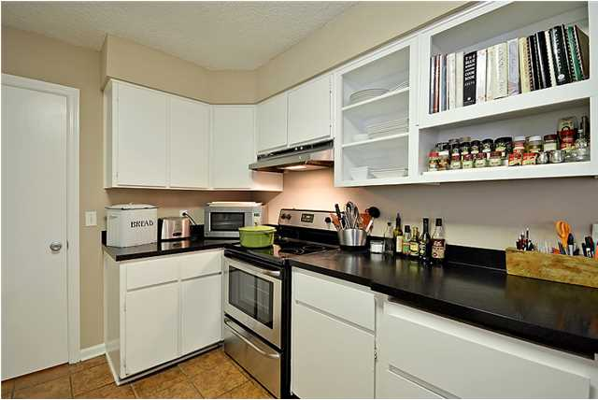
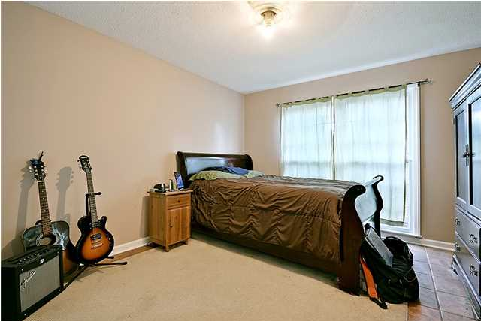
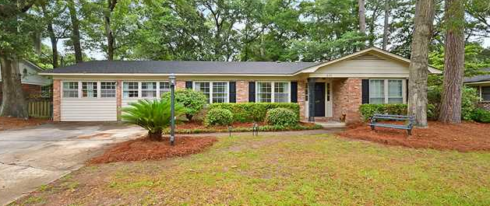
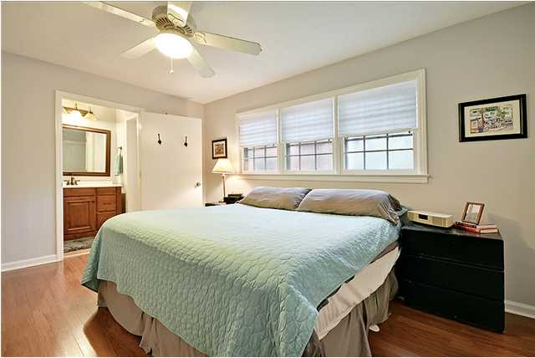
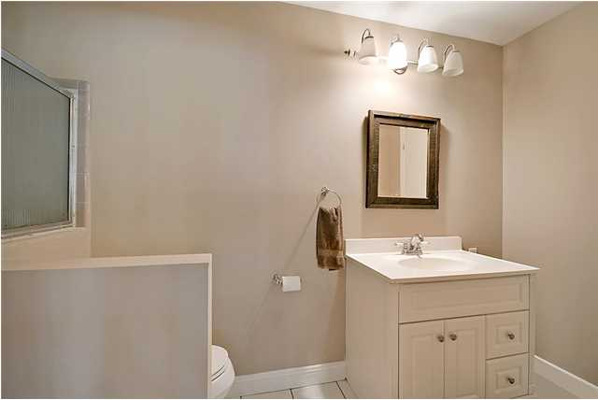
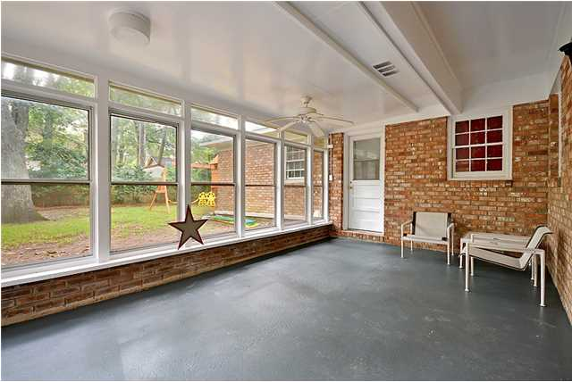
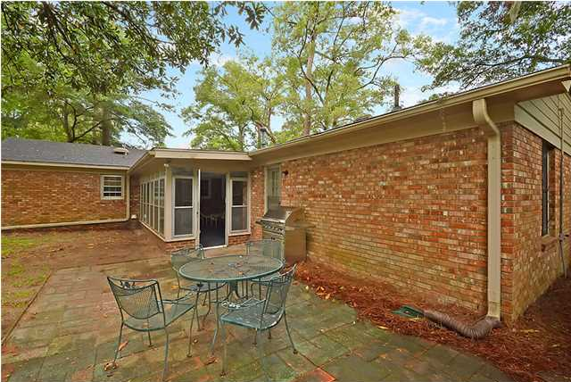
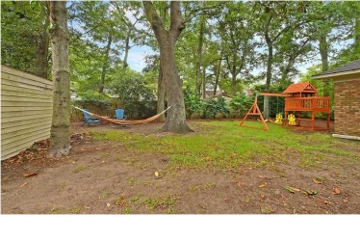


Clearview Bargain ~ Zoned for Stiles Point
620 Clearview Dr
Clearview – Charleston – MLS# 15002919 - $299,500
Amazing opportunity to live in the heart of James Island in one of the most desirable neighborhoods! Beautiful, well maintained brick home sitting on the perfect lot in this great neighborhood of Clearview. As you enter the flowing open floor plan prepare to be wowed! The massive open living room flows perfectly and offers the ideal location to entertain guests. All new paint throughout gives the perfect update along with a new electric range, new dishwasher, new wood flooring in the bedrooms, NEW carpet added to the master! You will find a little piece of paradise on the rear screened-in porch overlooking the mature back yard, already set up with a patio as well as large storage shed, this is the perfect location for the fire pit! All new landscaping and fresh pine straw! There is also a brand new HVAC unit. Water heater is only two years old. The bedrooms are all large with plenty of storage and closet space, as well as three full bathrooms! This is the perfect house for anyone looking for incredible location, fantastic schools and James Island living at it's best. Just a short golf cart ride away from Sunrise Park, The James Island Yacht Club and a swim club. Five minutes to downtown and a few short minutes to Folly Beach!
Dan Lorentz, Realtor
ERA Agent of the Year
843-532-4653
dan@danlorentz.com
www.danlorentz.com
ERA Wilder Realty, 125-F Wappoo Creek Dr, Charleston, SC 29412

