Slide 1
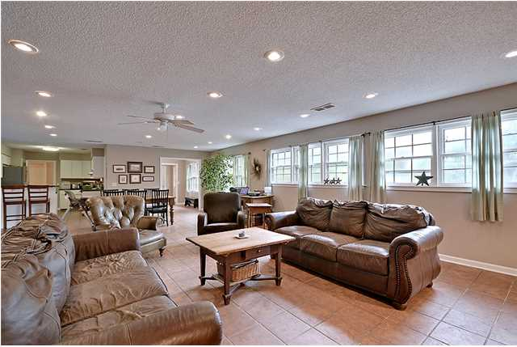
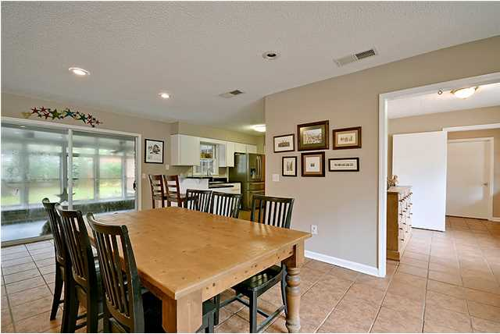
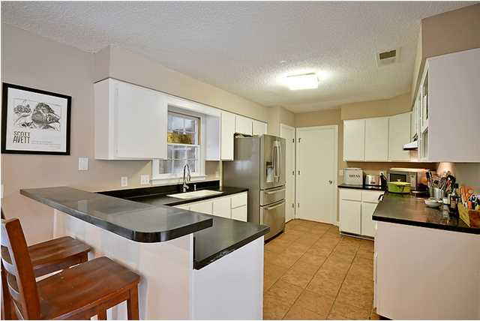
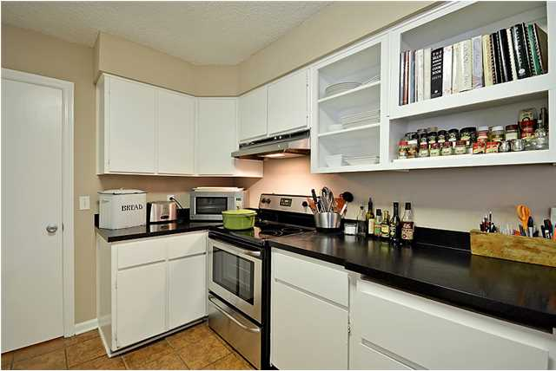
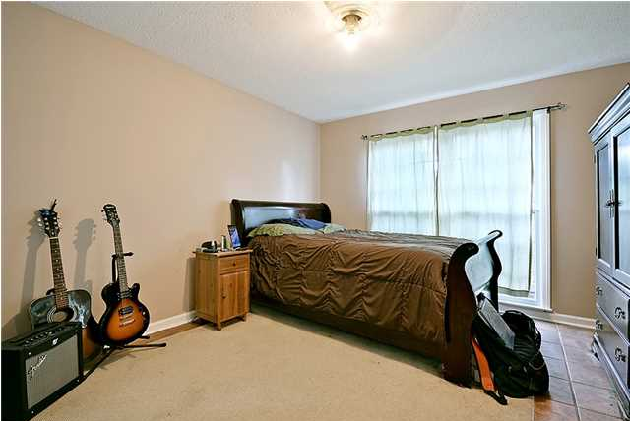
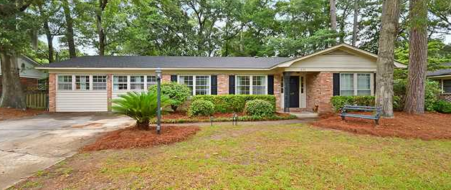
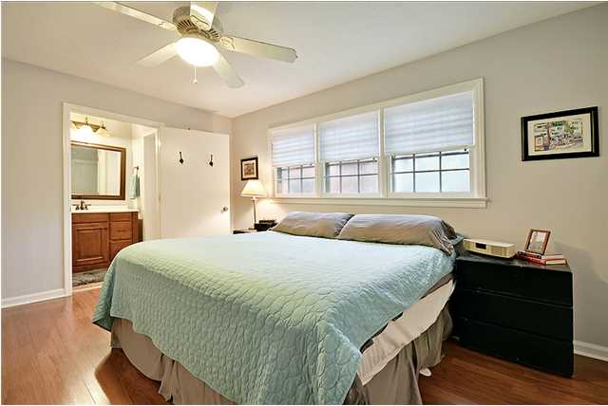
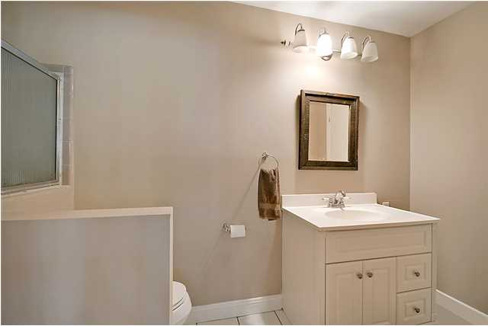
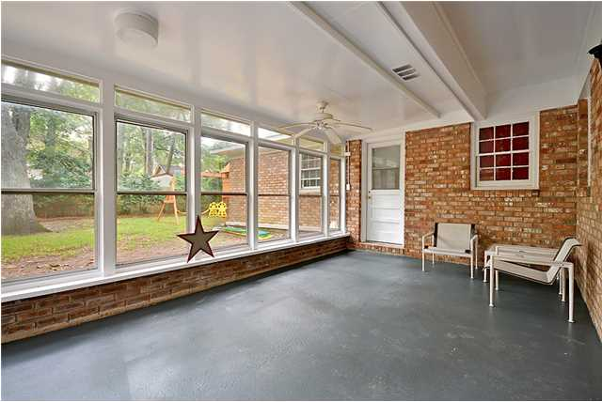
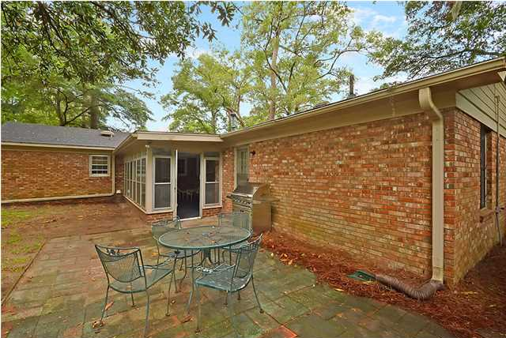
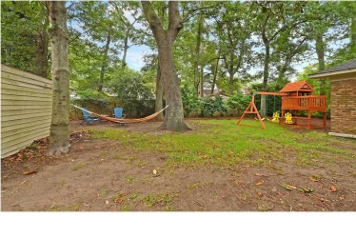


10 CAP RATE! BRING INVESTORS!
620 Clearview Dr
Clearview – Charleston – MLS# 1418254 - $309,000
Just reduced for a quick sale! Amazing opportunity to live in the heart of James Island in one of the most desirable neighborhoods! Beautiful well maintained brick home sitting on the prefect lot in this great neighborhood of Clearview. As you enter this amazing flowing open floor plan prepare to be wowed! The massive open living room flows perfectly and offers the ideal location to entertain guests. All new paint throughout gives the perfect update, as well as new electric range, new dishwasher, new wood flooring in the bedrooms! You will find a little piece of paradise on the rear screened-in porch overlooking the mature back yard, already set up with a patio as well as large storage shed, this is the perfect location for the fire-pit! All new landscaping and fresh pine straw! There is also a brand new HVAC unit! Water heater is 2 years old. The bedrooms are all large, plenty of storage and closet space, as well as three full bathrooms! This is the perfect house for any buyer looking for incredible location, fantastic schools and James Island living at it's best. Owners are offering a one year AHS home warranty to buyers. Just a short golf cart ride away from Sunrise Park, The James Island Yacht Club and a swim club. Five minutes to Downtown and a few short minutes to Folly Beach!
Dan Lorentz, Realtor
ERA Agent of the Year
843-532-4653
dan@danlorentz.com
www.danlorentz.com
ERA Wilder Realty, 125-F Wappoo Creek Dr, Charleston, SC 29412

