Slide 1
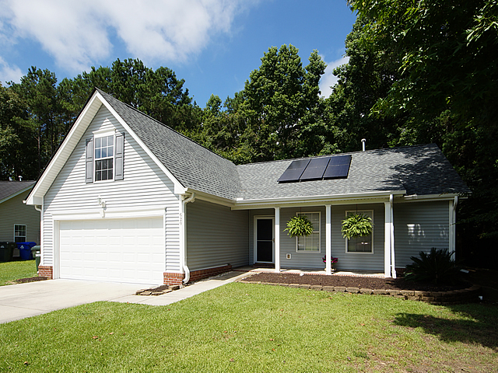
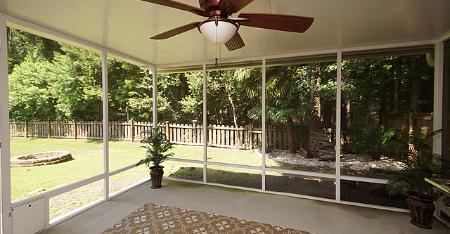
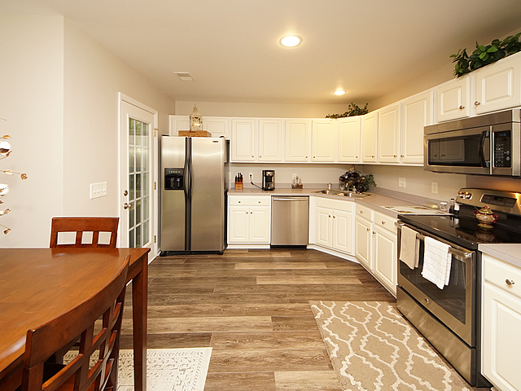
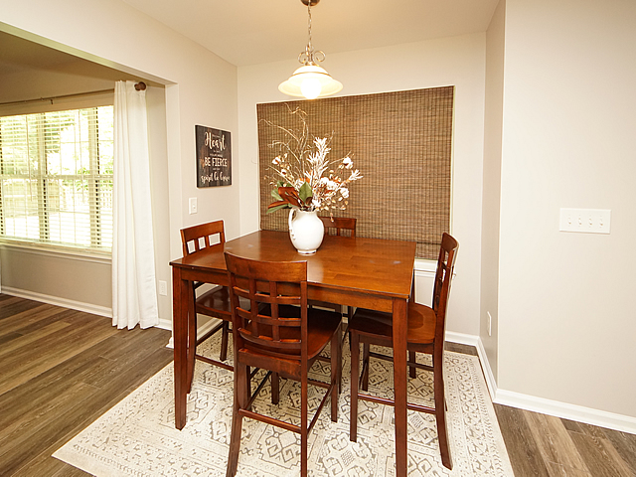
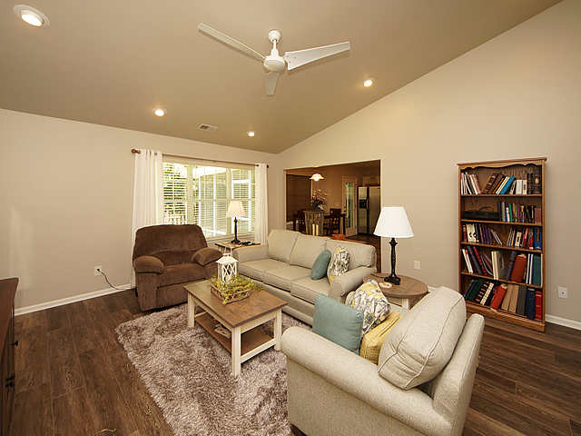
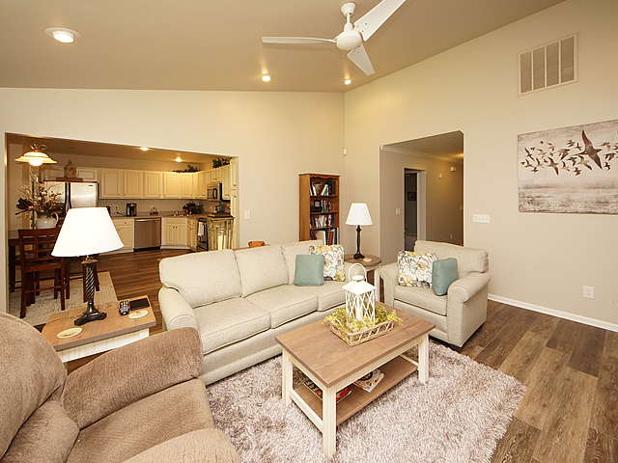
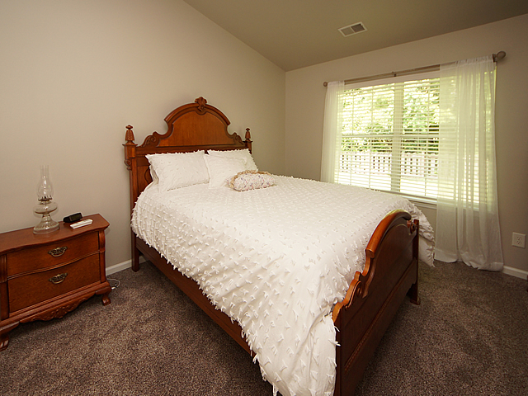
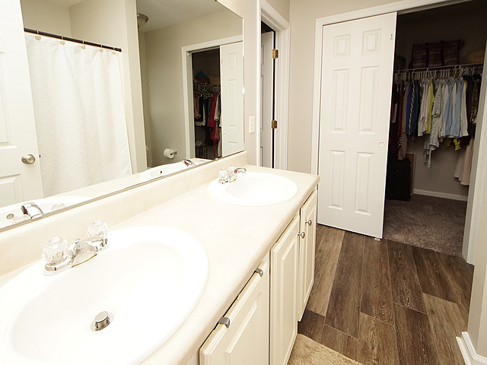
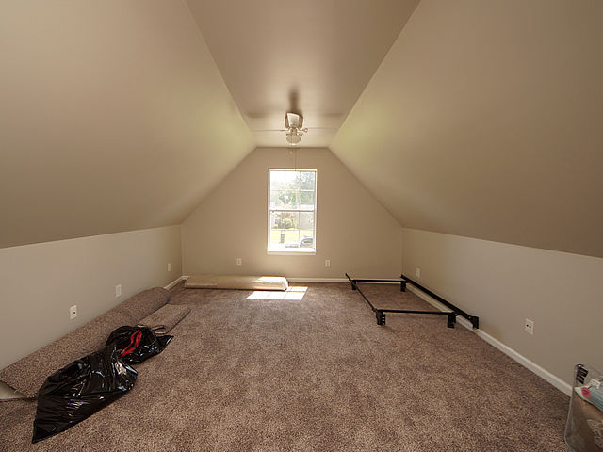
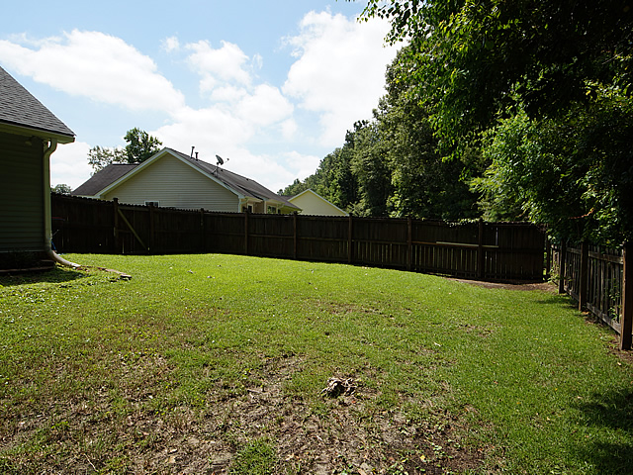
GREAT INVESTMENT OPPORTUNITY! STEADY INCOME.
Harness The Power Of The Sun…FOR FREE! $20,000 Value!
620 Hainsworth Dr
Grand Oaks Plantation
Charleston, SC 29414
MLS# 18018290
$279,000
Enjoy ECONOMICAL AND COOL living in the Lowcountry with home equipped with NEW SOLAR PANELS that convey payment free with an Acceptable Offer! 20K value plus "Lower to no electric bills." Many benefits to having solar!
Beautiful 1 story 3 bedroom, 2 bath home on a corner lot in desirable Grand Oaks Plantation. Open floor plan features fresh paint, new blinds, and new flooring through out to include engineered wood flooring and new carpet. Kitchen has a stainless steel Bosch dishwasher. Range and microwave @ 2 years old. Refrigerator, and Whirlpool washer and dryer convey. Roof replaced in 2016! Large fenced in yard with screened in porch backs up to wooded area for plenty of privacy. Mirror and shelving in Hall Bathroom do not convey. Sellers need a late August closing date.
KATHY COOPER
843-607-3511
kathycooperrealty@icloud.com
Harbourtowne Real Estate
672 Marina Drive, Ste 110 | Daniel Island, SC 29492

