Slide 1
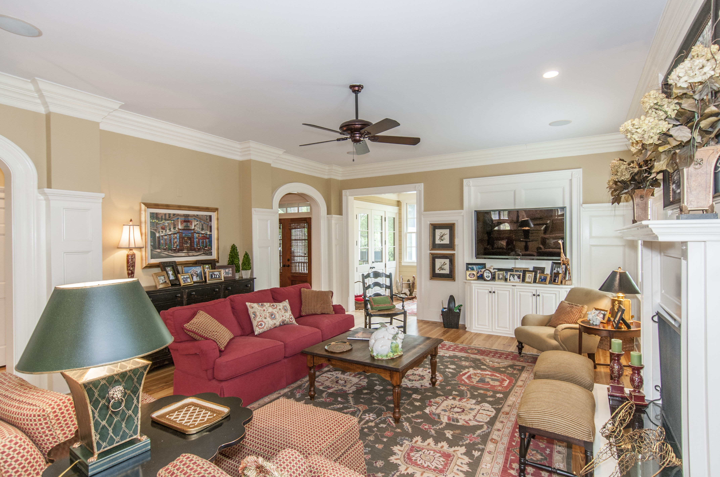
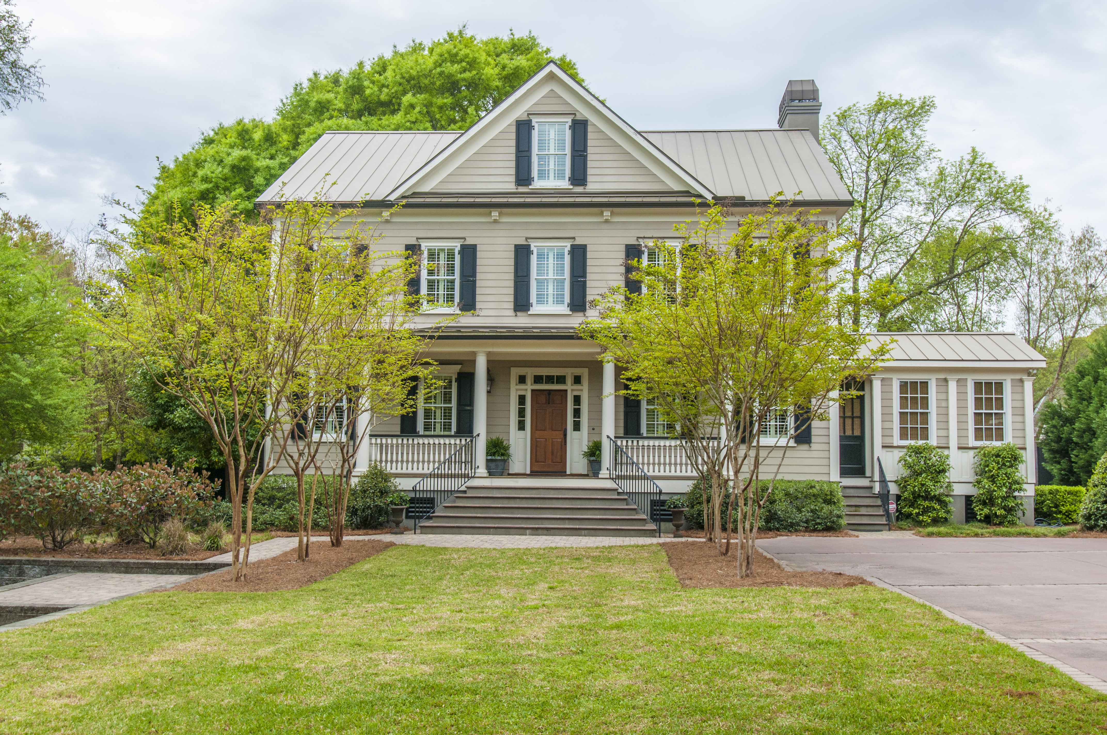
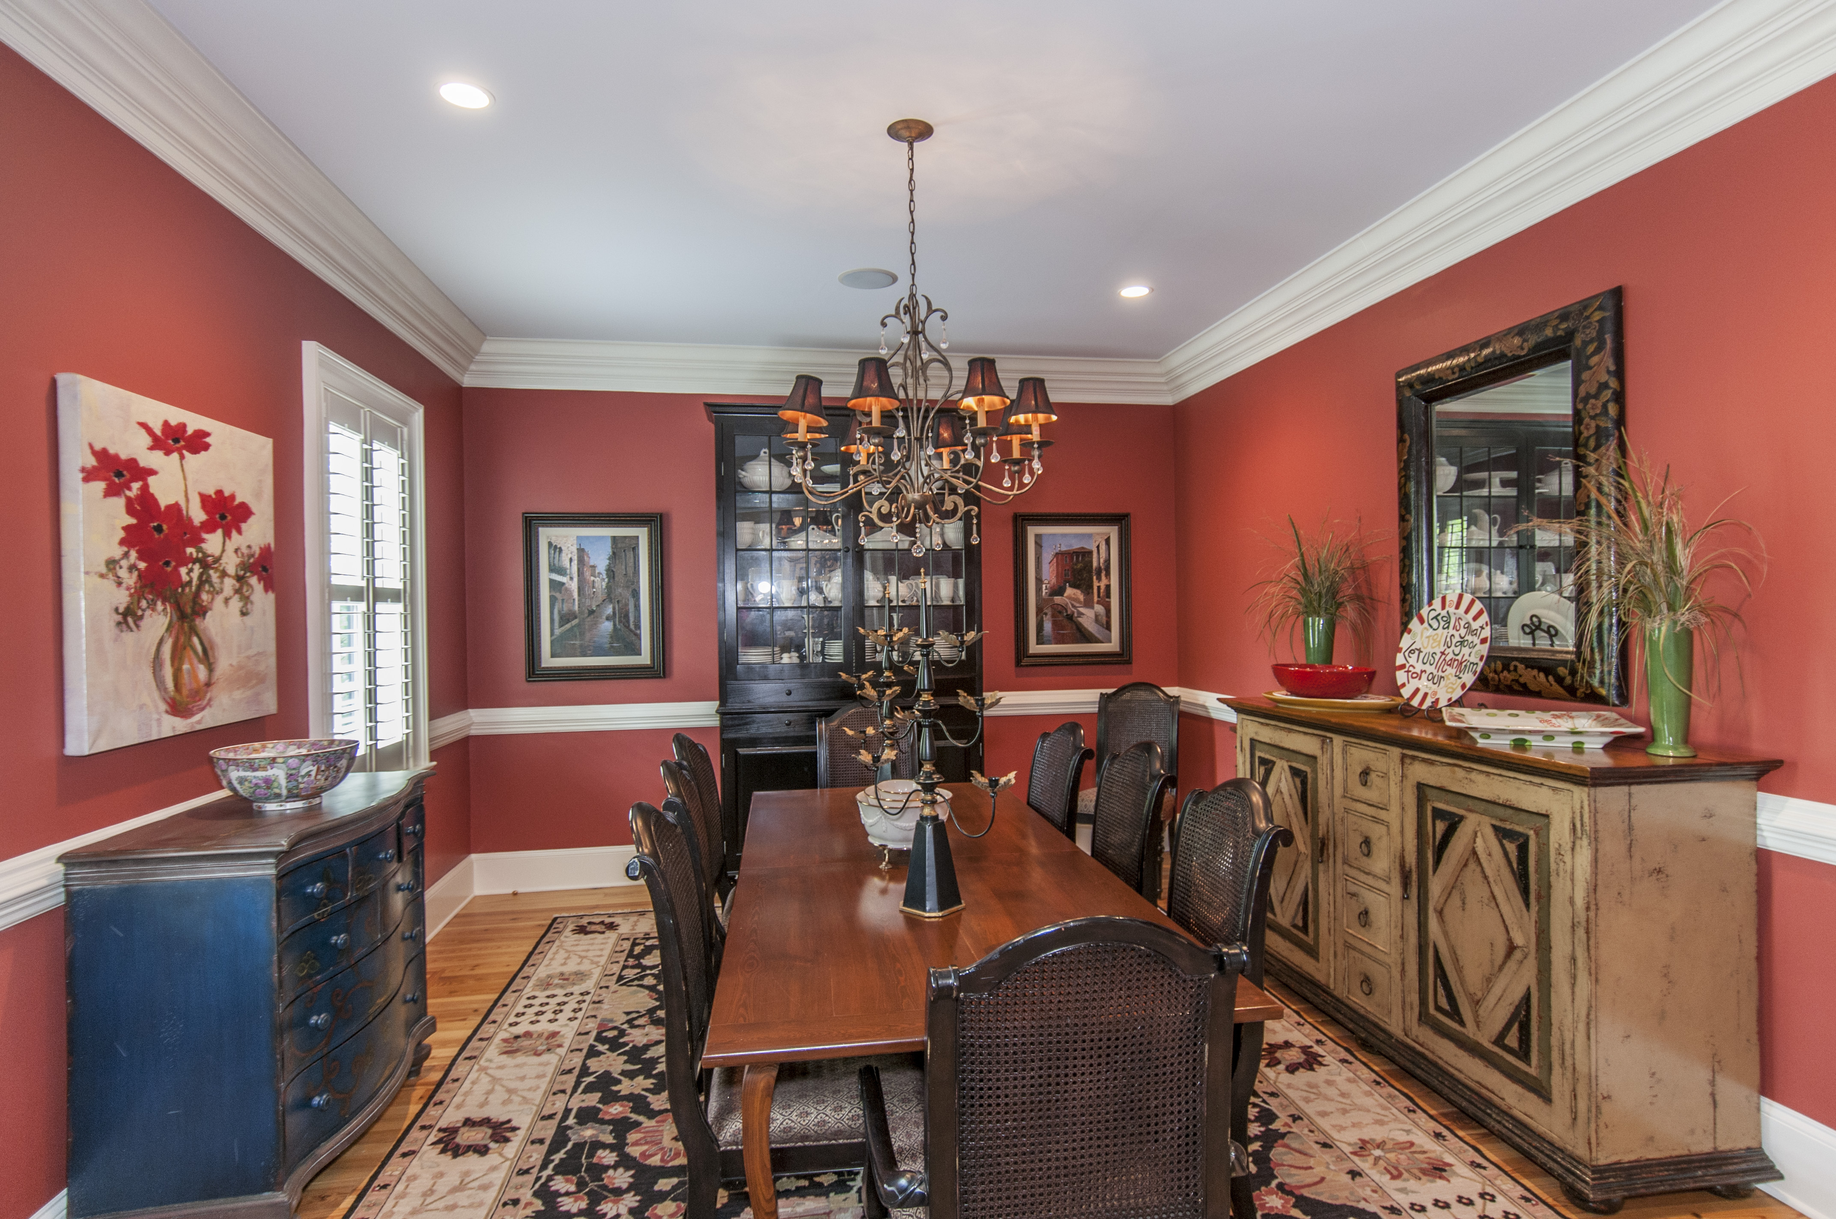
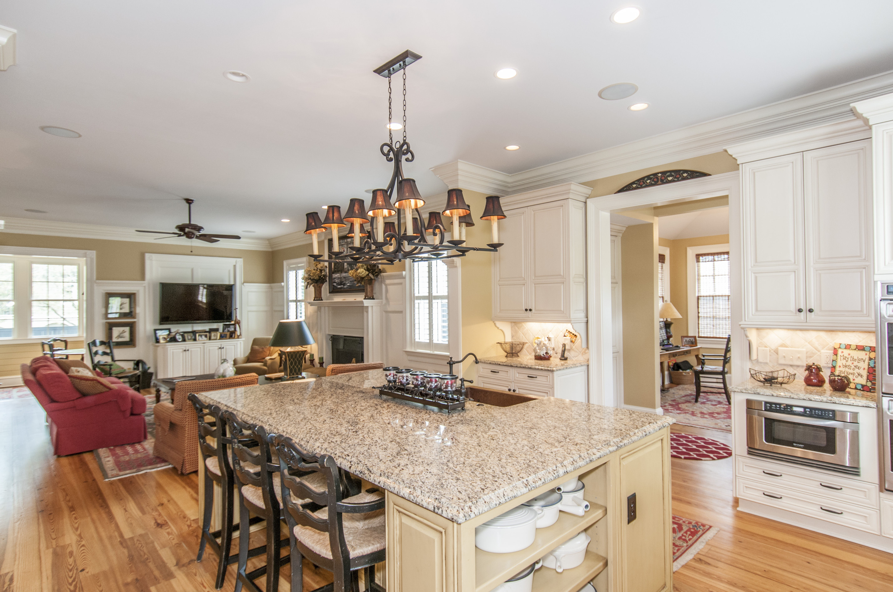
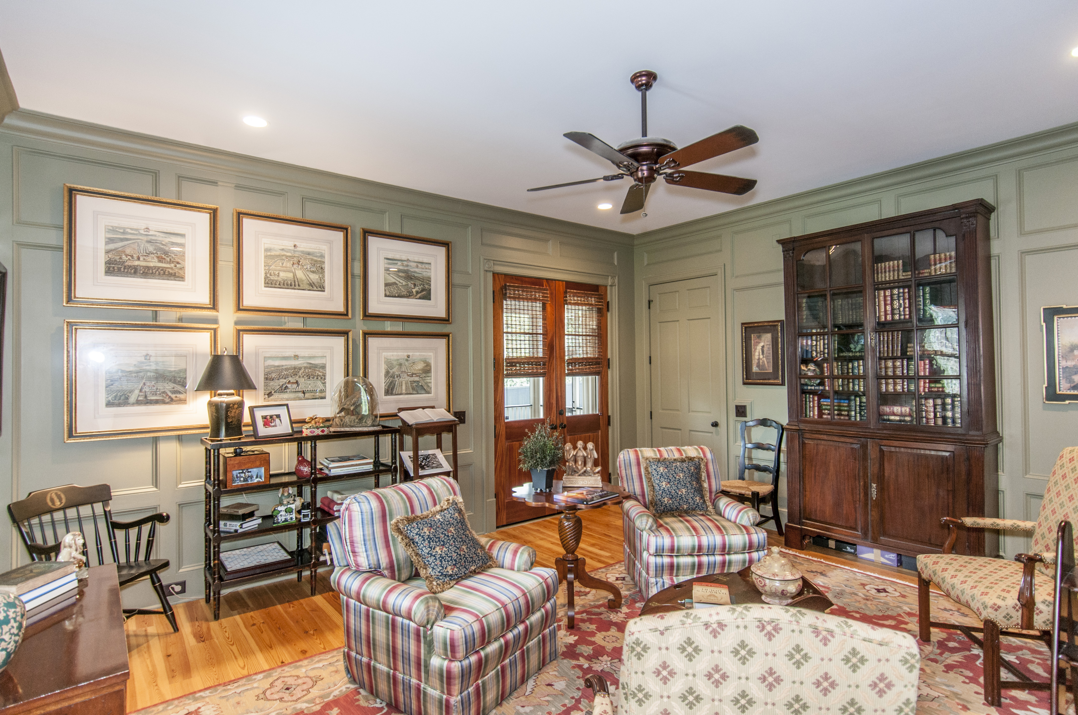
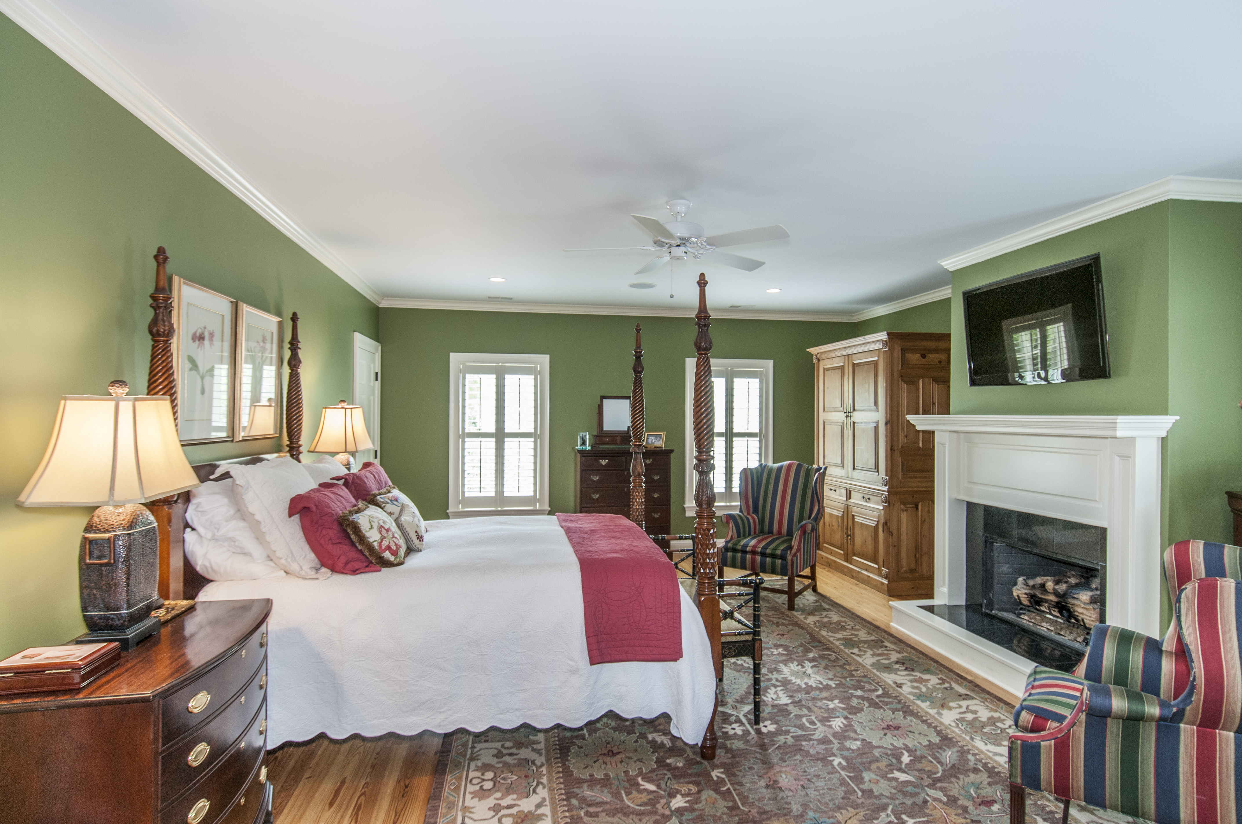
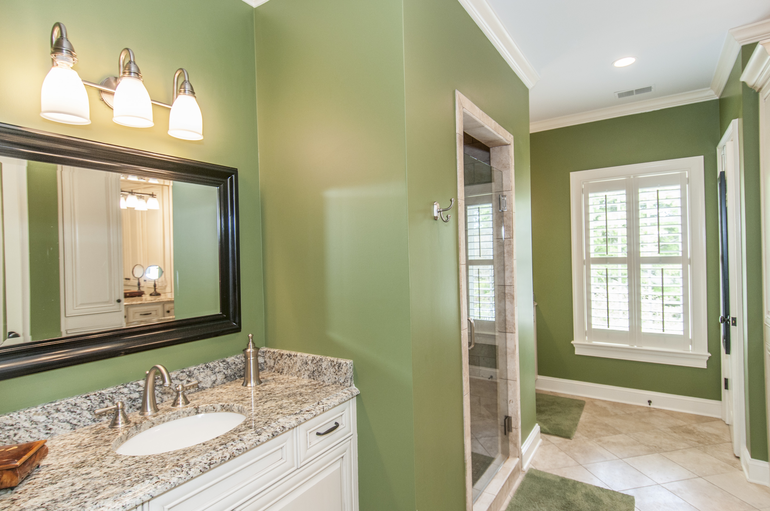
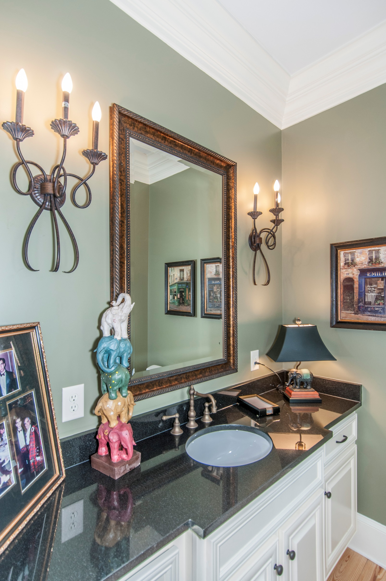
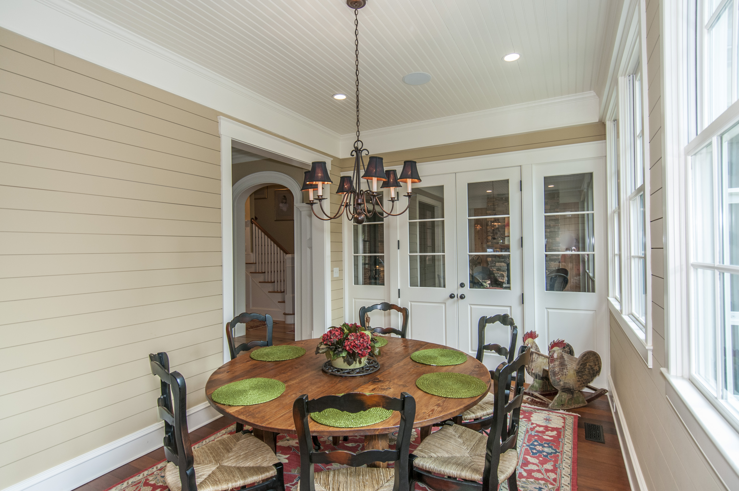
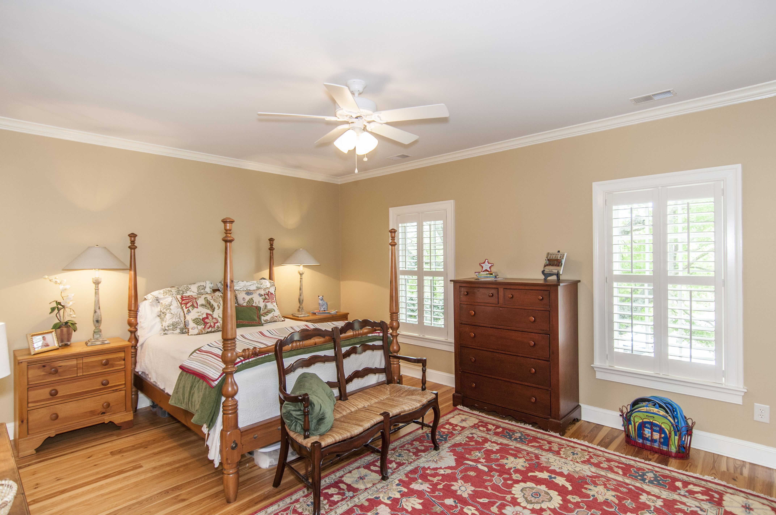
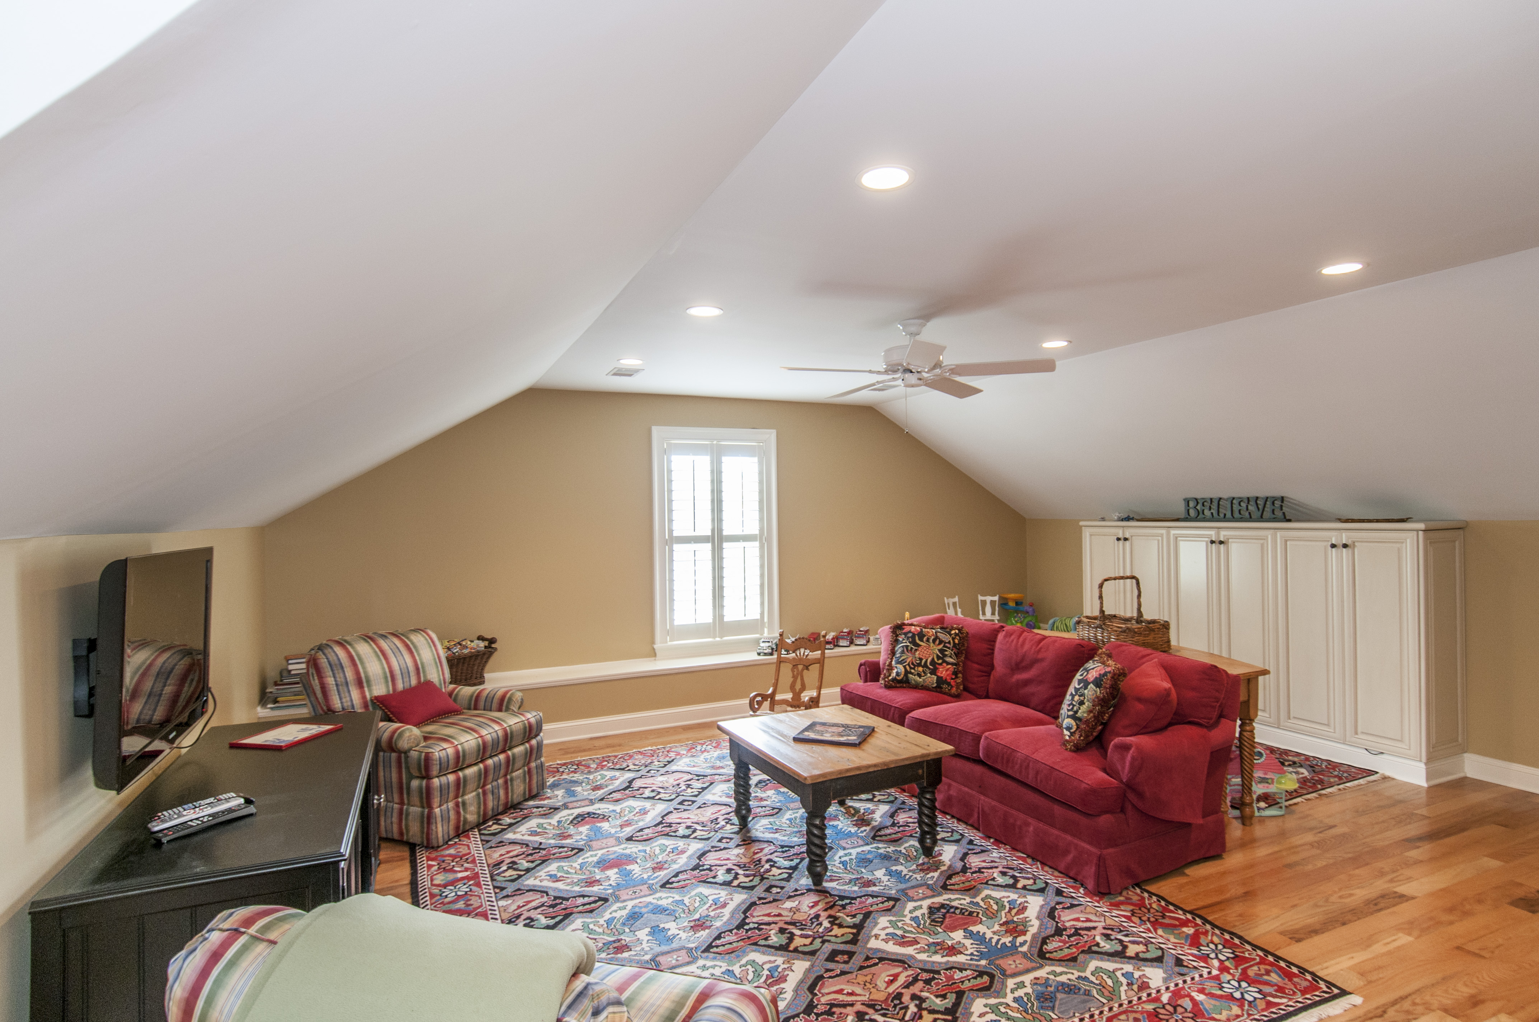
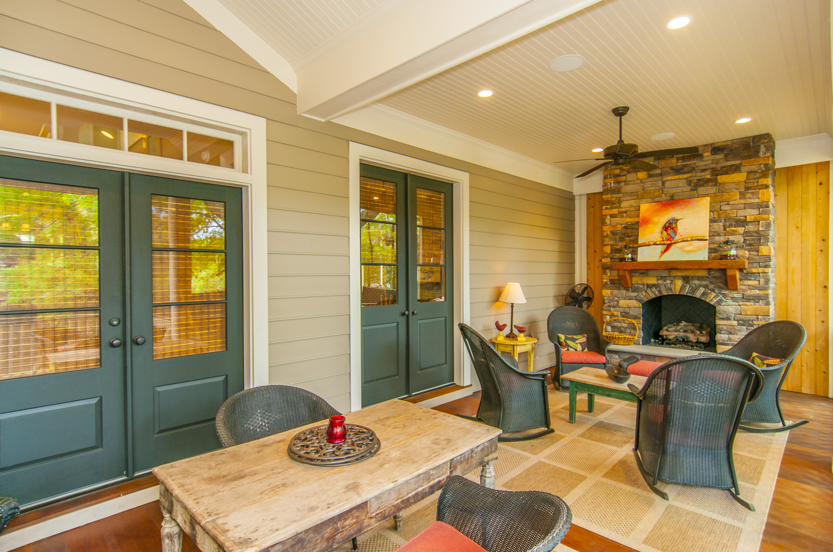
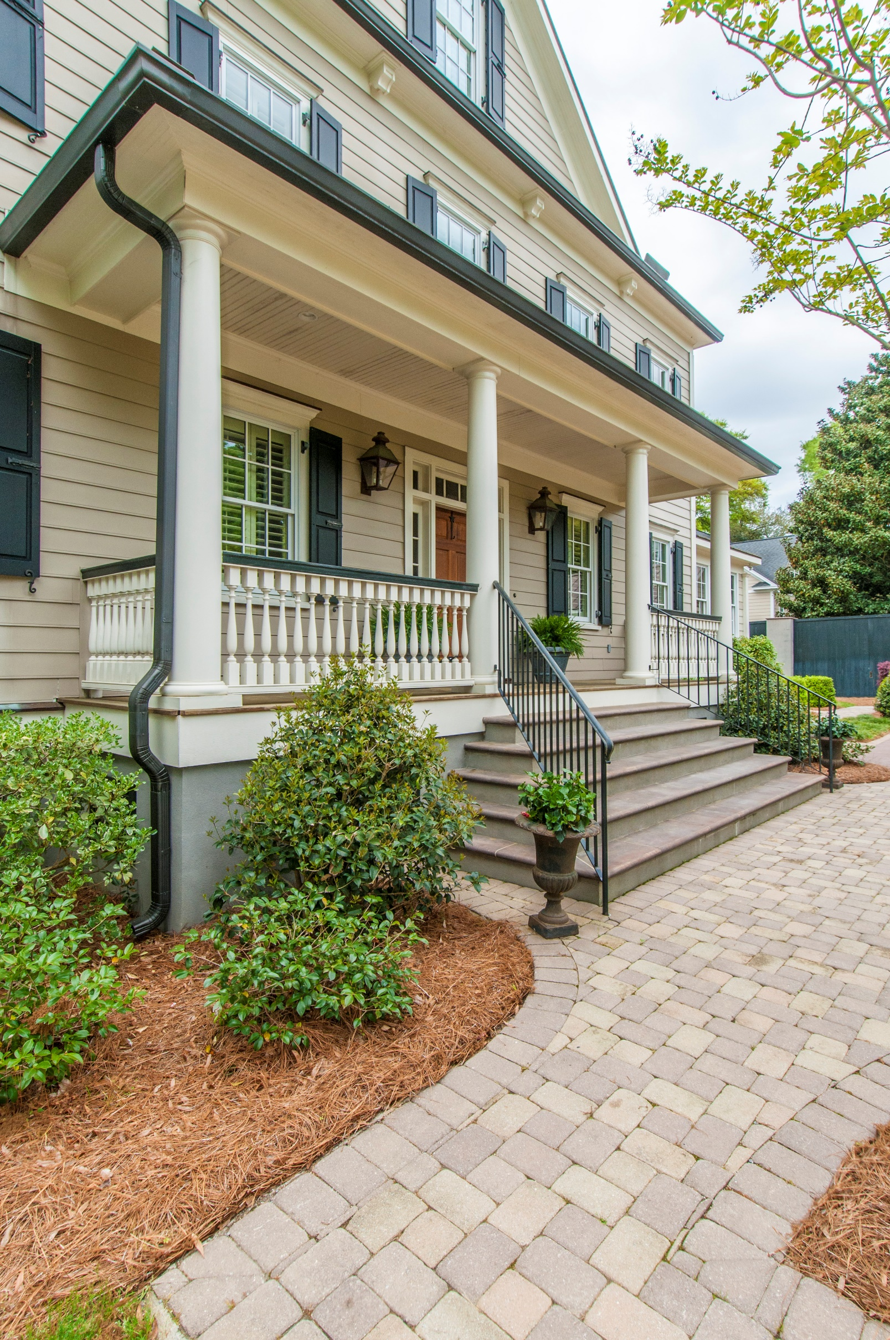


621 Ann Street
Old Village :: Mount Pleasant :: MLS# 15016311 :: $1,795,000
Elegant Modern Living with Old World Charm!
Luxury living at its finest with plenty of privacy! Nestled at the end of Ann St., situated behind fencing and beautiful iron gates. Enjoy the privacy of your own mini-estate with a sunken garden and mature oaks. This gorgeous house was built in 2009 with all of the finest of modern amenities and extras a discriminating buyer wants. Open floor plan is ideal for entertaining. You will find sun-filled gorgeous rooms with beautiful architecture. Rooms to enjoy on the main level is the Great Room with a massive fireplace, formal dining room, office and library. The great room opens onto the screen porch with a massive fireplace to keep you warm during cool winter nights. Kitchen has all possible upgrades with integrated custom cabinetry, stainless appliances and natural stone surfaces. A lovely sun-filled breakfast room is adjacent to the kitchen. The butlers pantry/wet bar is next to the family room for easy entertaining. The large Master Bedroom suite is located on the second floor with another fireplace, custom closets and bath. Two more bedrooms, laundry room and full bath are also found on the second floor. The completely finished third floor has two rooms and a full bath - perfect for a 4th bedroom, playroom, teen suite with study or office. The backyard landscaping is laid out for a pool. There is also a separate 2-car garage with plenty of storage. This home is truly remarkable and a must-see for those who want an exceptional one-of-a-kind family home. Ready to move in!
Jill F Miller
Mobile - (843) 566-5115
jillsellscharleston@gmail.com
CarolinaOneRealEstate.com
Carolina One Real Estate
195 W Coleman Blvd
Mt Pleasant, SC 29464

