Slide 1

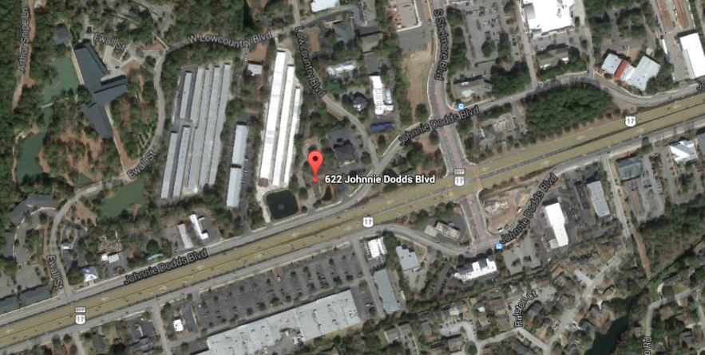


PRIME HIGHWAY FRONTAGE & SIGNAGE
GREAT HIGH-TRAFFIC LOCATION
An amazing opportunity to have tremendous presence and signage very close to downtown and prominently displayed in Mount Pleasant.
This property long since has a history of prominence as a successful law firm(s) location, but the floor plan provides more opportunities than meet the eye. With a potential sale lease back in play, a buyer can now occupy half the facility and have lease back income to help them plan for future growth or build investment income. Quick access to Highway 17 and Mathis Ferry make this a very attractive office building today or it hold potential for conversion to medical office that can allow a doctor or hospital group/system to establish a key location in Mt. Pleasant. The demographics of this location are very promising for many business types. Don't let your assumptions limit your vision for this property, take a tour today.
Address: 622 JOHNNIE DODDS BLVD
Area: (42) CHS-Mt.Pleasant South of IOP Connector
City: MOUNT PLEASANT
County: Charleston
Listing ID: 1427300
Tax Map#: 514-00-00-120
Acres: 1.04
Square Feet: 8,443
Listing Price: $1,800,000

