Slide 1
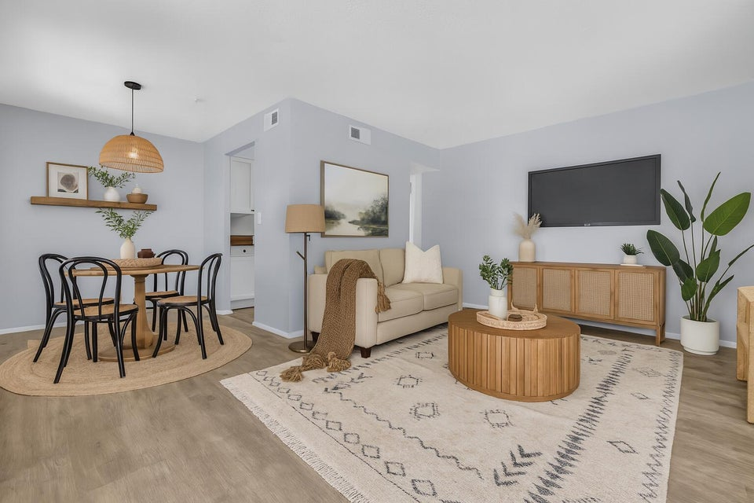
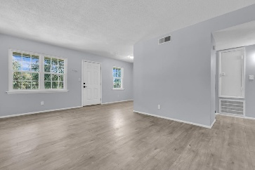
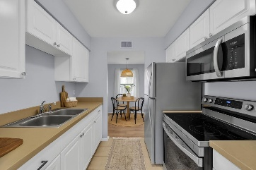
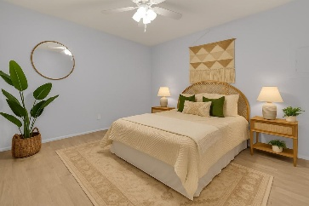
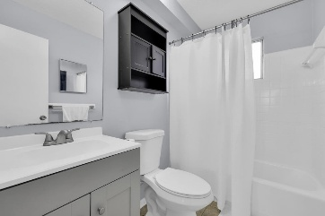
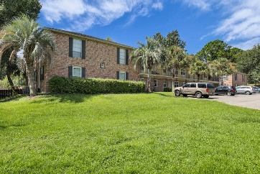
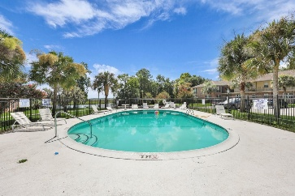
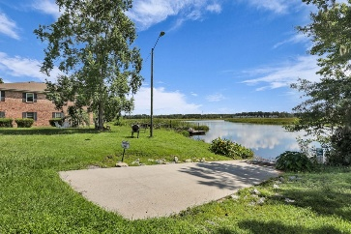
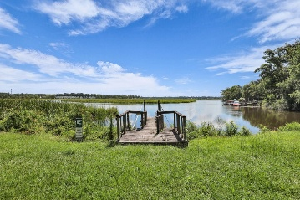



Renovated Condo in Hanahan for $150,000
6240 Old Point Road C14
The Reserve at Old Point
Hanahan, SC 29410
MLS# 25020638
$150,000
1 Beds | 1 Bath | 600 SF
Welcome to 6240 Old Point Road Unit C14, an updated upstairs condo nestled in the heart of Hanahan. This move-in-ready unit features newer flooring, windows, HVAC system, appliances (excluding dishwasher), paint, and outlets—giving it a fresh, modern feel throughout. Located just minutes from downtown Charleston, this home offers the perfect balance of convenience and charm. You'll enjoy peaceful suburban living with quick access to everything the Lowcountry has to offer. The community itself features sought-after amenities including a pool, dock, and boat ramp, perfect for those who love the outdoors.
Whether you're a first-time buyer, a seasoned investor, or anything in between, this condo presents an attractive opportunity in a rapidly growing market. With Hanahan real estate on the rise, now is the perfect time to secure your spot in this thriving community.
VIRTUAL TOUR
Nick Mazzilli 843-640-5575
nick@themazzilliteam.com
sellmyhousecharlestonsc.com
The Mazzilli Team
3427 W Montague Ave
Suite 6
North Charleston, SC 29418

