Slide 1
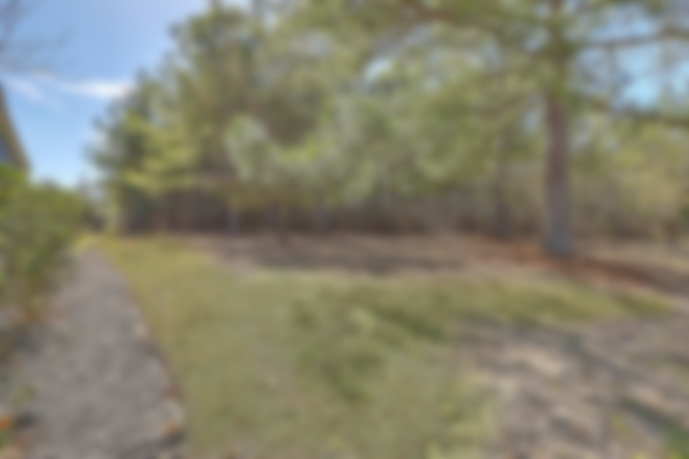
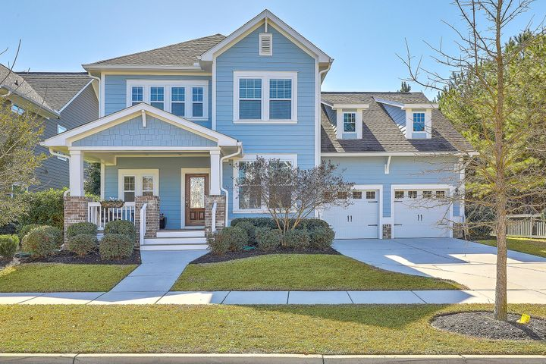
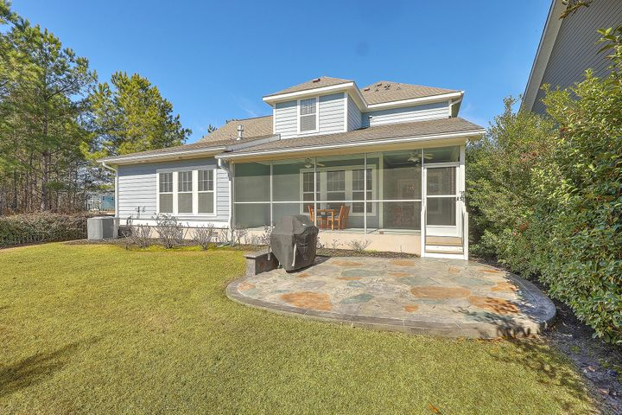
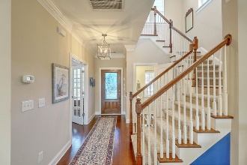
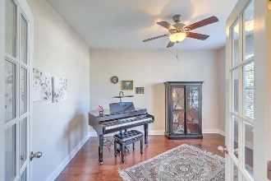
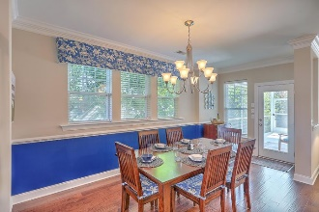
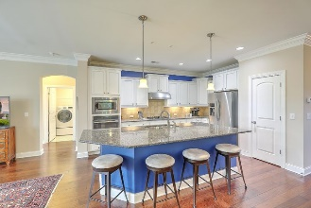
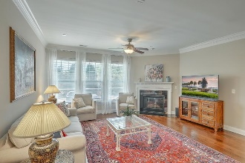
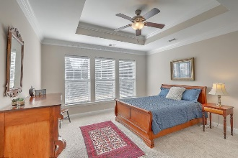
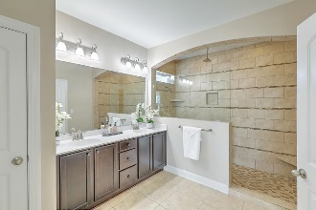
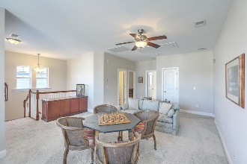
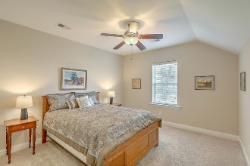
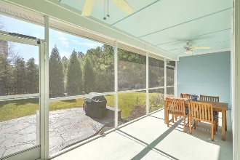


JUST LISTED! Immaculate Like New Home In Carnes Crossroads
627 Van Buren Drive
Carnes Crossroads | Summerville, SC 29486 | MLS# 21003899 | $439,975
No need to wait for new construction with this meticulously maintained Lenwood plan that butts up to wooded green space! As you enter the lovely southern style front porch, you will see the office with French doors to the right, perfect for working or learning remotely. The heart of the home is the dream kitchen which is open to the dining area and family room. You will have plenty of space to cook, making this open concept plan perfect for entertaining. Abundant storage space, soft close drawers and doors, s/s appliances and pantry would please any home cook! Enjoy plenty of natural light with the abundance of windows and on those chilly nights, cozy up to the fireplace with a glass of wine. From the dining area, go out to the awesome wrap-around screened porch, allowing plenty of space to enjoy throughout the year. To the rear of the home is the spacious Owners Retreat, complete with tray ceiling, large bathroom with dual vanities, massive tiled walk-in shower and walk-in closet. The laundry room and powder room finish off the first floor. Upstairs, retreat to the large loft area, perfect as a game room or additional space for remote learning/working. Three additional guest bedrooms with two full bathrooms complete the inside of this wonderful home.
Video Tour: https://vimeo.com/510319782
Desiree Maurer Office - (843) 416-2000
Mobile - (843) 327-9010 desiree.maurer1@gmail.com
www.yourcharlestonhousesearch.com
Keller Williams Realty 496 Bramson Ct Ste 200 Mt. Pleasant, SC 29464

