Slide 1
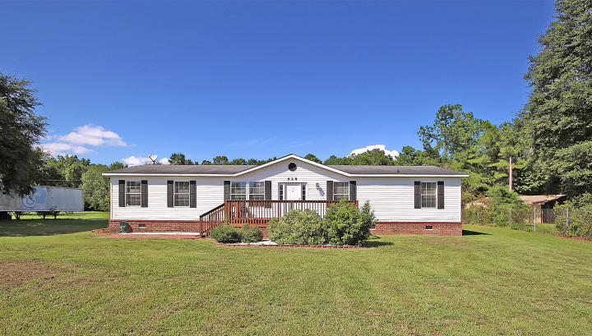
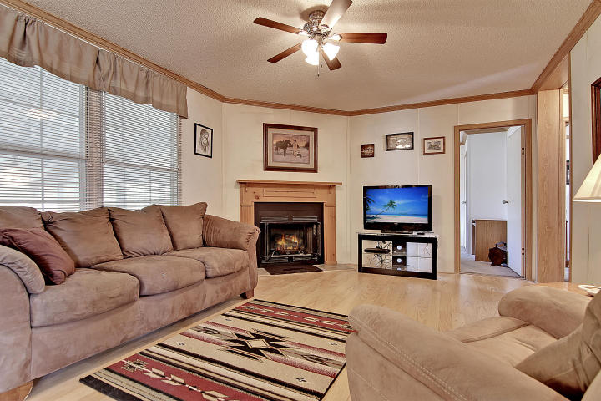
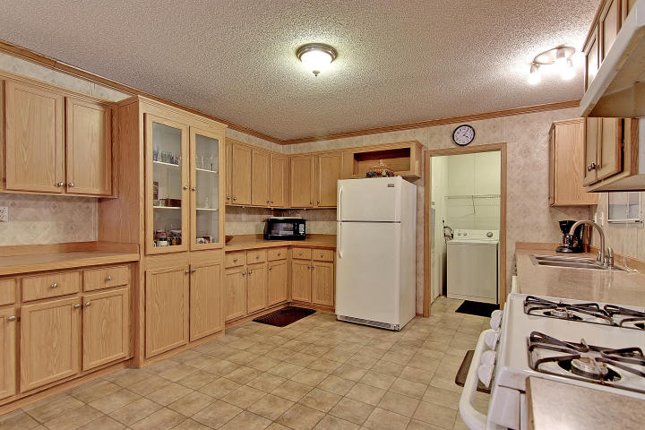
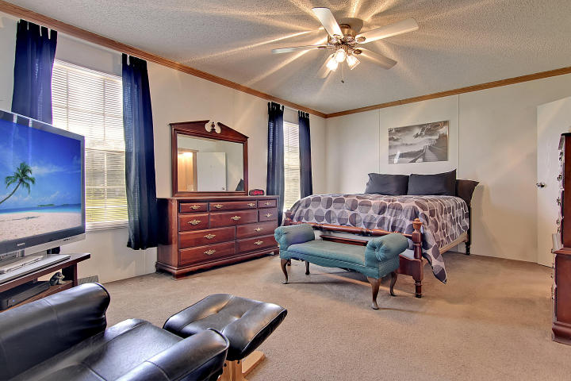
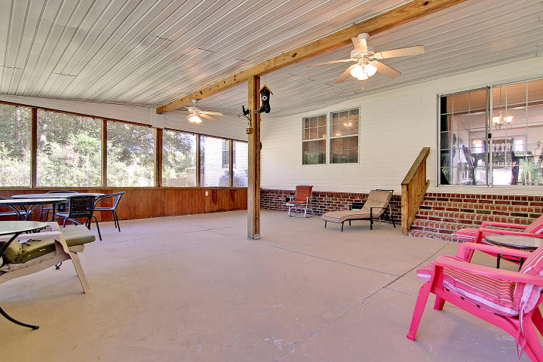
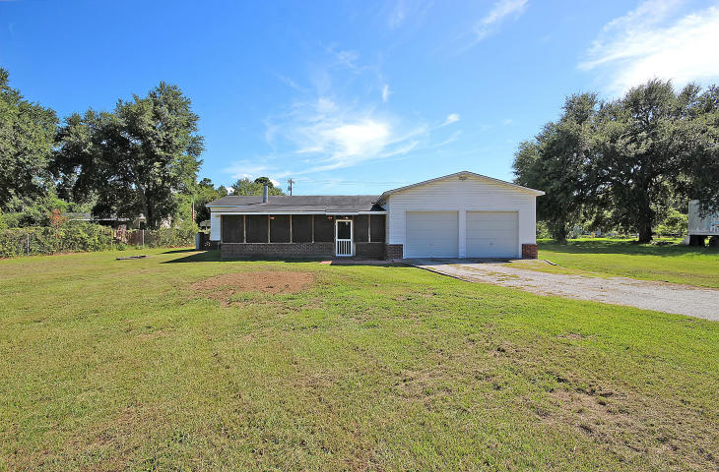
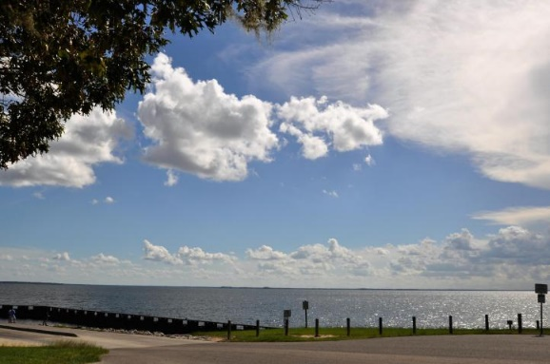

Easy Access to Lake Moultrie
628 Barn Road
Bonneau Estates ~ Bonneau, SC 29431 ~ MLS# 16022113 ~ $179,500
Access three boat ramps within five minutes of this 4BR, 2BA home and begin your adventure on the gorgeous 60,000 acre Lake Moultrie. Fishing, boating, kayaking, stand up and paddle, water skiing, wake boarding and canoeing are just a few fun activities that you could be enjoying in this beautiful body of water. Or take a short drive to the Bonneau Beach public park & swimming area.
Inside this one story home are laminate hardwood floors, tons of windows to let the natural light pour in and an open floor plan. A large front deck and massive screened-in patio are great outdoor living spaces. A walk-in closet and en-suite full bath with dual vanity, walk-in shower and garden tub make the owner’s retreat an oasis. Your lakeside country getaway awaits you, don't miss out!
Additional features include:
The eat-in kitchen is very spacious with lots of counter space/cabinets, a gas range and sliders in the eat-in area leading to the screened-in patio
The living room has a cozy gas fireplace
There is a workshop in the 2 car garage
Francis Marion National Forest is approximately 10 minutes away
2 boat landings approximately 5 minutes away
Book your showing today!
Monique Mixson Monique@mattoneillteam.com 843-709-4075

