Slide 1
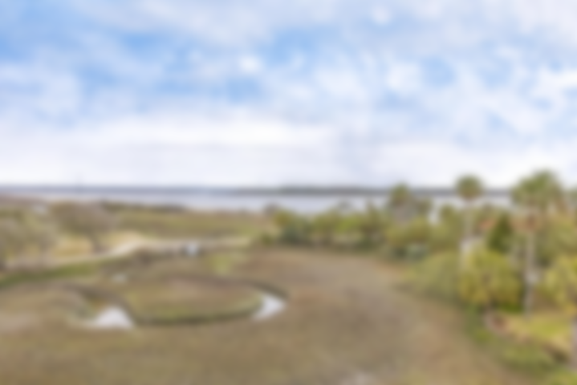
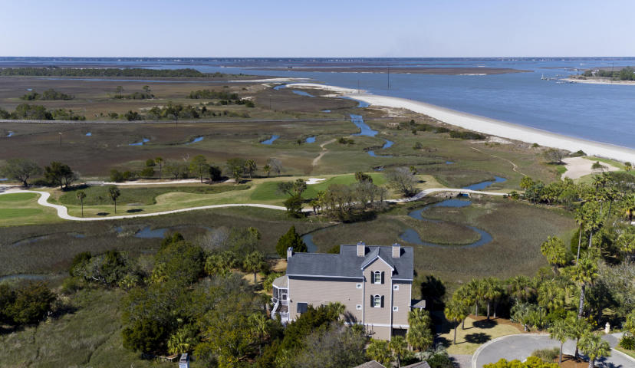
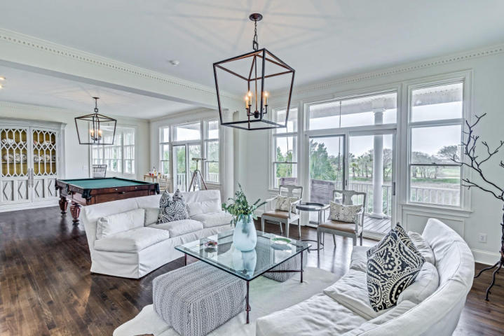
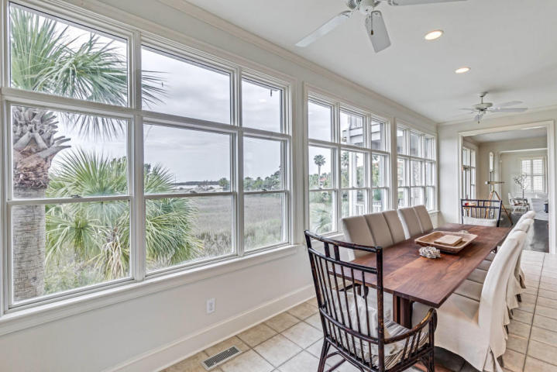
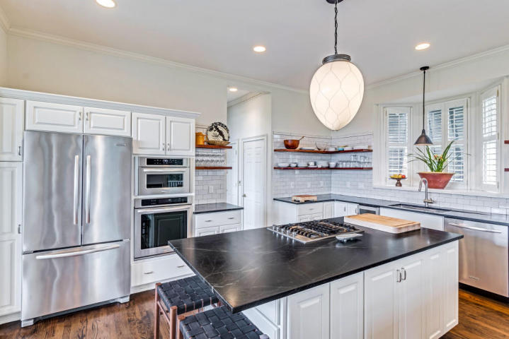
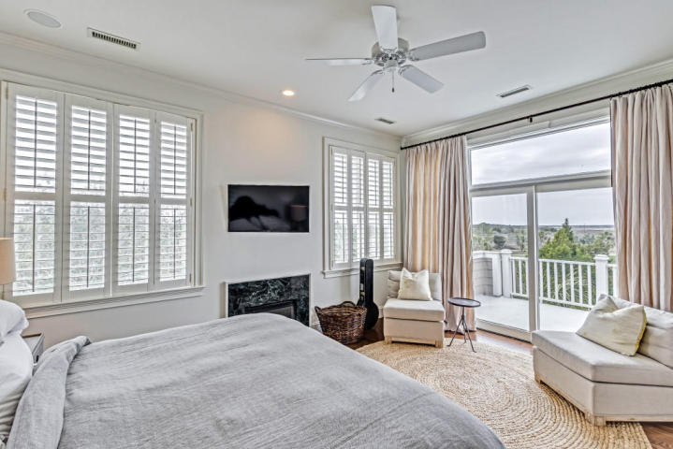
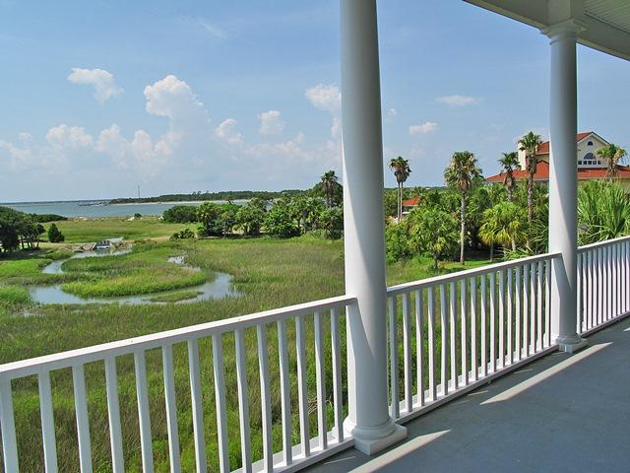



62 Ocean Point Drive Wild Dunes ~ Isle of Palms, SC 29451 MLS# 17005387 ~ $2,250,000
Stunning home with expansive views and privacy
Perched on an acre of land and contained within a perimeter bulkhead wall, this unique gem provides stunning views of the Atlantic Ocean, Dewee's Inlet, the Links golf course, and tidal marsh offering unsurpassed privacy and serenity. Five porches, four gas log fireplaces, a three bay garage, elevator--and that's not the half of it! Views are captured and maximized from every room in the house. The home has been beautifully renovated including the kitchen, master bedroom and bath and the addition of hardwood floors on the first and second floors. The home is being offered furnished with exclusions (see list under documents). The elevator runs from the garage to the second floor for ease with groceries, luggage and cumbersome items. The garage has plenty of storage and a separate room currently used for woodworking. The gated Ocean Point community has the most private and exclusive pool and Jacuzzi in Wild Dunes with expansive ocean and golf course views.This stretch of beach wraps around the north end of the island and is well off the beaten path. As you curve around the back side you encounter drift wood, weathered horseshoe crab shells, star fish and sand dollars galore. Come take a look at this extraordinary property--you won't be disappointed.
Fantastic Rental Property
Ann Cortes Office - (843) 886-8110
Mobile - (843) 324-6808
ann.cortes@carolinaone.com
Carolina One Real Estate | 1503 Palm Blvd | Isle of Palms, SC 29451-2280

