Slide 1
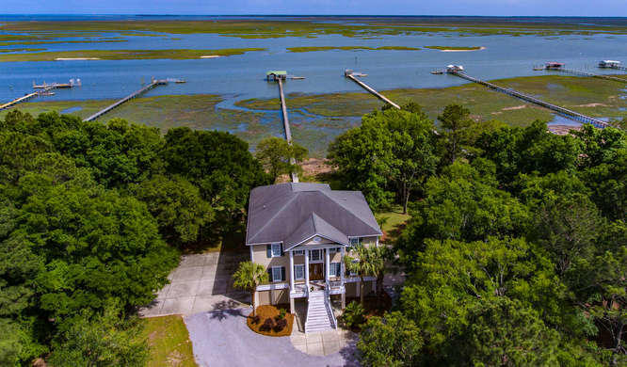
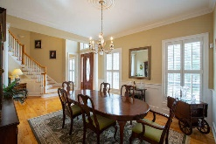
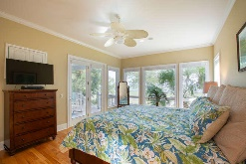
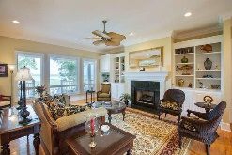
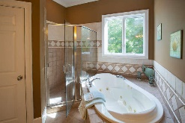
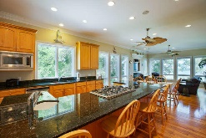
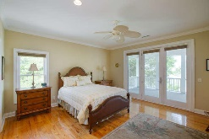
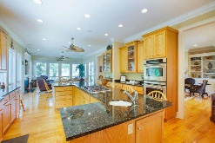
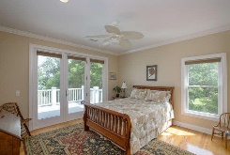
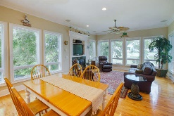
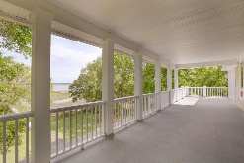
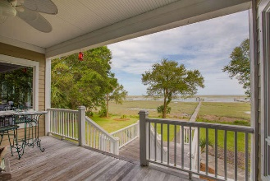
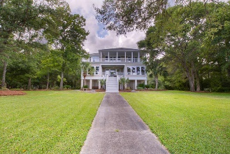
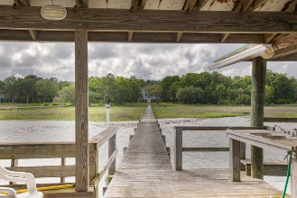
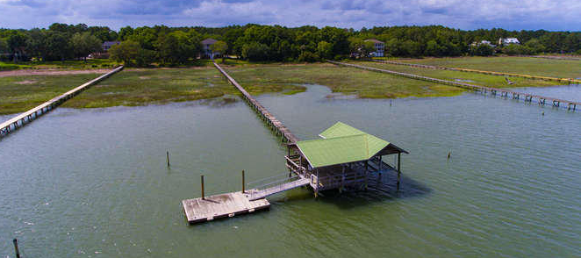


6329 Come About Way
Romain Retreat ~ Awendaw, SC 29429
Amazing Intercoastal Waterway
Live the ultimate Lowcountry lifestyle on your own private waterfront estate. You'll revel in the peaceful privacy afforded by the over 2 acres of land that leads to your own private dock on the Intracoastal Waterway. Located in Romain Retreat, away from it all yet minutes to the conveniences of Mount Pleasant, classic elevated Lowcountry architecture welcomes you home. Once inside, a grand entry foyer with dramatic staircase greets all who enter, while gleaming hardwood floors, crown mouldings and plantation shutters hint at the custom touches found throughout the home.
Asking $1,500,000
MLS# 18015139
4,496 SqFt
5 Bed/4 Full+2 ½Baths
Deepwater Dock, Covered Pierhead, and Boatlift
Don Dawson
843-514-0452
ddawson@carolinaone.com
Carolina One Real Estate • 2713 Highway 17 North • Mount Pleasant, SC 29466
www.TeamDawsonSC.com

