Slide 1
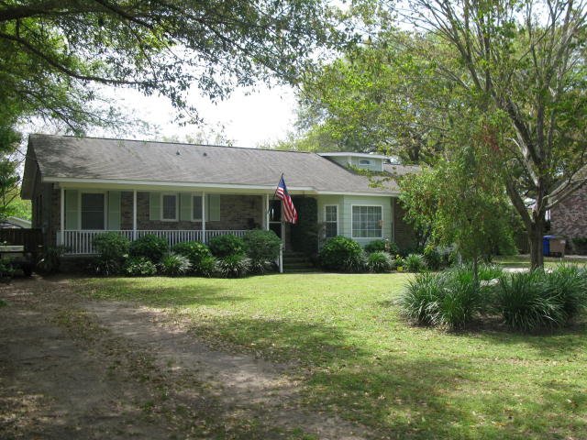

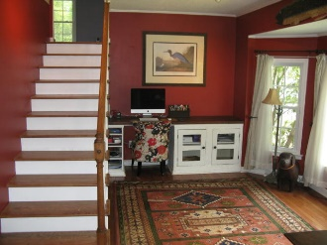
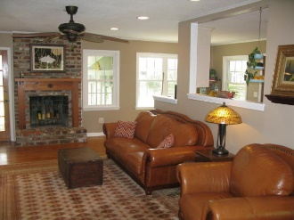
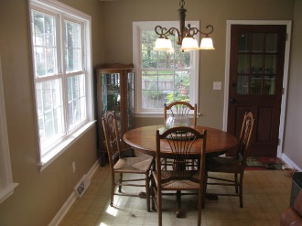
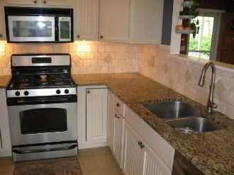
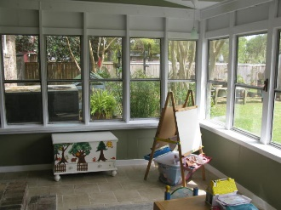
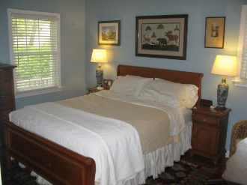
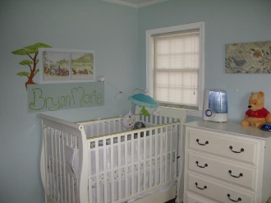
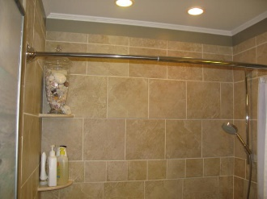
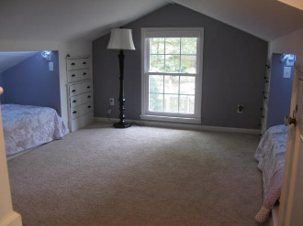
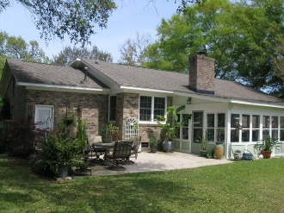
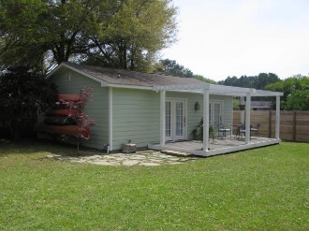
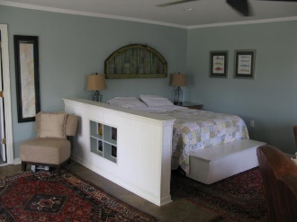
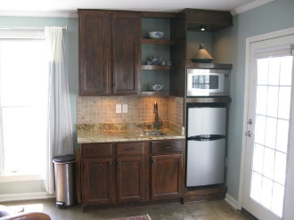



Immaculate Home in Lighthouse Point
633 Schooner Road
Lighthouse Point
Charleston, SC 29412
MLS# 16009165
$359,000
2,050 SF
4 Bedrooms :: 3 Bath
PRIDE of ownership in this immaculately cared for home! The house has been extensively updated, including new cabinets, granite counter tops, backsplash, new roof, new windows, spray foam insulation in the crawl space, new bathroom, etc. The house is a 3 bed 2 bath roughly 1475 sq feet, w/ 200 sq ft sunroom, & 400 sq ft patio, and garage. The is an upstairs kids playroom (or office) for added usable space. Fireplace. In the lush landscaped, fenced back yard there is a full 1 bed 1 bath, 600 sq ft mother in law suite. It has its own large deck highlighted by custom pergola. There is irrigating system and flag stone patio. GREAT AREA!!! There is a nice sized shed/work shop with power. There is a custom made wooden playground for the kids to enjoy. Zoned for Stiles Point Elementary!
Eric Draper
(843) 442-7118
eric.draper@gmail.com
www.charlestonrealestategroup.com
Charleston Real Estate Group | 792 Folly Rd. C1 | Charleston, SC 29412

