Slide 1
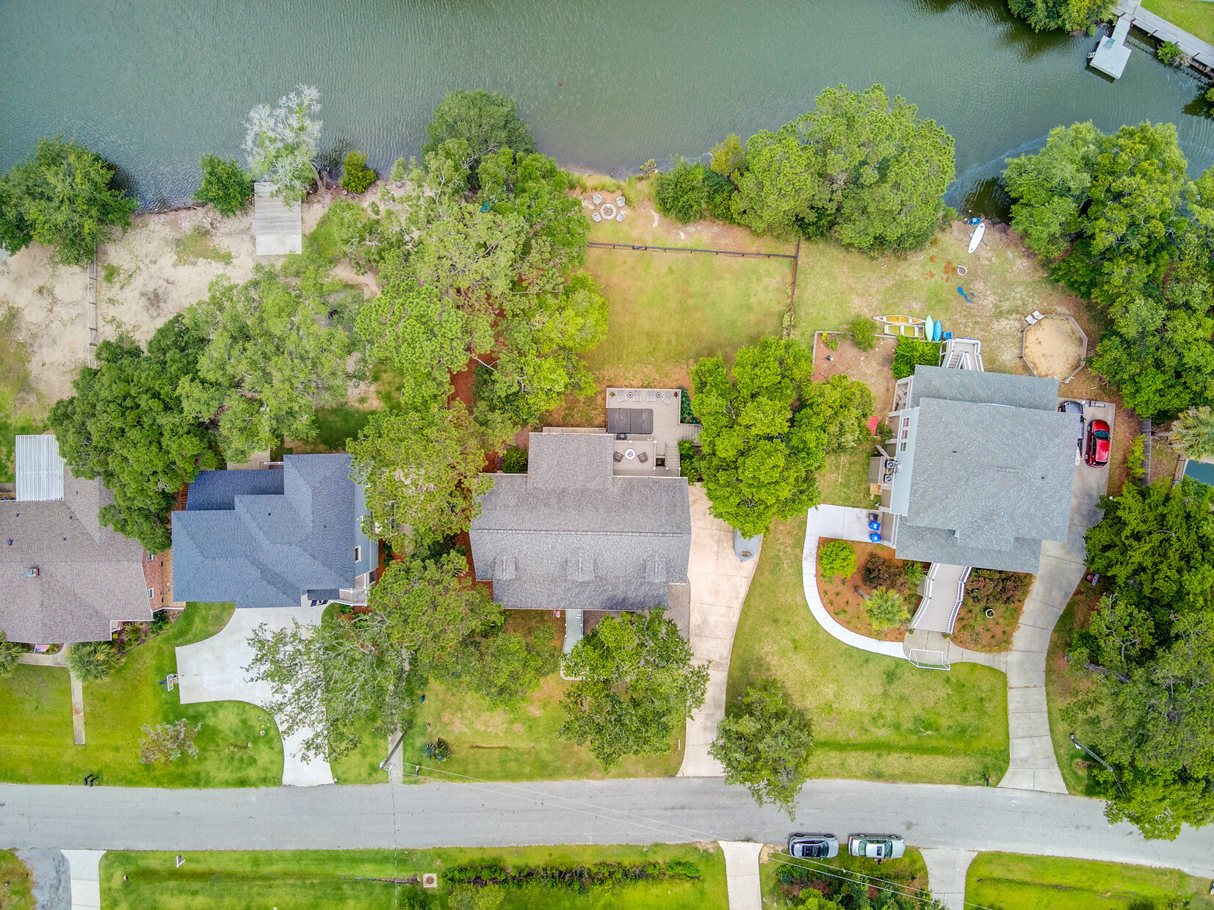
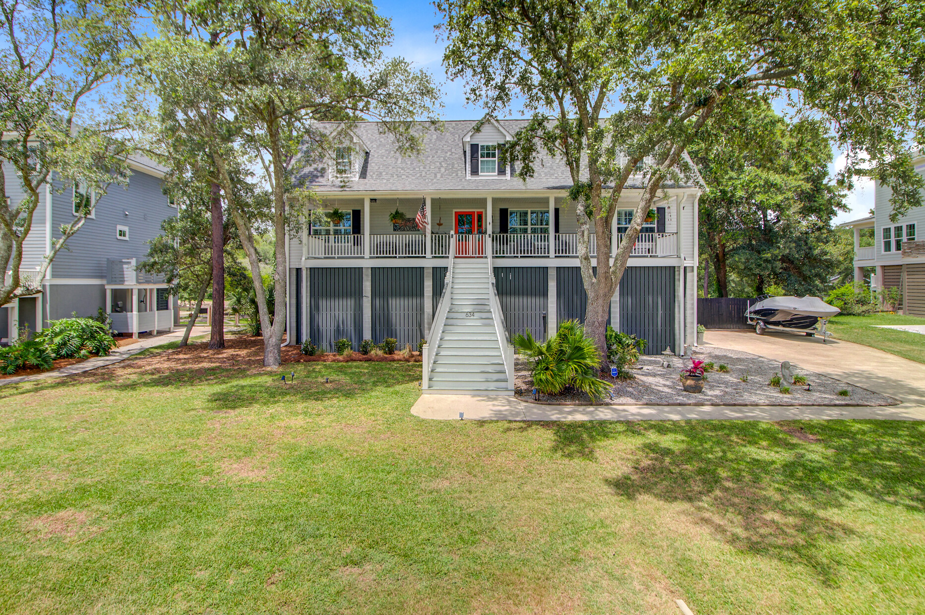
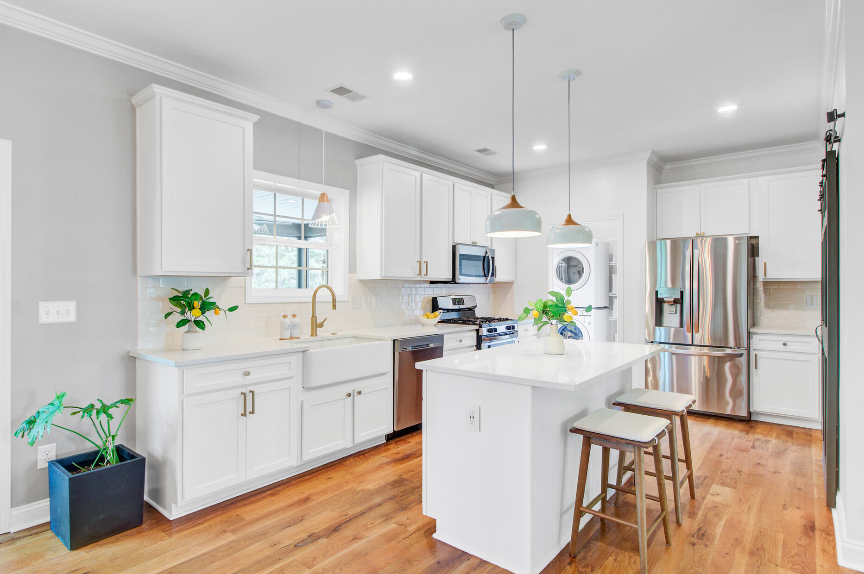
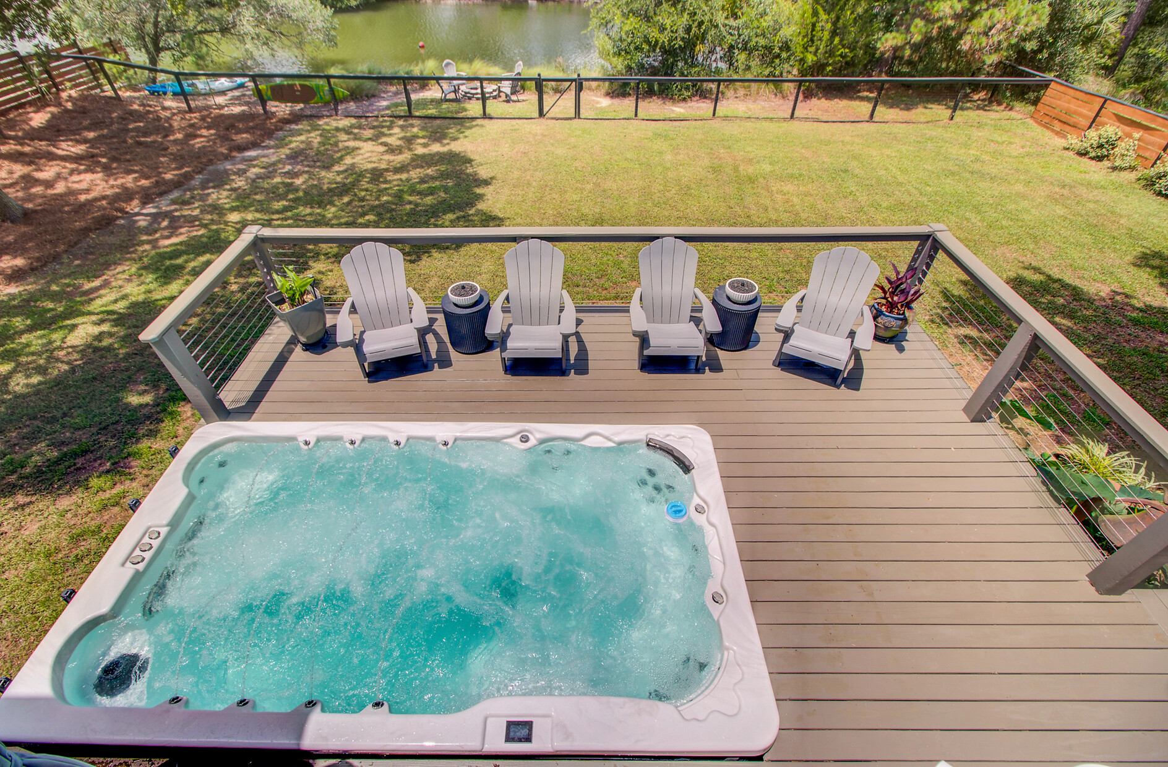
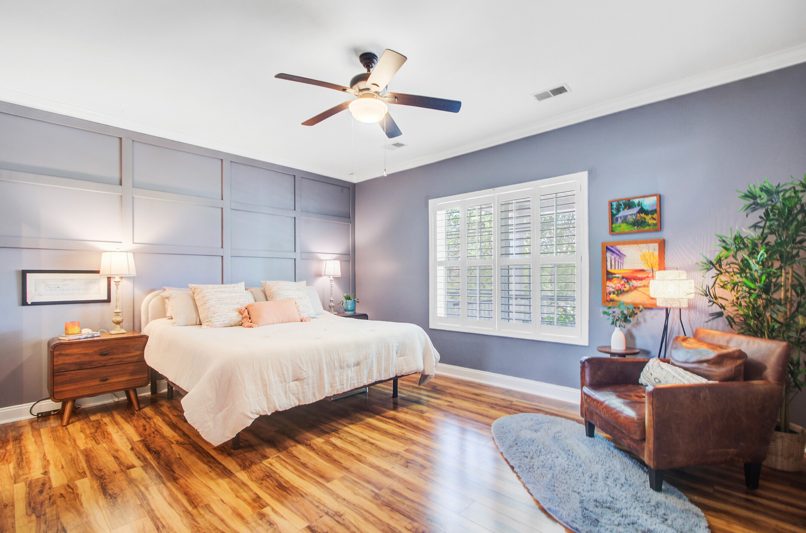
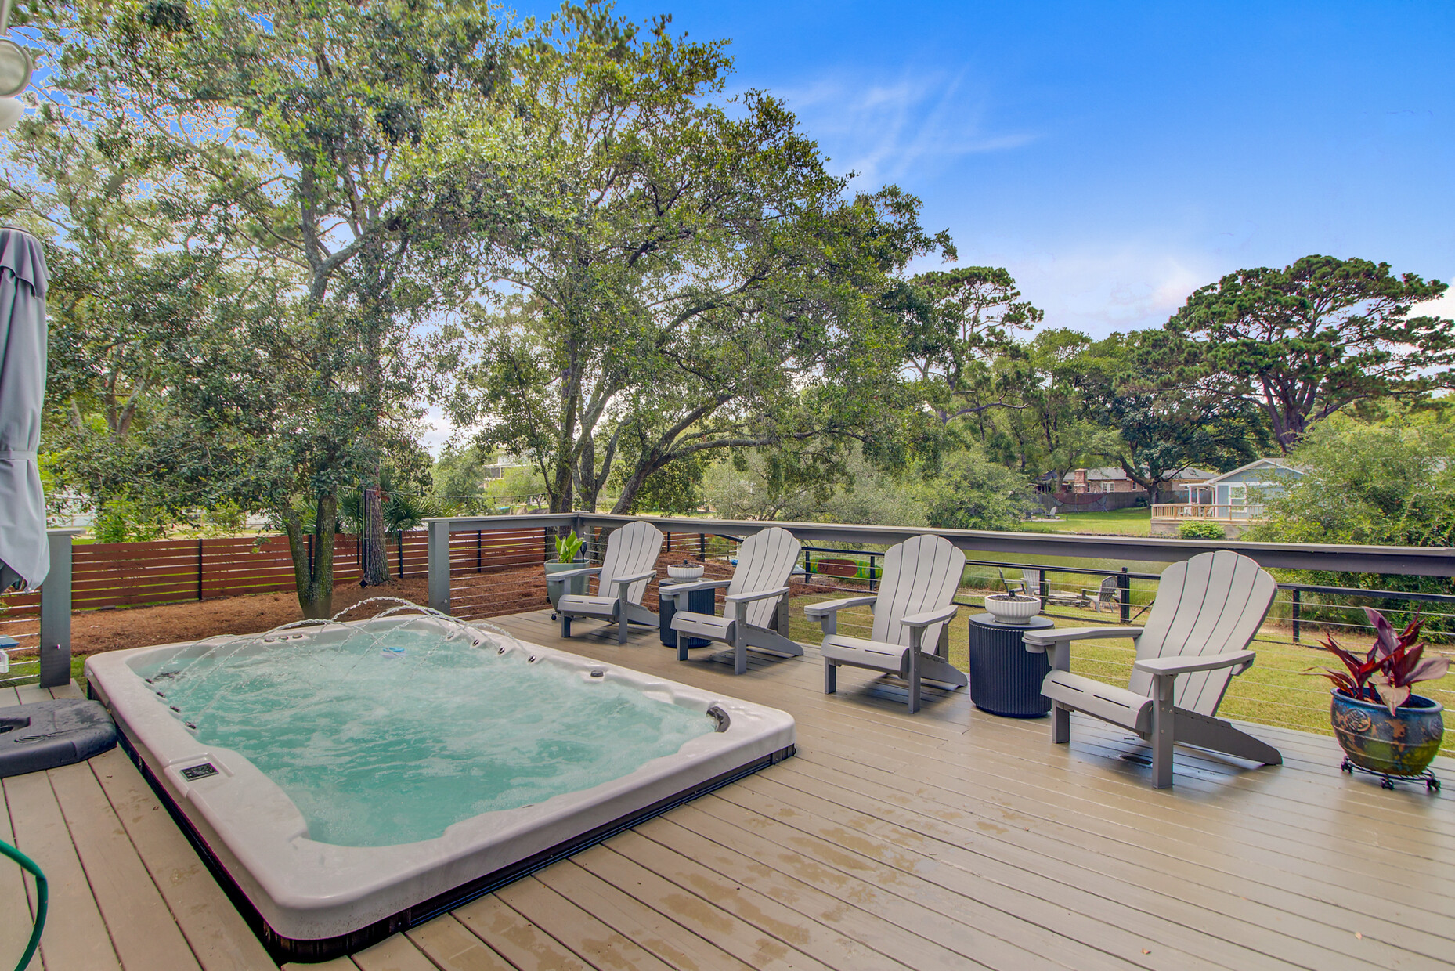
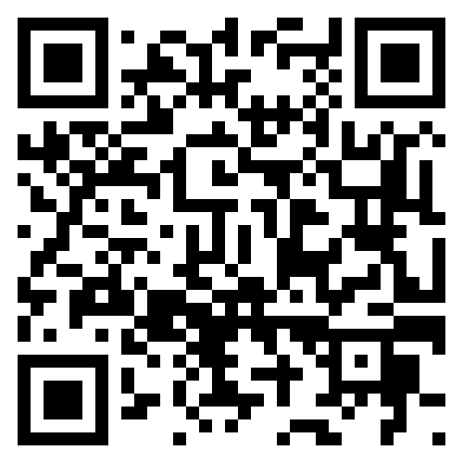


New Listing and Open House
634 Lynne Avenue
Lighthouse Point
Charleston, SC 29412
MLS# 25016720 | $1,075,000
Video Tour
Just Listed on James Island!
This rare 4BR/3BA elevated home offers stunning water views, a versatile layout with dual living areas, a screened porch, fenced yard, swim spa, and boat/RV parking. Minutes to Folly Beach & Downtown Charleston!
📍 634 Lynne Avenue, Charleston
📆 Open House: Saturday, June 21 | 1:30–3:30 PM
Don’t miss this Lowcountry gem—schedule your tour today!
Video Tour
Ellen O'Neil
Broker/Owner, ABR, e-PRO, CNE
Charleston Realtor of Distinction
843-300-8530
www.EllenONeilProperties.com

