Slide 1
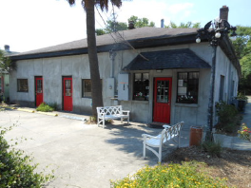
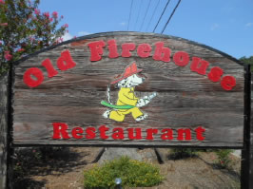
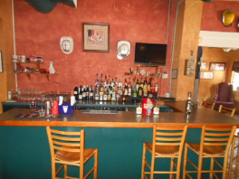
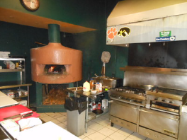
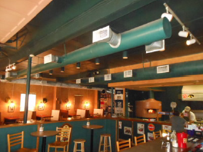
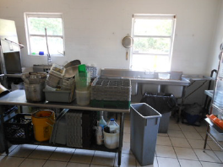
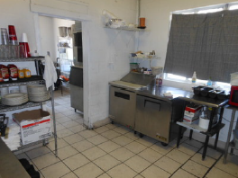
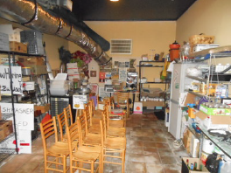
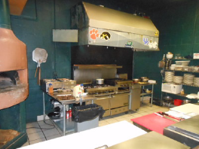
Old Firehouse Restaurant
MLS# 29982524 ~ $350,000 (Sale)
MLS# 29985891 ~ $5,000 (Lease)
$40,000
Price Reduction!
First class all the way!!!
Truly a 10 on a 10 point scale
6350 Highway 162, Hollywood, SC 29449
Old Firehouse Restaurant, open since 2002, is located in the heart of Hollywood, a short drive south from Citadel Mall and I-526. The former firehouse built in the 1950’s has been transformed into a cozy small town meeting place with an open kitchen, bar, and dining room. As you enter the building and look up, you can still see the original firehouse doors and firehouse t-shirts from around the world and on the walls. The loyal patrons enjoy the variety of the menu when they choose seafood, beef, chicken, pasta, burgers, and wood-fired pizza.
Located just a couple miles from Hwy 17, near the intersection of Hwy 162 & 165
2,740 square feet
Owner financing considered
100% interior renovation in 2001
Asking price for business $200,000/building $350,000
Owners will lease the business, sell the business…lease-purchase the building or sell both the business and the building. Owners willing to be creative!! Property Not For Sale without Business being sold to same person or another party
You better hurry…this home may very well have multiple offers the first weekend it's offered for sale.
Rick Willis
843-327-3017 · Rick@RickWillis.com · The Group, LLC

