Slide 1
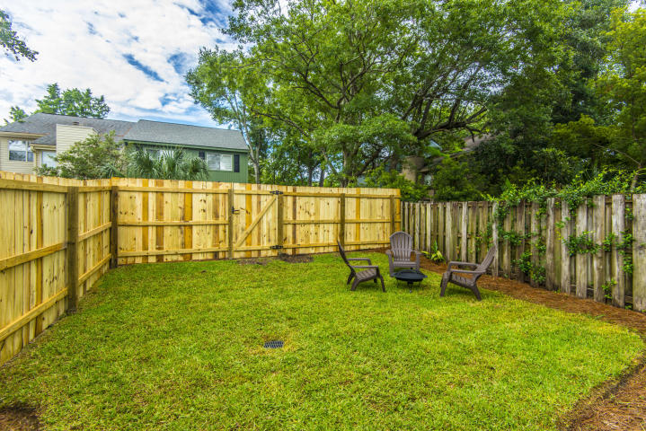
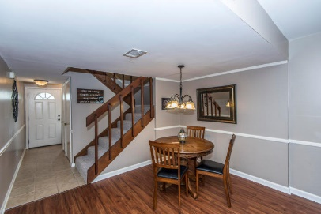
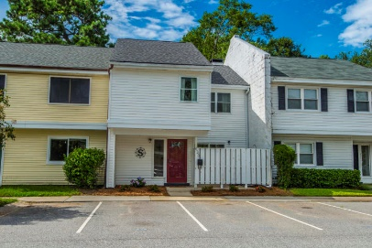
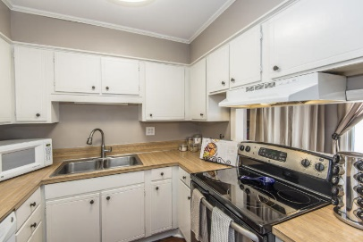
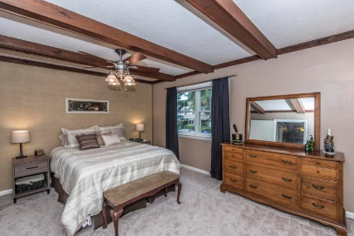
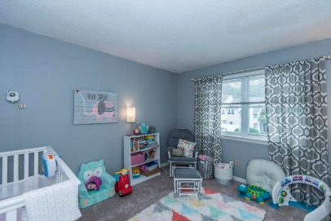
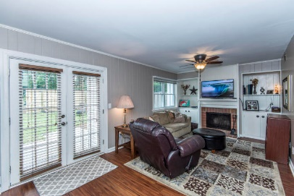
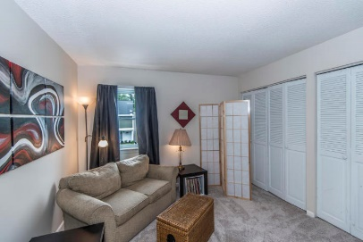
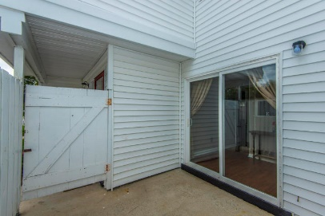


Be Near Everything!
635 Baytree Ct
Bay Tree
Mount Pleasant
MLS# 17020376
$250,000
This townhouse is the perfect LOCATION. You are close to Shem Creek, Trader Joe's and Whole Foods.
This townhouse has been freshly painted and just had a new hot water heater installed. The backyard has been regraded and added new sod and a new fence.
Downstairs has Smartcore luxury vinyl waterproof tile and upstairs has new carpet. Home has been inspected and repairs made. Roof was replaced in 2014 and HVAC in 2012.
The perfect LOCATION
Close to Shem Creek, Trader Joe's and Whole Foods.
Freshly painted and just had a new hot water heater installed
Backyard has a new fence and has been regraded and re-sodded
Downstairs has Smartcore luxury vinyl waterproof tile
Upstairs has new carpet
Home has been inspected and repairs made
Roof was replaced in 2014
HVAC replaced in 2012
Del Shaffer
843.408.6821
dshaffer@carolinaoneplus.com

