Slide 1
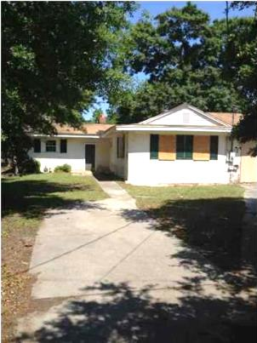
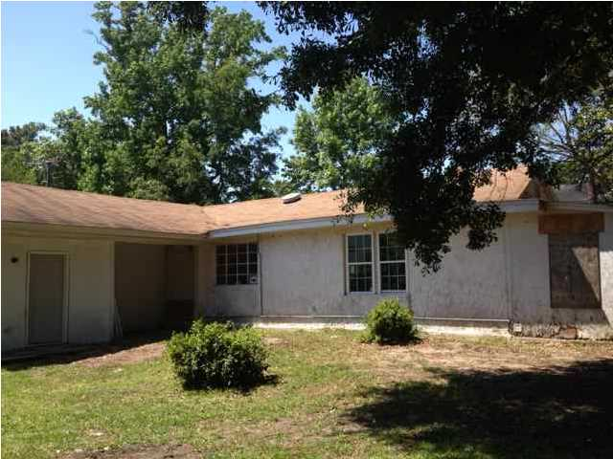
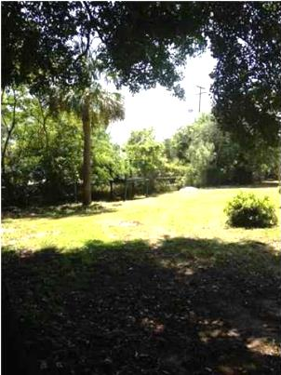
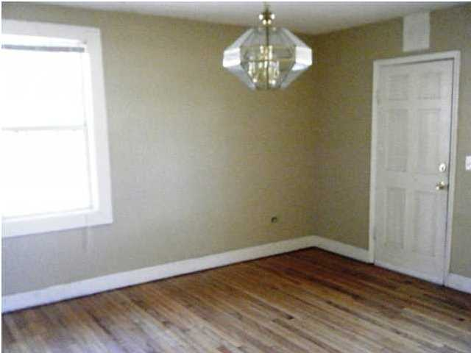
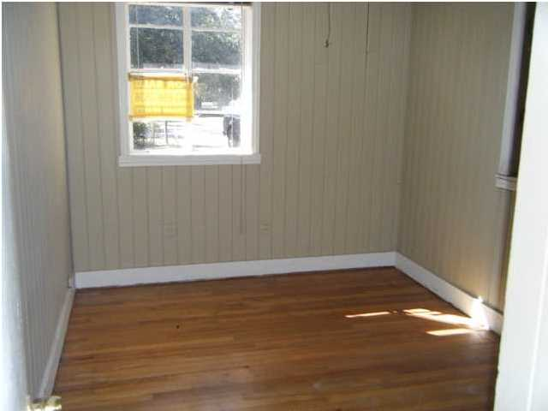
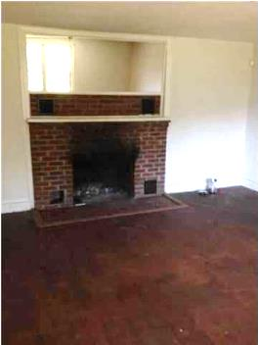
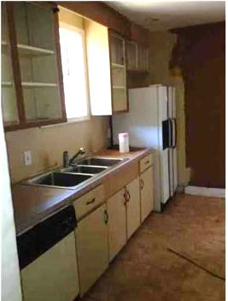
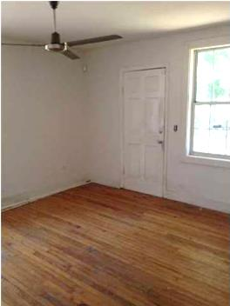
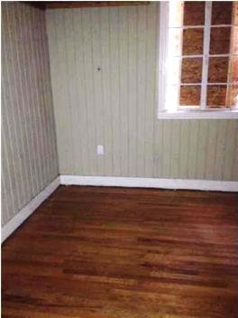
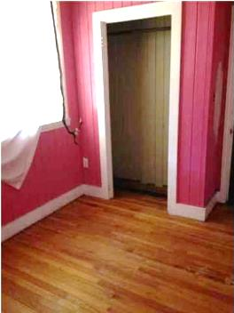
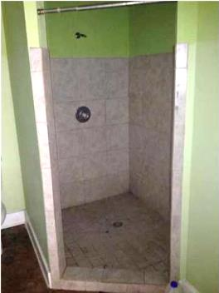
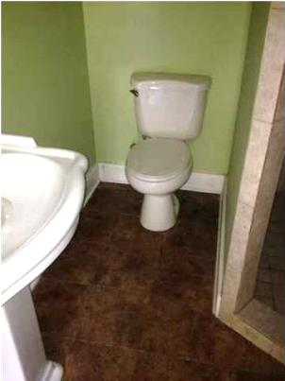
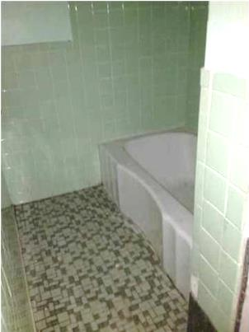
Ardmore Investment Opportunity
~ Handyman Special ~
636 Sequoia St ~ Charleston ~ MLS# 1412477 ~ $67,900
Handyman special under $70k, on a huge lot, and a very convenient location only 4 miles to downtown Charleston! Close to restaurants, shopping, I-526, etc. This home has the potential to become a duplex with a 3br/2ba and 1br/1ba with an estimated $40k-50k in rehab costs if you hired it out to have it turn key. Excellent opportunity for a cash cow with some sweat equity.
William Johnson
haynes.landsouth@gmail.com
Mobile (843) 864-8159
Land South of Charleston, LLC | 409 King St | Charleston, SC 29403

