Slide 1
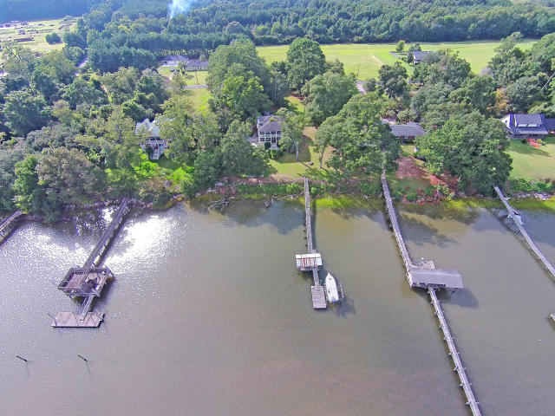

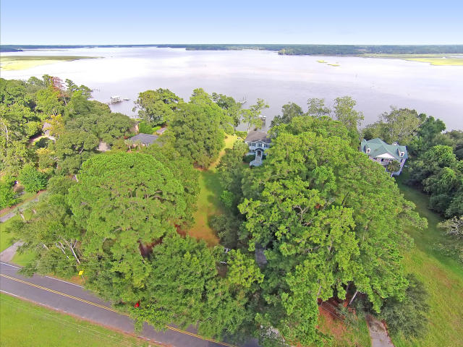
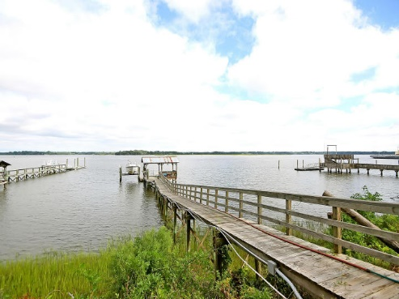
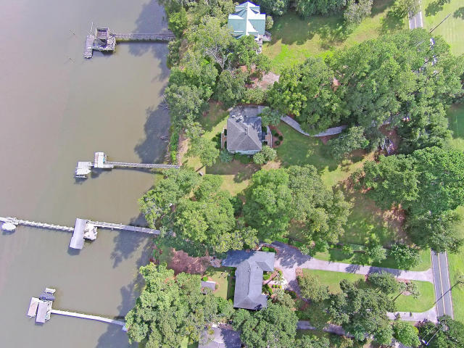
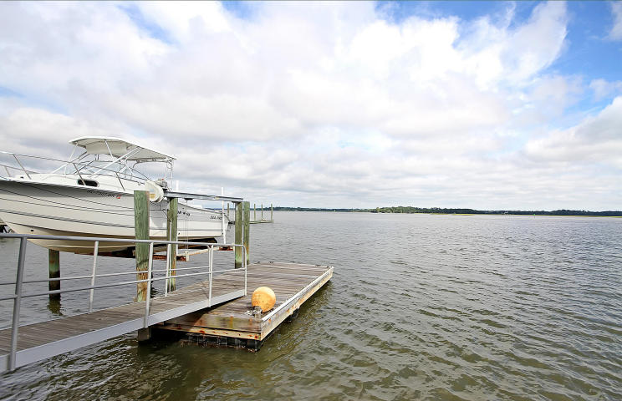
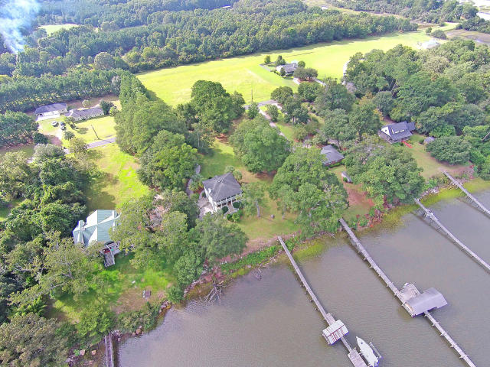
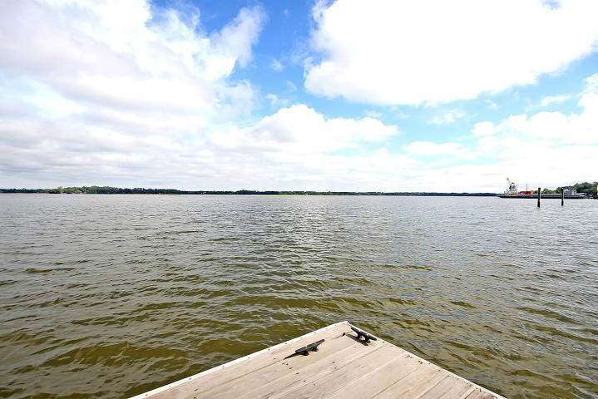
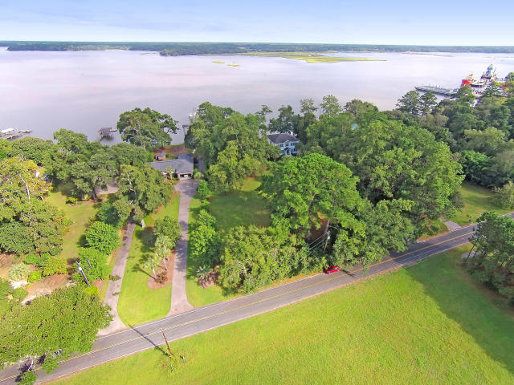
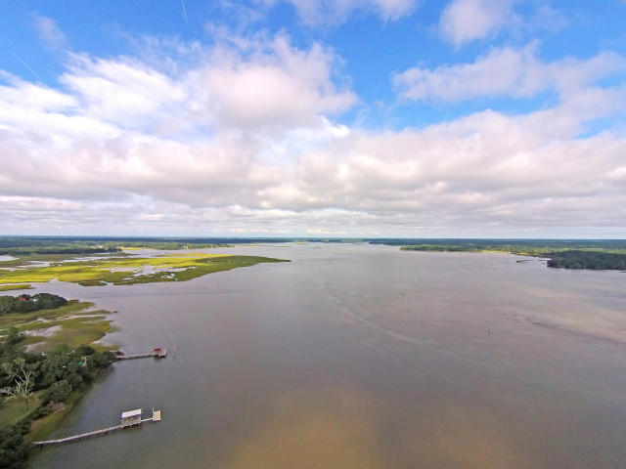

Parkshore Marshfront
Build Your Dream Home On Deep Water!!!
6395 Simmons Bluff Rd ~ Meggett ~ MLS# 15024831 ~ $325,000
This lot is a Lowcountry water-lovers dream come true!
Situated on Wadmalaw Sound on the scenic banks of the Intrecoastal Waterway, you will enjoy stunning views, incredible fishing, and lots of local wildlife.
Imagine starting your day by taking the short walk down the existing dock to your boat for a day on the water. This was even the site of the Battle of Simmons Bluff during the Civil War!
As an added bonus, this property is a short drive to shopping, dining, and historical Downtown Charleston.
This property has everything you're looking for, so make sure you book your showing today!
Call or email for details: (843) 654-7777 or Ben@MattOneillTeam.com

