Slide 1
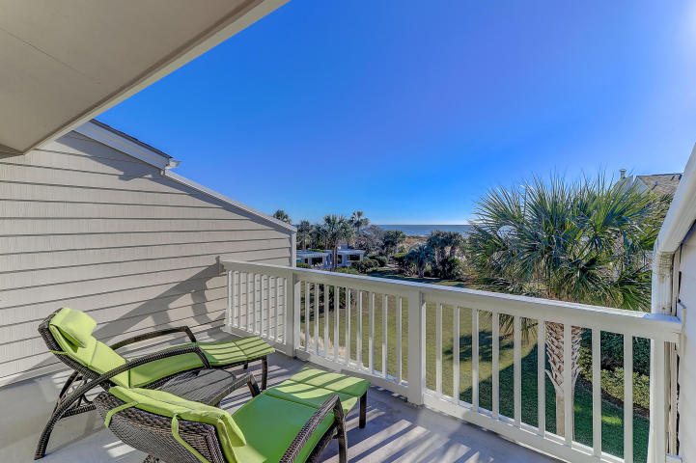
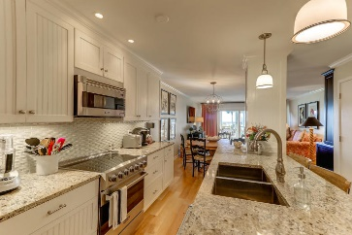
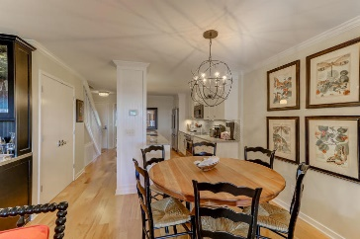
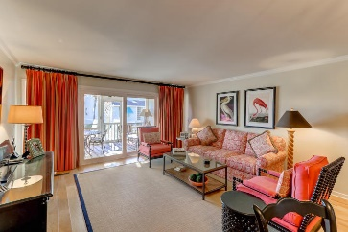
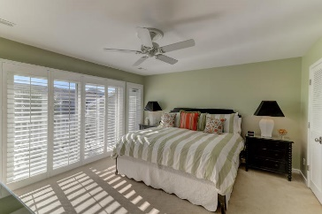
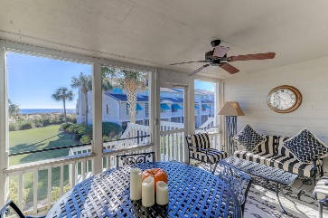
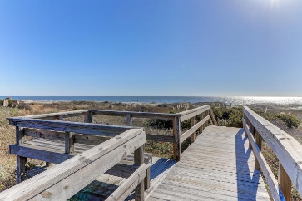
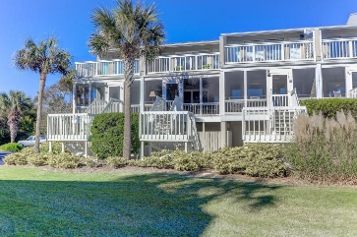


63 Beach Club
Wild Dunes ~ Isle of Palms
MLS# 17032792 ~ $1,330,000
Stunning Ocean Views
Jaw Dropping Reno
Amazing ocean views from this gorgeous Beach Club Villa condo! This total renovation with stunning custom details are jaw dropping. 63 Beach Club Villa feels like a Single Family home with a full meticulous drive under garage, a workshop area, tons of storage all attached to an outdoor shower. Walk a few steps to the Beach Club Villa private pool and board walk to the ocean. When you enter, you'll be impressed with perfection! Smooth ceilings, crown molding, gorgeous wood floors, and tons of light. Home is wonderful for entertaining with such an open flow. Cooking in this Custom kitchen is a joy! The smart cabinetry, granite counters, glass basket weave back splash, and stainless steel Viking appliances, double pantry and a fun bar for enjoying friends while cooking.
The spacious living room offers a Custom designed wine bar that will be awed by all. You'll find extraordinary lighting and details throughout this home. Step out to the screen porch for a relaxing view of the ocean. Downstairs is 1 bedroom and 1 bath and upstairs are 2 bedrooms and 2 bathrooms. Absolutely relax and sun off the upstairs master deck with the feeling of total privacy. You will be blown away by the beauty and thoughtful attention to detail 63 Beach Club Villa offers.
Darlene Smith
Office - (843) 886-8110
Mobile - (843) 696-7824
darlenesmith@carolinaone.com
DarleneSmithTeam.com
Carolina One Real Estate
1503 Palm Blvd Ste
Isle of Palms, SC 29451

