Slide 1

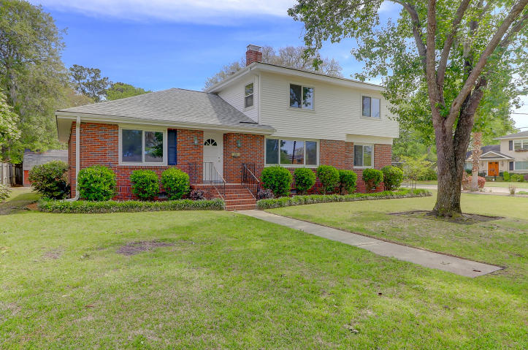
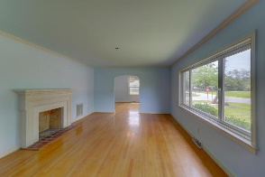
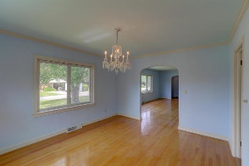
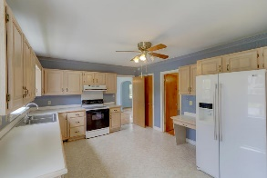
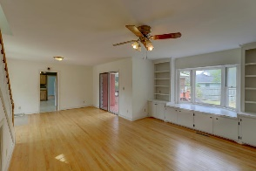
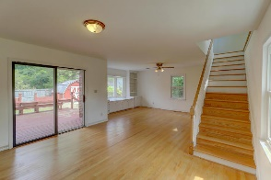
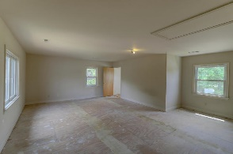
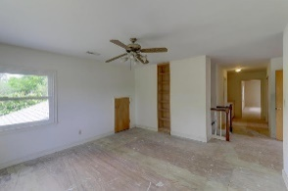
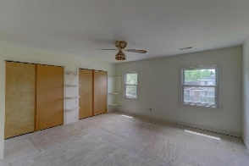
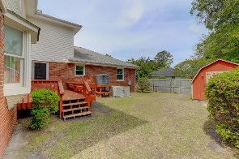


63 Chadwick Drive
Charleston, SC 29407 | MLS# 18011250 | $699,000
Spacious Five Bedroom
South Windermere Home
Super nice custom South Windermere home with lots of square footage! 3810 SF on a corner lot at the far end of Chadwick. This home was enlarged in the 1980s and has five very large bedrooms a formal living room and dining room and two large dens, one on each floor...each one large enough for any pool table or grand piano. Large kitchen, fireplace, good quality thermal windows. Newer HVAC. Storage building, Irrigation System.
CSA Real Estate Services
339 Cabell Street
Charleston, SC 29407-6928
Charlie Smith
(843) 813-0352
csmith@csarealestate.com
www.csarealestate.com

